Slide 1


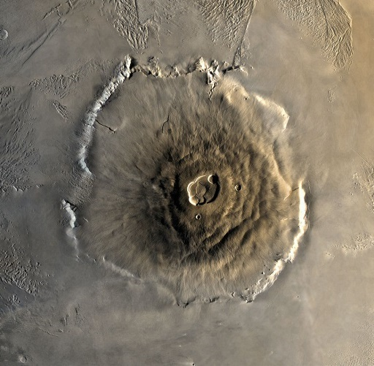
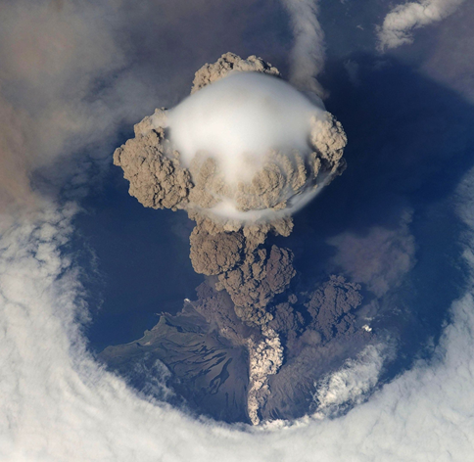
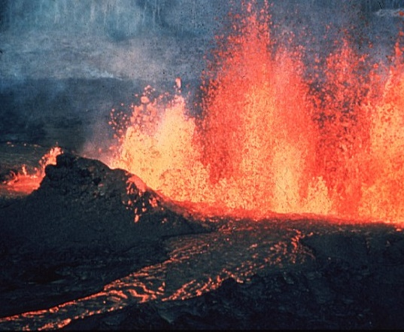
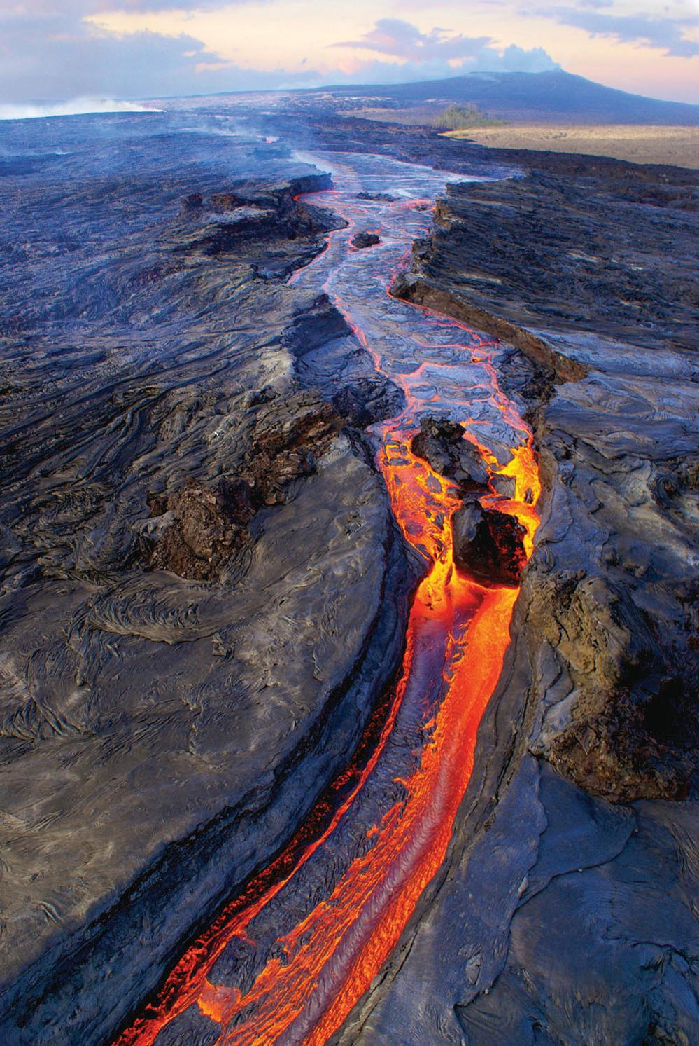
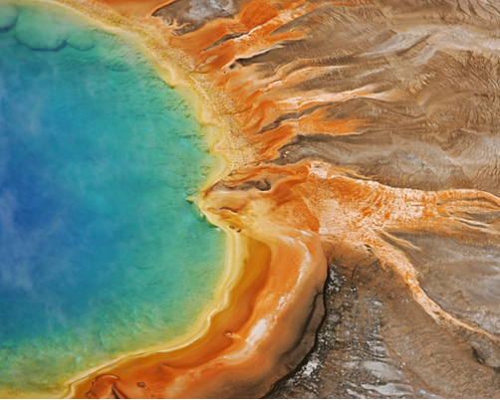
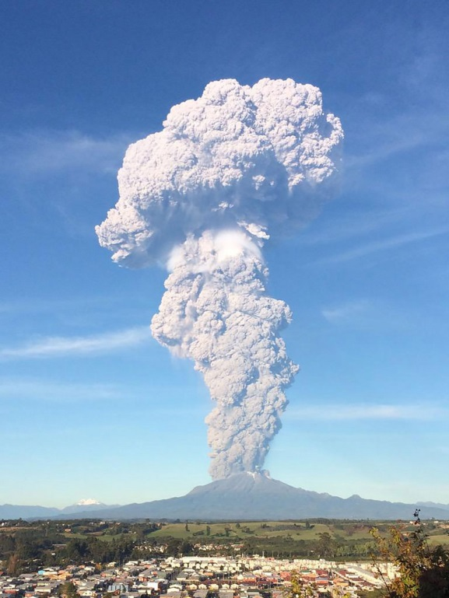
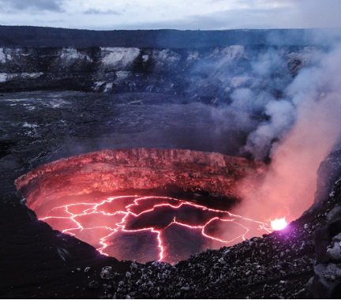
Notes:
Volcanoes
Volcano structure
Where does magma come from?
Why do volcanoes erupt?
Types of eruptions (explosive and effusive)
Types of lava (+ lava flow viscosity experiment)
Where do volcanoes form? (plate boundaries)

Slide 2

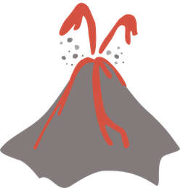
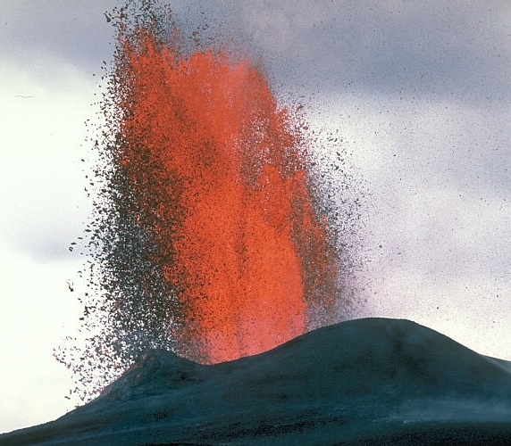
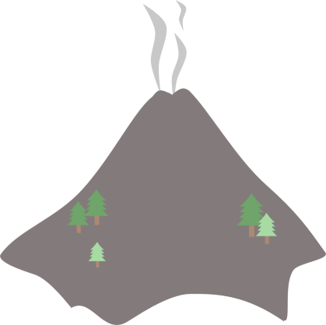

Hot rock
Active
Dormant
Extinct
z
z
z
Cool rock
Notes:
Volcanoes are openings in the Earth’s rocky surface which allow hot molten rock, ash and gas to escape from below the surface a bit like a chimney.
Q: Can anyone name some volcanoes in Europe? (lots of answers including Etna, Stromboli, Vesuvius – Italy, Santorini, Milos, Nisyros – Greece, Eyafallajokull, Katla, Hekla – Iceland, Lanzarote, Tenerife etc.
If students know lots of volcanoes try to get them to name some in North America, South America, Africa, South East Asia etc.
Volcanoes are not always erupting – they can be active, dormant or extinct
Active volcanoes are volcanoes that are either currently erupting or known to have erupted recently (within the last 10,000 years)
Dormant volcanoes are volcanoes that are ‘asleep’ – they are still thought to be active and could erupt again but they haven’t done so in the last 10,000 years
Extinct volcanoes are volcanoes that will never erupt again because their supply of hot magma has run out and turned into solid rock (such as gabbro or granite).
The UK has many extinct volcanoes including Helvellyn in the Lake District, Arthurs Seat in Edinburgh, Ben Nevis in Fort William and Snowdon in north Wales.

Slide 3

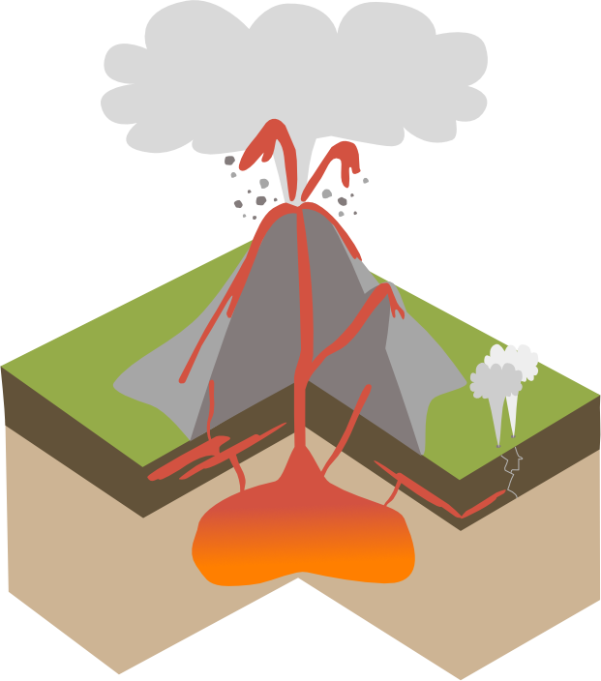
Ash, steam & gas
Volcanic bombs
Crater
Main vent
Secondary vent
Conduit
Lava
Geysers
Sills
Volcanic bombs: large lumps of rock and molten blobs of magma thrown out from the volcano
Ash, steam & gas: material erupted from the volcano
Geyser: vent that shoots steam and boiling water into the air
Sill: flat sheet of igneous rock formed underground
Dykes
Magma chamber
Notes:
Volcanoes are not just holes in the surface of the Earth, if we slice into a volcano we can see what an average volcano structure might be.
Go through each label explaining what it means:
Note that when molten rock is below the surface of the Earth it is known as magma but when it erupts it is called lava
Ash steam and gas – material erupted from a volcano
Lava - erupted magma
Magma chamber - pool of magma below the volcano
Conduit - channel which magma travels through
Main vent - main opening in the ground surface
Crater - created when an eruption blows the top off a volcano
Sills - flat sheets of igneous rock formed underground rather than erupting from a volcano
Dykes – vertical columns of igneous rock formed from magma cooling below the surface
Geysers - vent that shoots steam and boiling water into the air
Volcanic bombs - lumps of rock and blobs of lava ejected by the volcano

Slide 4

Magma collects in magma chamber
As magma is added the pressure increases causing fractures
Magma is less dense than surrounding solid rock so rises
Erupts on the surface through a volcano as lava, ash and gas
Notes:
Deep beneath a volcano, molten magma collects in a large magma chamber. As more and more magma is added to the magma chamber, the pressure increases and causes the rock around the magma chamber to crack.
The hot liquid magma, which is less dense and more bouyant than the surrounding solid rock, rises upwards through cracks in the crust and erupts on land through a volcanic vent.
Magma that reaches the Earth’s surface erupts as lava, ash, gas and steam. As a volcano erupts over days, weeks and even thousands of years, each eruption of lava and ash solidified into igneous rock and adds layers onto the volcano so that over time it grows into a huge landform.

Slide 5

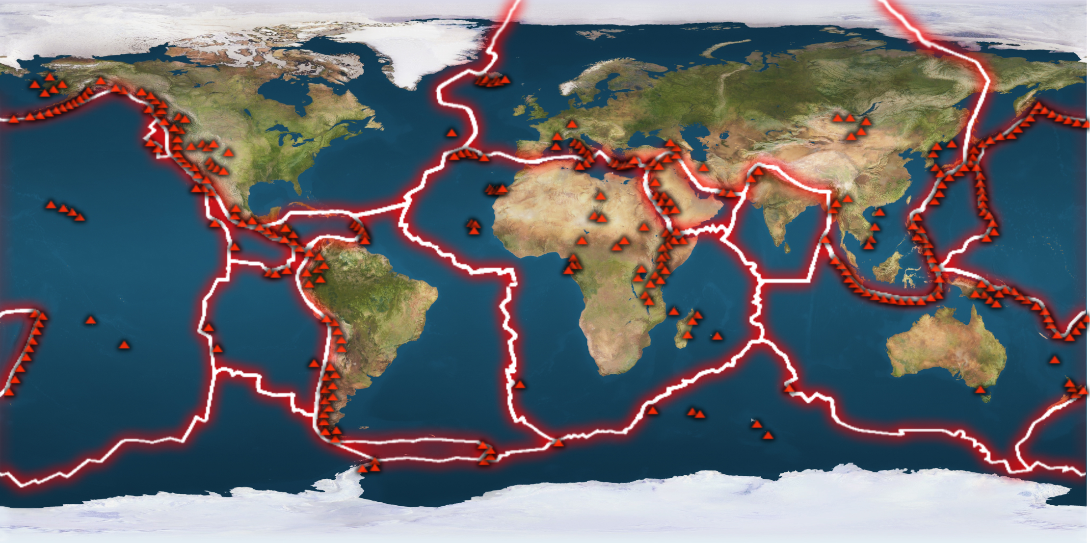
Notes:
The Earths crust and upper mantle are together known as the lithosphere. The lithosphere is rigid and brittle and is broken up into tectonic plates which fit together like a huge jigsaw puzzle.
Q: What do you notice about where the volcanoes are on this map? They are near plate boundaries
In fact over 75% of active volcanoes on Earth are found around the edge of the Pacific plate in a region known as the Pacific Ring of Fire

Slide 6

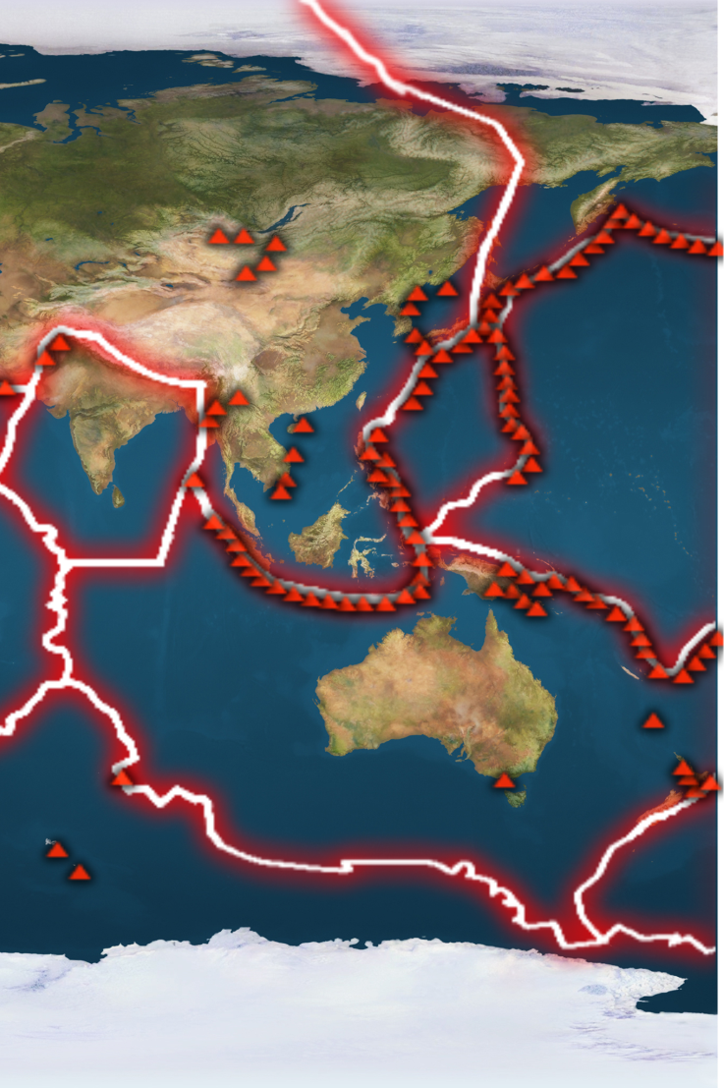
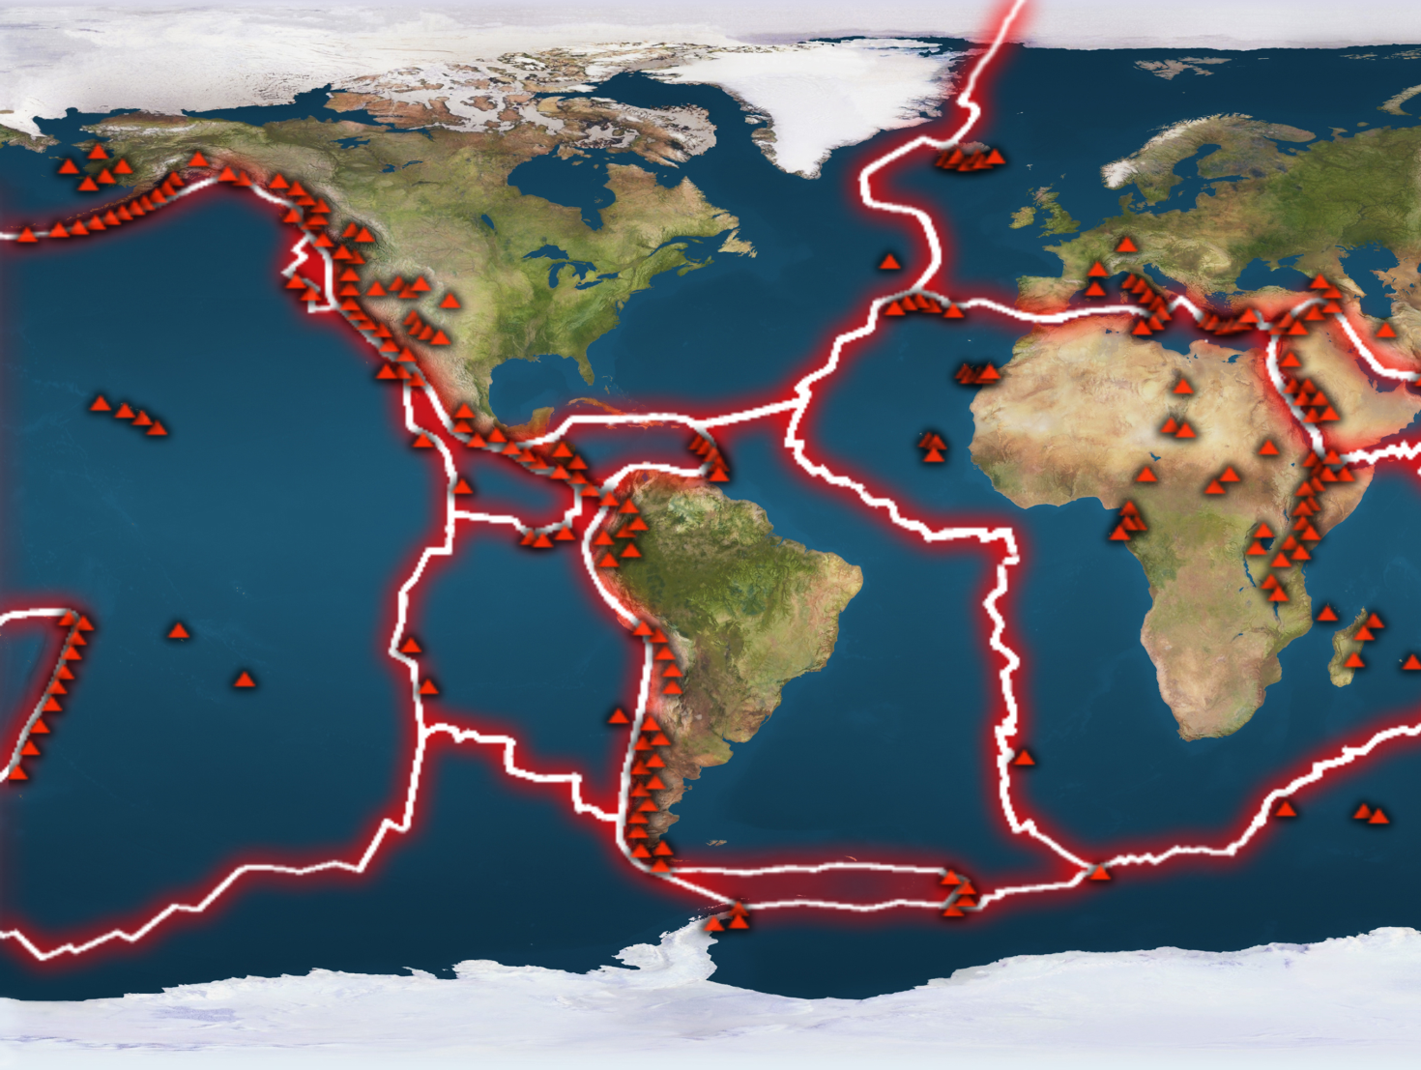
Pacific plate
Notes:
The Pacific Ring of Fire shows the region around the Pacific plate where most of the volcanoes on Earth are found
Note : The map is the same but has been shifted to show the whole of the Pacific Ocean

Slide 7

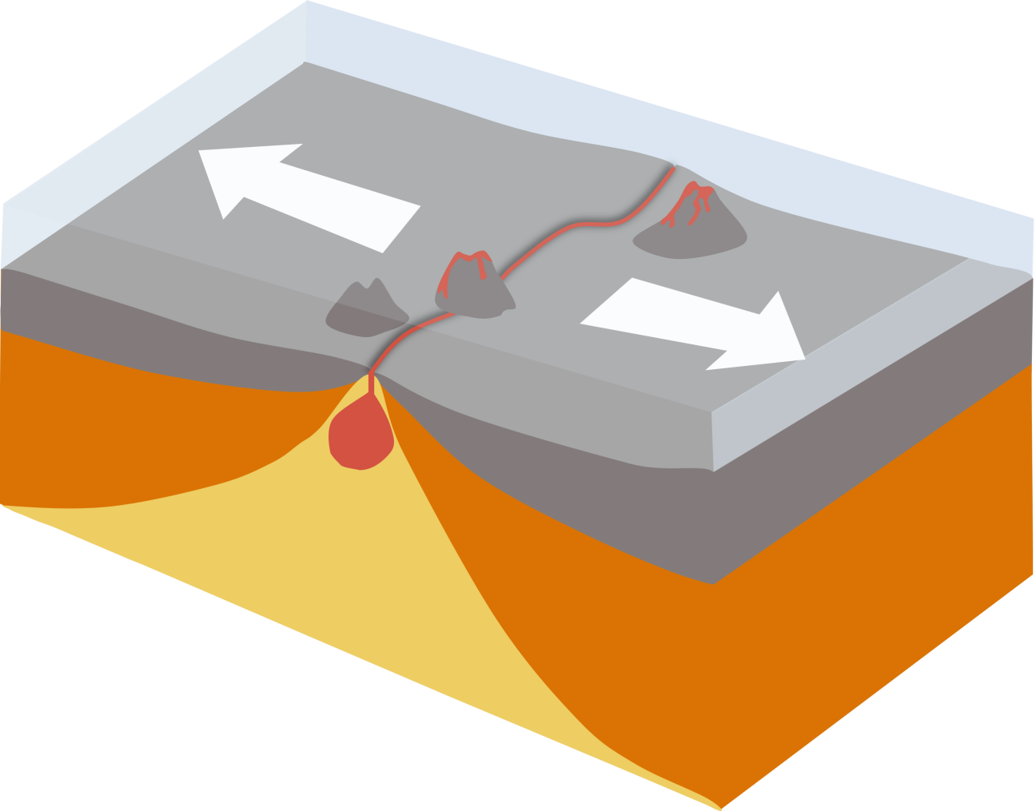
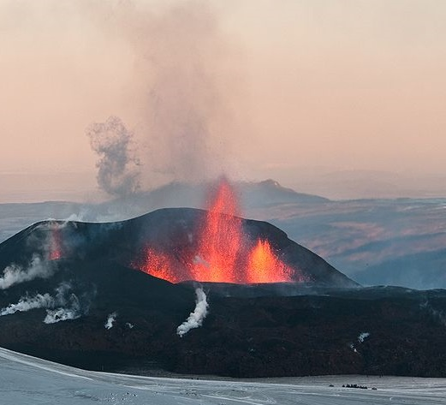
Plates moving AWAY from each other
Volcanoes
New ocean crust
Iceland
Magma
Asthenosphere
(lower mantle)
Lithosphere
David Karnå / CC by 3.0
Notes:
There are 3 ways in which we can get volcanoes on Earth: places where plates are moving away from each other, places where plates are moving towards each other and places where the mantle is extremely hot.
When two plates are moving away from each other this is called a constructive or divergent plate boundary, here new oceanic crust is created from sea floor spreading.
When two plates pull apart the underlying hot mantle (asthenosphere) upwells to the surface. As it rises the pressure acting upon the mantle rocks reduces and they start to partially melt in a process known as decompression melting. This produces pockets of basaltic magma which then erupts on the surface creating new oceanic crust and underwater volcanoes.
The Mid Atlantic Ridge is an example of a constructive plate boundary on Earth, it is actually a huge chain of underwater volcanoes. Iceland which is located on the Mid Atlantic ridge has around 30 active volcanoes and more than 100 extinct volcanoes.

Slide 8

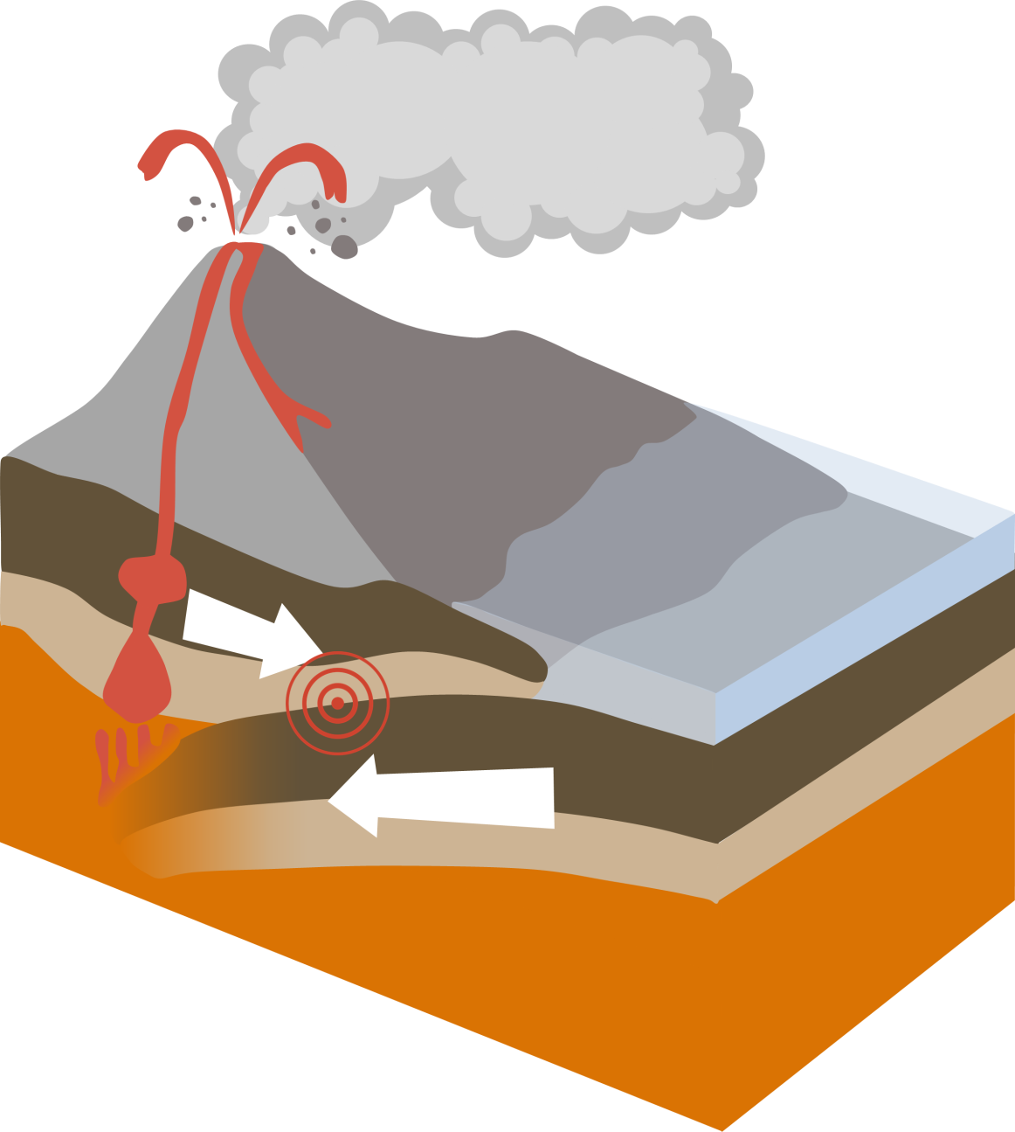
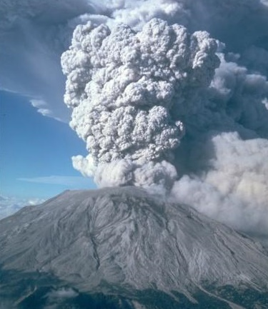
Oceanic and Continental plates
Volcano
Continental crust ~2.7 g/cm³
Magma
Oceanic crust ~2.9 g/cm³
Mount St. Helens, Washington, USA
Plate melts
Plate is subducted
Notes:
When an oceanic plate is moving towards a continental plate (or two oceanic plates are moving towards each other) this is called a convergent boundary or destructive boundary.
At oceanic-continental convergent boundaries the oceanic plate is pushed beneath or subducted the continental plate to form a subduction zone. Oceanic crust has an average composition of basalt which has a density of 2.9g/cm3, continental crust has an average composition of granite which has a density of 2.7 g/cm3 and so is more buoyant and will not be subducted.
If you have basalt and granite rock samples you could pass them round the class for students to look at
During subduction hydrous minerals (minerals containing water in their structures) in the upper parts of the oceanic plate are heated and release water into the mantle. This lowers the melting point of the mantle causing it to partially melt and generate pockets of molten magma. The hot magma (up to 1000°C) is more buoyant than the surrounding rocks so rises and erupts on land typically as andesitic lava creating a continental volcanic arc like the Andes in South America and the Cascades in North America.

Slide 9
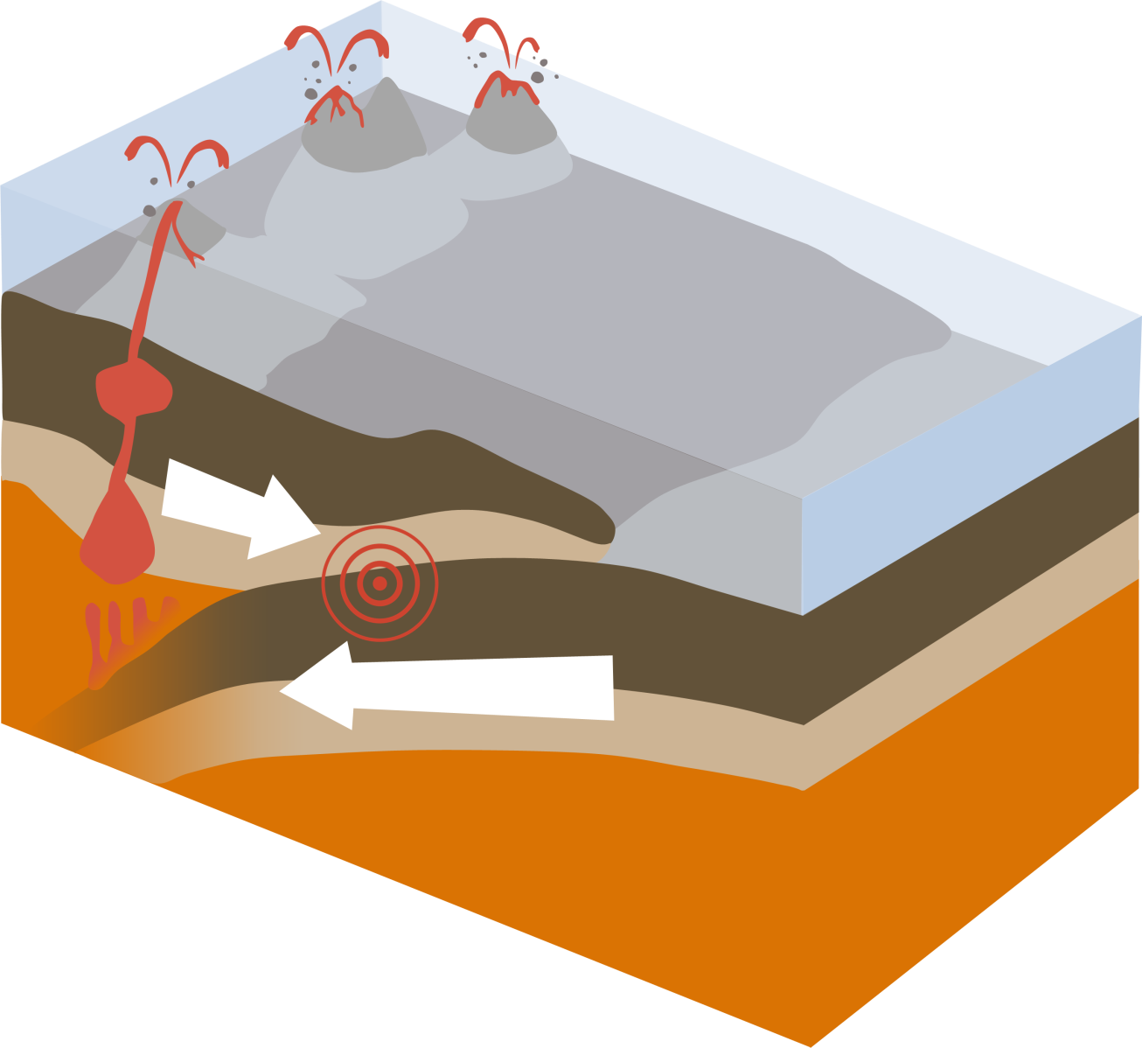
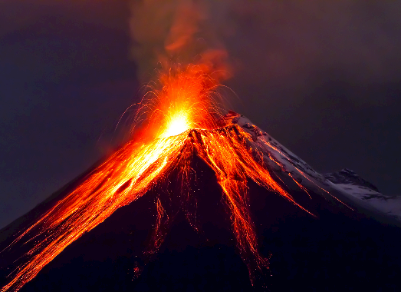
Oceanic and oceanic plates
Oceanic island arc
Ocean trench
Younger oceanic plate
Magma
Older oceanic plate
Plate is subducted
Mount Mayon, Philippines
Plate melts
Notes:
When two oceanic plates converge, it is usually the older oceanic plate that is subducted beneath the younger plate forming a subduction zone. Oceanic crust is created at a mid ocean ridges, as crust is progressively pushed away from the mid ocean ridge it cools down and becomes denser therefore older oceanic crust will be denser than younger oceanic crust and the older plate will be subducted.
As in oceanic-continental convergent boundaries, the descending oceanic plate is heated and hydrous minerals in the crust dehydrate to release water into the mantle. This lowers the melting point of the mantle which partially melts to form magma. The hot, buoyant magma rises and erupts on the sea-floor producing an arc of volcanic islands typically made from andesite lava. Volcanic arcs such as the Philippines, the Caribbean islands, the Mariana Arc and the Aleutian Islands have all been formed from oceanic-oceanic convergent boundaries.

Slide 10

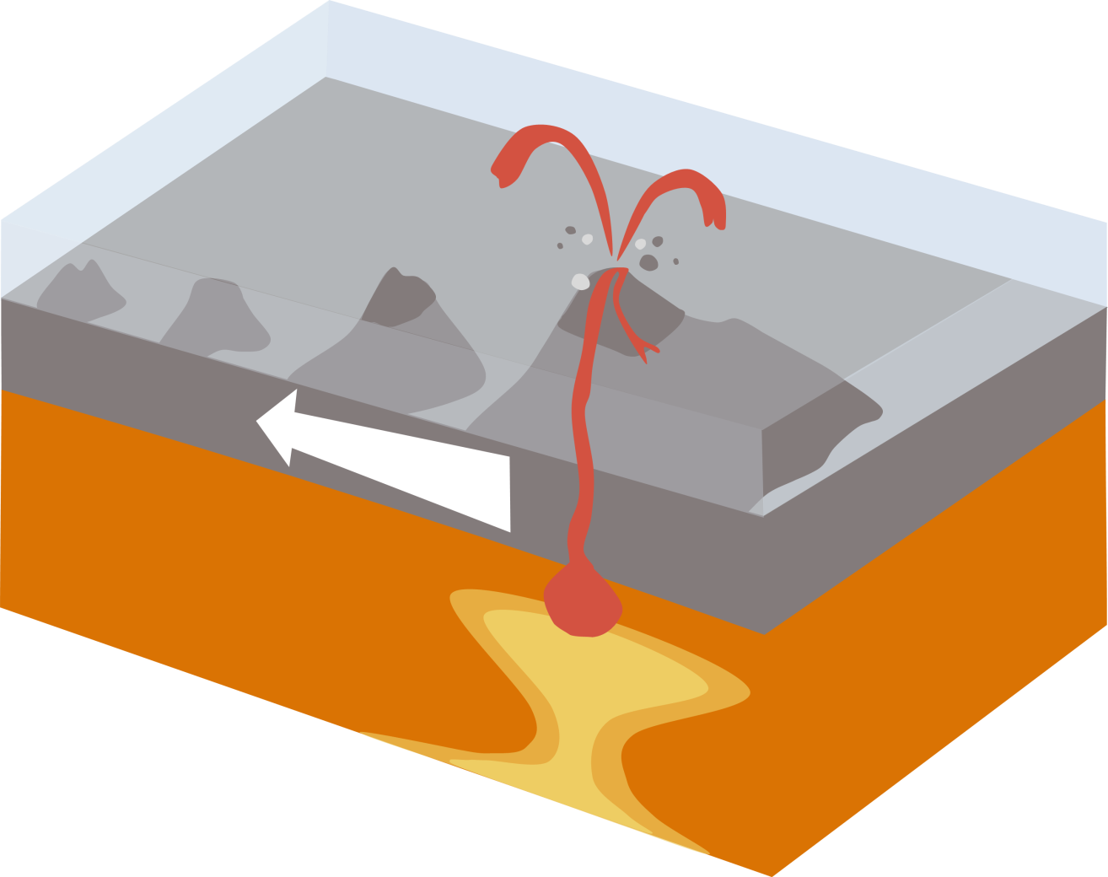
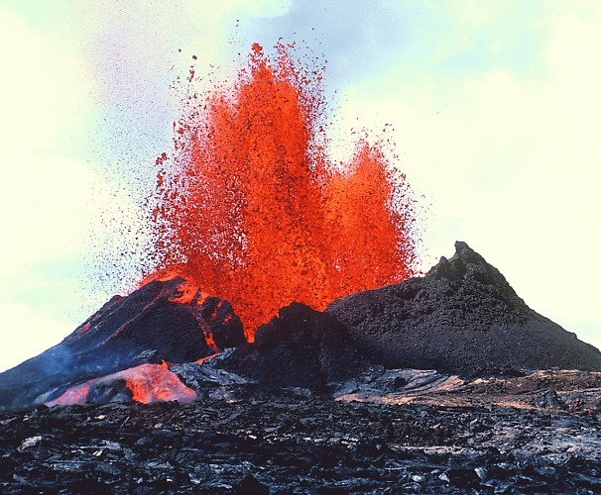
Plate moving OVER a HOTSPOT
Older extinct volcanoes
Active volcano
Plate moving over hotspot
Magma
Hot spot
Kilauea, Hawaii
Kilauea, Hawaii
Notes:
Most volcanic activity occurs at plate boundaries, however sometimes volcanoes can form in the middle of plates far away from any plate boundary.
These volcanoes for example those which make up the Hawaiian islands likely form due to ‘hot spots’, areas of super-heated rocks in the Earth’s mantle.
As these hot rocks rise, the pressure acting upon them reduces and this allows them to partially melt to form pockets of basaltic magma. This magma then up-wells and erupts on the sea floor as a volcanic seamount. As the plate gradually moves like a conveyor belt over the stationary mantle hot spot, a chain of volcanoes is formed recording the past movements of the plate.
Click for Hawaiian island chain

Slide 11
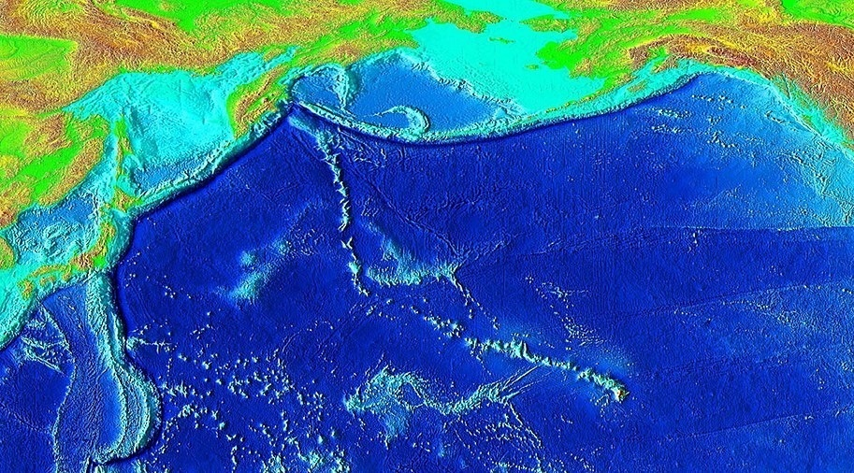
78Ma
Emperor Seamount chain
3570km
43Ma
Hawaii
Hawaiian Island chain
Notes:
Maths question – use the Hawaiian hotspot to work out the speed of the Pacific plate
Q: How far do you think the Pacific plate has moved since you were born? Have students guess answers
Work out the average rate that the Pacific plate moves each year in cm
The oldest seamount in the Hawaiian chain is 43 million years old and is 3570 km away from Hawaii. Hawaii is still volcanically active so assume the hotspot is located directly beneath Hawaii.
Plate movement = Distance/time
3570 / 43,000,000 = 0.0000872093 km year-1
0.0000872093*100000 = 8.72 cm year-1
8.72*16 (or age of student) = 139.52cm in 16 years
Q: What do you think happened to create the bend in the island chain? A: the Pacific plate changed direction from more northerly to more westerly

Slide 12

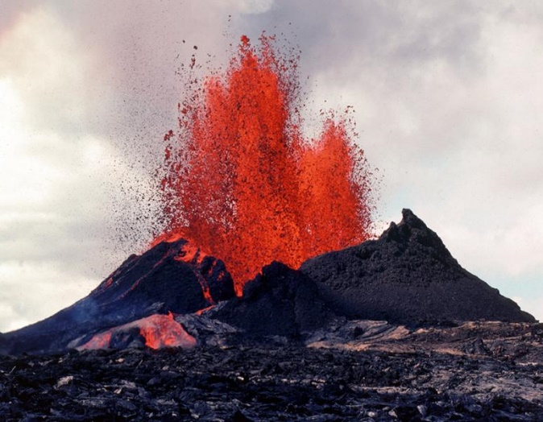
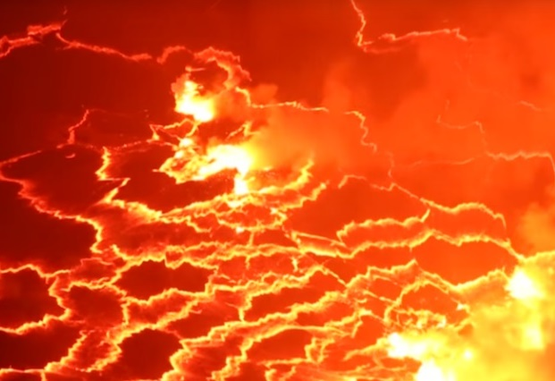
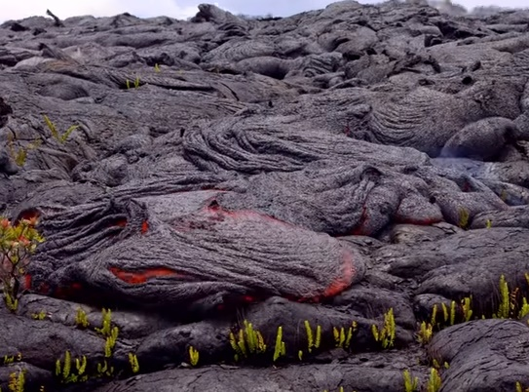


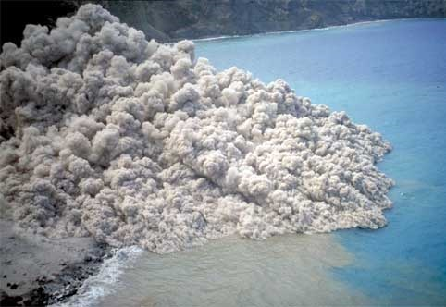
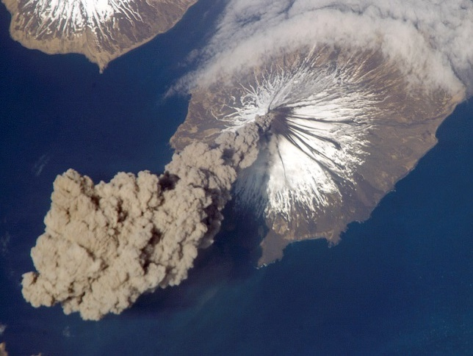
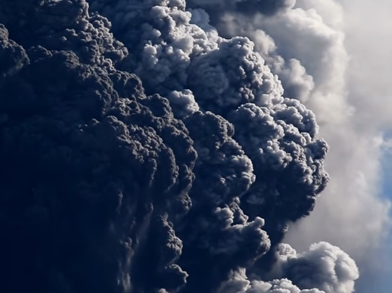
Lava lake, Nyiragongo
Volcanic bomb
Effusive
Lava fountain, Hawaii
Pyroclastic flow, Monserrat
(British Geological Survey)
Explosive
Ash cloud, Aleutian Islands
Notes:
There are two types of eruption that can happen from a volcano called effusive and explosive. The type of eruption effects what will be erupted (huge ash column or rivers of runny lava).
If the magma is low viscosity (runny) and doesn’t have many gas bubbles, then the volcano will erupt gently, in an effusive eruption. Lava can spray up as a fountain (Strombolian eruption - named after the Italian volcano Stromboli) or flow gently from the volcano as a lava flow. The lava in effusive eruptions is usually basaltic in composition (i.e. will form the igneous rock basalt when it solidifies).
If the magma in the magma chamber is very viscous and has lots of gas bubbles trapped within it, then the volcano will erupt violently making a big cloud of ash and gas above the vent. Lava from an explosive eruption is usually andesite or rhyolite and has more SiO2 than basalt.
Q: What happens when you shake a fizzy drink? A: It explodes!
Fizzy drinks contain carbon dioxide gas under pressure and this is what makes them fizzy. When a bottle of fizzy drink is shaken, lots of extra bubbles of carbon dioxide gas are created. These extra bubbles want to get out of the bottle so when you unscrew the cap, the bubbles explode out of the bottle taking the fizzy drink with it. This is what essentially what happens in explosive eruptions – the bubbles of gas trapped within the viscous magma explode out of the volcano taking rock fragments, lava and ash with it.
Watch the two videos – lava from Kilauea (‘Kil-ah-way-ah’) volcano in Hawaii showing an effusive eruption and ash clouds from Eyjafjallajokull (‘ey-yah-fyel-lah-yo-kul’) in Iceland showing an explosive eruption.
Recommended to watch the Hawaii video from start for about 1 minute and start Iceland video at 1:30 and watch for around 1 minute (see if you can spot the volcanic bombs and rock fragments!).
Sometimes the gas and ash column generated during an explosive volcanic eruption collapses and creates a flow of hot gas and ash that races down the side of a volcano – this is known as a pyroclastic flow. Pyroclastic flows can be over 800°C and travel extremely quickly at over 10m per second!
Effusive eruptions can also sometimes form lava lakes, these are lakes of molten lava contained in the crater of volcano and are very rare on Earth - watch 50 second YouTube video of Nyiragongo lava lake by clicking on picture or going to https://www.youtube.com/watch?v=_2th8dY03Wo

Slide 13

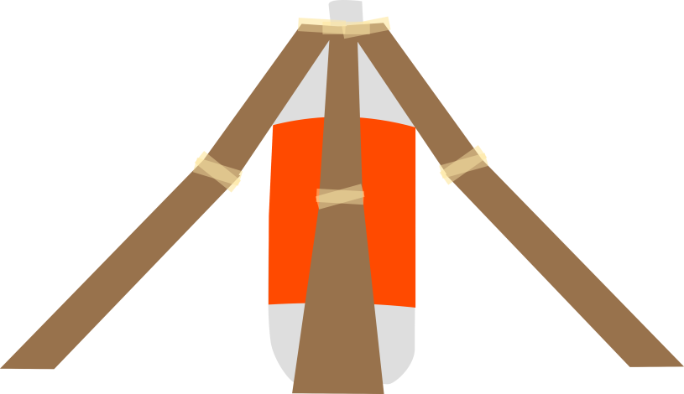
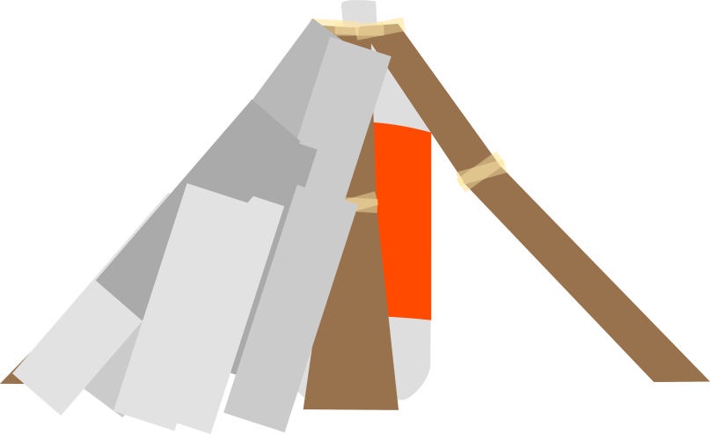
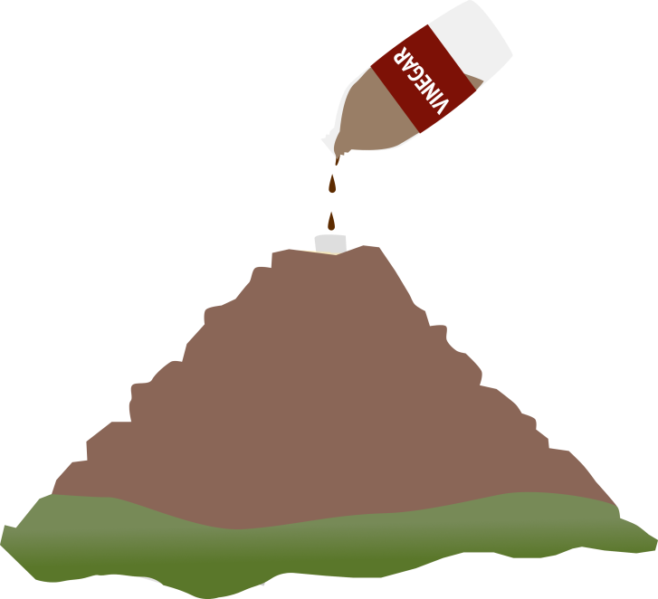

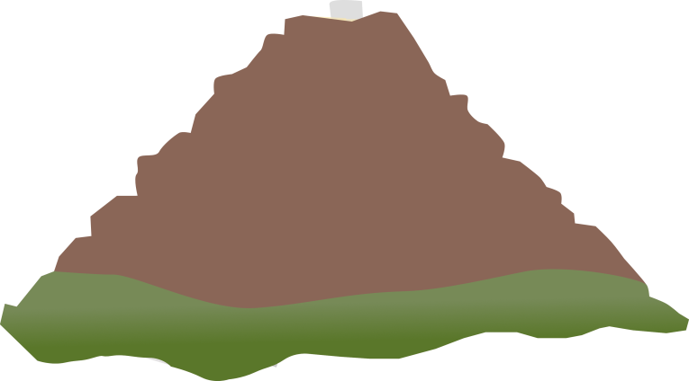
1
2
4
5
3
Notes:
Fun activity to make your own volcano could do as a whole class or in groups or as homework. Using vinegar and bicarbonate of soda or mentos and diet coke – activity sheet can be found here https://www.geolsoc.org.uk/Education-and-Careers/Resources/Activity-Sheets-And-Presentations ‘Make your own volcano’

Slide 14

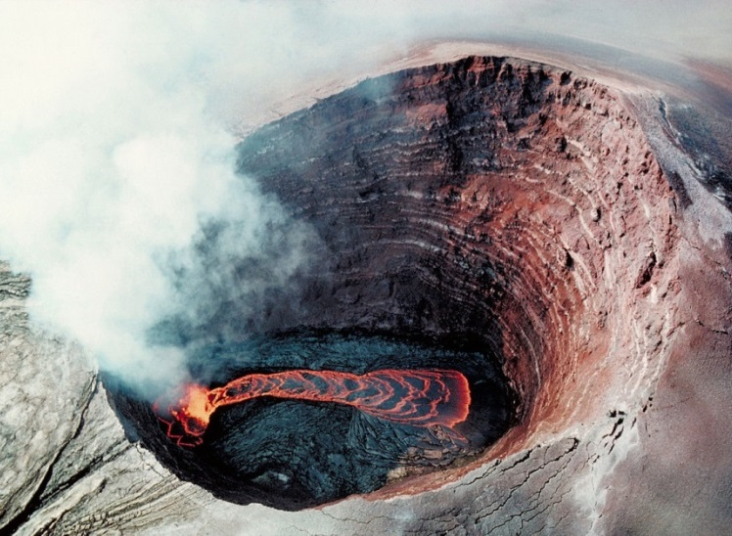
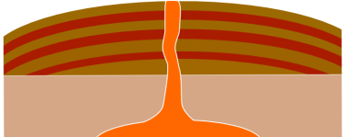
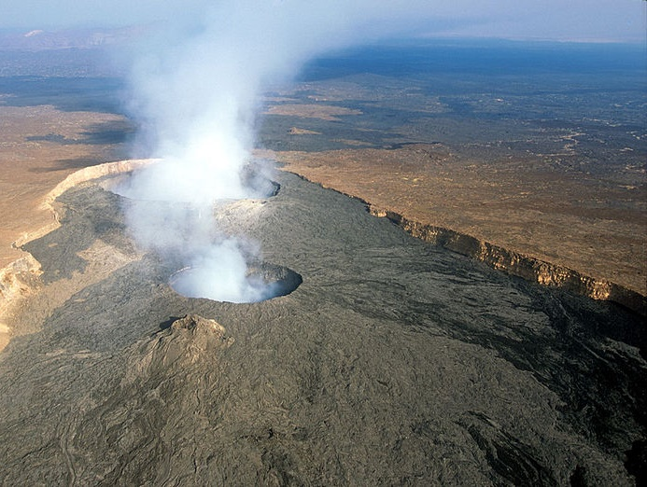
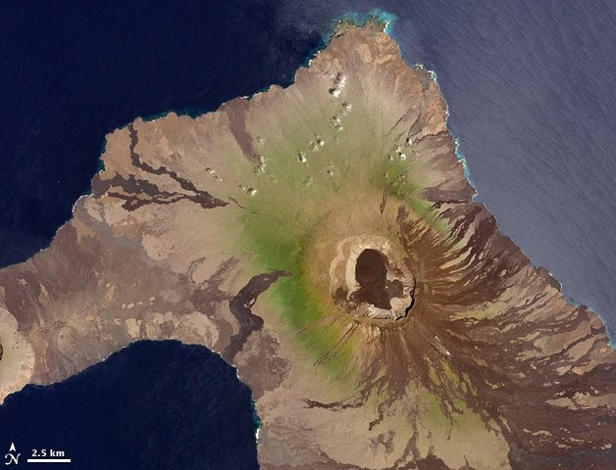
Shallow slopes made from lava
Runny basalt magma
Kilauea lava lake, Hawaii
Wolf Volcano, Galapagos Islands
Erta Ale Volcano, Ethiopia
Photo: filippo_jean/CC-By-2.0
Olympus Mons on Mars
Notes:
Shield volcanoes form from effusive eruptions of low viscosity lava. Because it’s so runny, this lava can travel a long way before it solidifies into rock and creates wide, sloping volcanoes in the shape of a shield.
Kilauea and Mauna Loa on the Big Island of Hawaii are good examples of shield volcanoes. Mars also has shield volcanoes – including Olympus Mons the biggest volcano in the solar system.

Slide 15

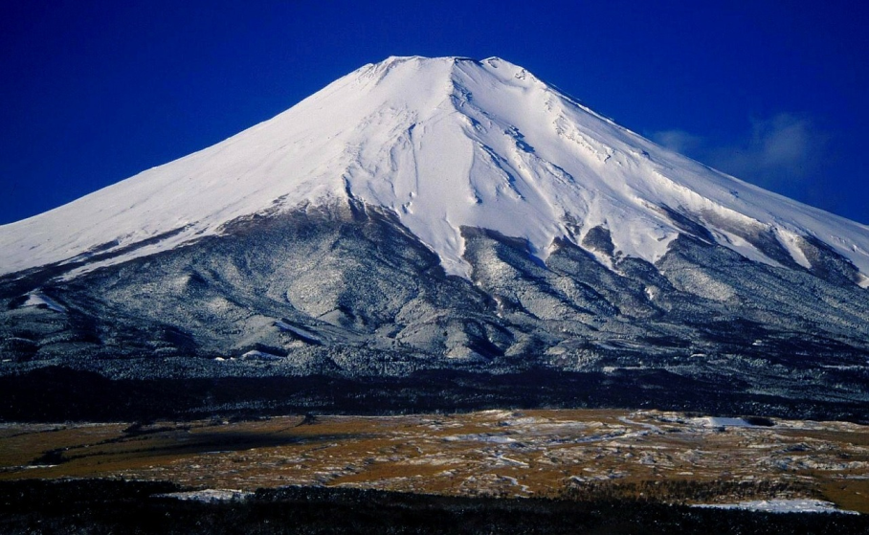
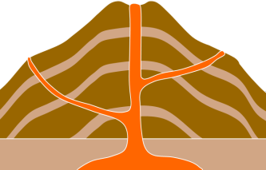
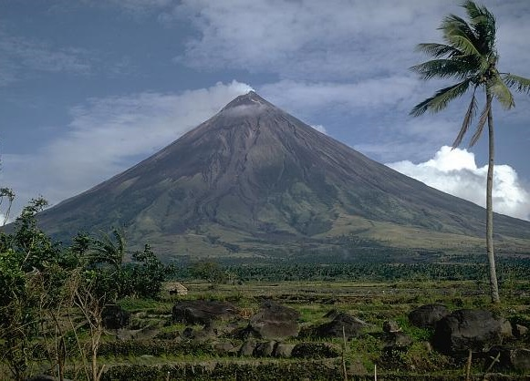
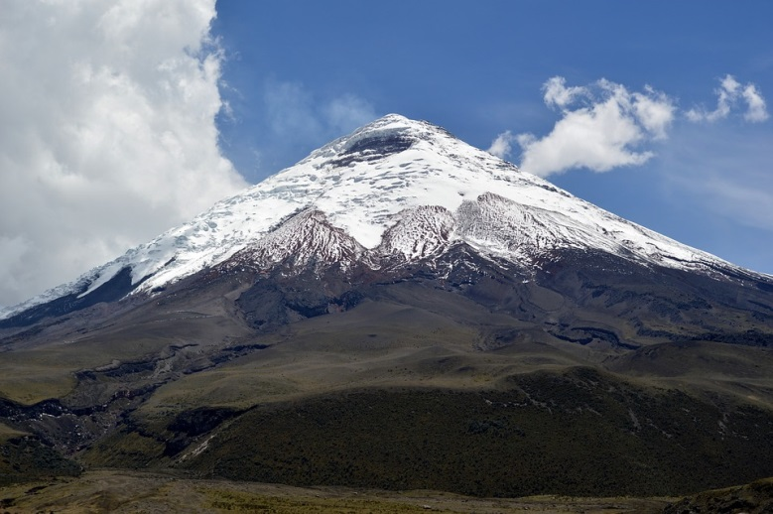
Mount Fuji, Japan
Sticky magma
Steep slopes made from lava and ash
Mayon Volcano, Philippines
Mount St. Helens, Washington, USA
Cotopaxi, Ecuador
Notes:
Composite volcanoes also sometimes called stratovolcanoes are formed from layers of alternating lava and ash, usually at destructive plate boundaries. The lava that erupts to form composite volcanoes is much thicker and flows more slowly than basalt lava. This means that it cannot spread out very far before it solidifies so forms cone-shaped volcanoes with steep sides.
Because of the thicker, stickier lava, composite volcanoes tend to erupt explosively and so they generate huge ash clouds and can sometimes cause pyroclastic flows, clouds of super-heated rock ash and gas that blast down the side of a volcano during large eruptions.

Slide 16

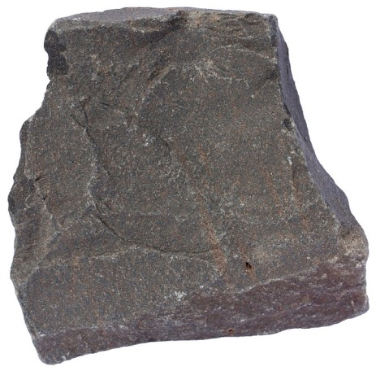
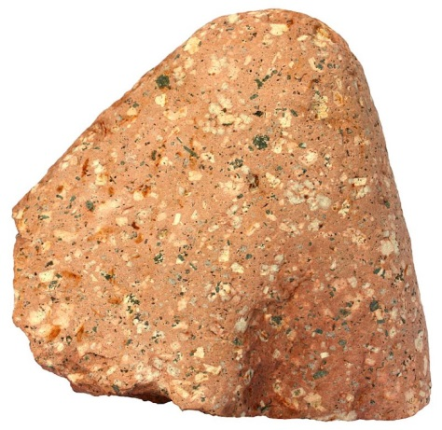
Lava type | Basalt | Andesite | Rhyolite
SiO₂ content | 45-55% | 55-65% | > 65%
Temperature | 1000 - 1200ºC | 800 - 1000ºC | 650 - 800ºC.
Volatile content | Low | Medium | High
Viscosity | Low | Medium | High
Notes:
The nature of volcanic eruptions and type of volcano produced is highly dependent on magma viscosity which is controlled by magma composition, temperature, volatiles and amount of crystallization. Magma Composition:
Magmas rich in silica (SiO2) are typically formed at destructive plate boundaries, by partial melting of crustal rocks which are richer in silica than mantle rocks. Such magmas erupt as andesite and rhyolite lavas. The higher silica content makes these magmas highly viscous, so when eruption occurs it is usually explosive (e.g. Mt St Helens). Low-silica magmas are typically formed by partial melting of mantle rocks beneath mid-ocean ridges or above mantle plumes like in Hawaii. These magmas erupt as basalts and the lower silica content makes them far less viscous. Eruptions are generally effusive. Temperature:
Magma temperatures reflect the melting points of their mineral components. Not surprisingly, magmas formed by partial melting of mantle rocks are much hotter – over 1200ºC for some Hawaiian basalts. Rhyolites may reach the surface at temperatures of less than 800ºC, and so have much higher viscosity. Volatile Content:
The amount of dissolved gases in the magma can also affect it's viscosity, but in a more ambiguous way than temperature and silica content. More silica rich magmas tend to have more dissolved volatiles but as they form bubbles these gas bubbles actually reduce the viscosity of the magma. Crystal Content:
Some magmas have already begun to crystallize by the time they reach the surface. Again, this applies particularly to the cooler, more viscous magmas typical of destructive plate margins. A crystal mush will increase viscosity.

Slide 17

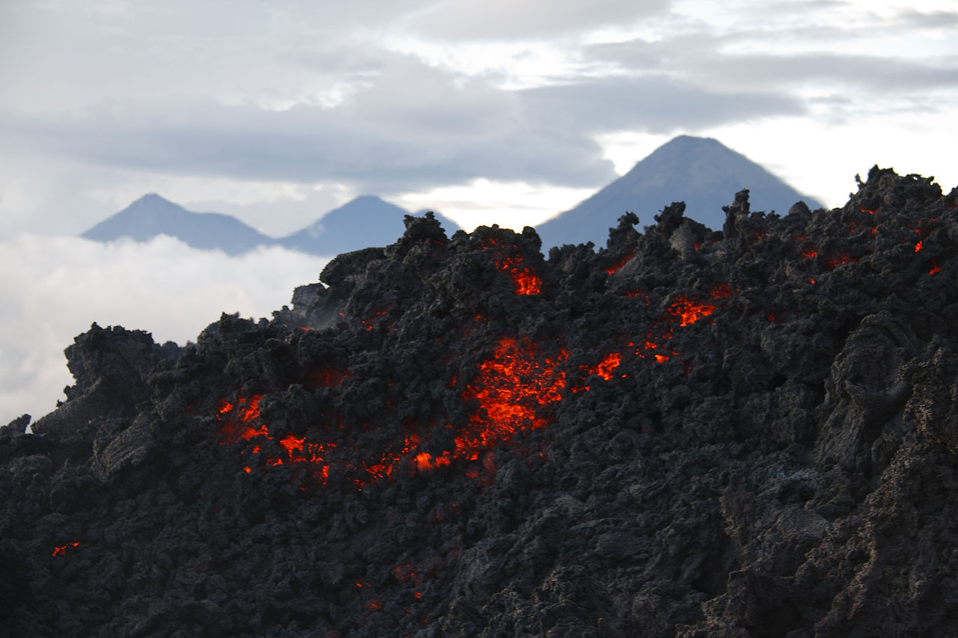
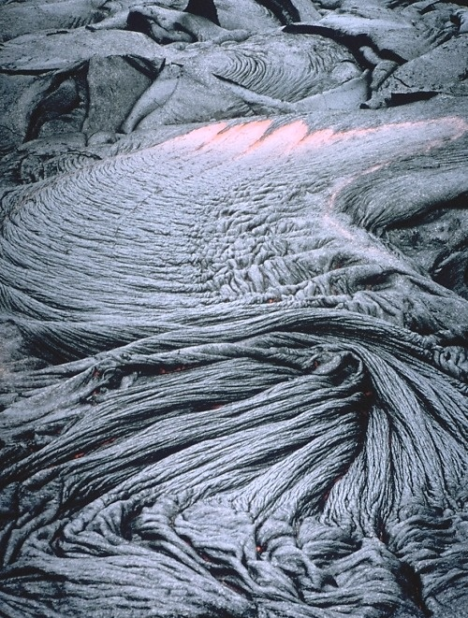
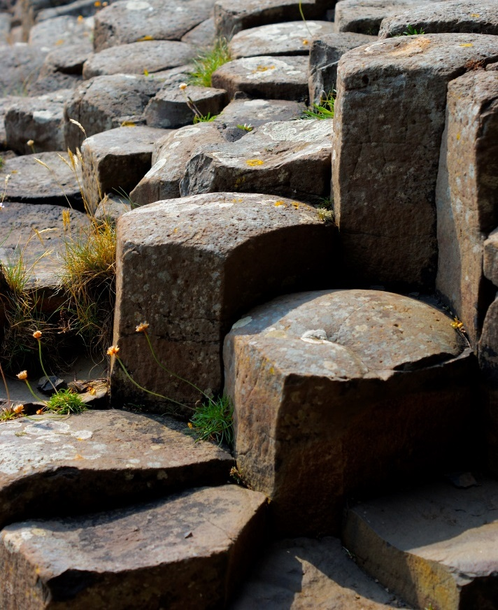
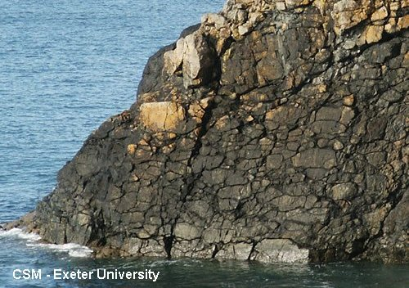
´A´a lava, Guatemala
Photo: Librex/CC-By-2.0
Pahoehoe lava, Hawaii
Pillow lava, Cornwall
Columnar joints, Isle of Mull
Notes:
There are a few different types of lava that come out of a volcano during an effusive eruption:
Pahoehoe, pronounced ‘pah-hoey-hoey’, forms from slowly flowing lava and has a smooth or ropey surface when it hardens into rock, pahoehoe lava is always low viscosity and therefore is usually basaltic.
’A’a, pronounced ‘ah-ah’, forms from fast flowing lava and has a rough, rubbly surface with jagged blocks when it hardens into rock. ’A’a lava can be basaltic but it can also be andesitic or rhyolitic.
Pillow lava forms when lava interacts with sea water – this happen when volcanoes erupt underwater for example at mid ocean ridges, or less commonly when lava flows from land into the sea, which sometimes happens in Hawaii. Pillow lavas forms characteristic pillow shapes and each ‘pillow’ often have chilled margins. This is very fine-grained or glassy outer part of the pillow which cooled very rapidly in cold seawater. Pillow lavas are extremely common on Earth as they form the uppermost part of all oceanic crust which covers approximately two thirds of our planet. Sometimes we get to see pillow lavas on land when sections of oceanic crust are thrust up onto the continent called ophiolites, for example in the Troodos ophiolite in Cyprus or as part of the Lizard ophiolite in Cornwall (image).
Hexagonal columnar joints such as those seen in the Giant’s Causeway and on the Isle of Mull can form in the center of thick lava flows. Parallel joints form in the basalt as the lava sheet cools and contracts.

Slide 18

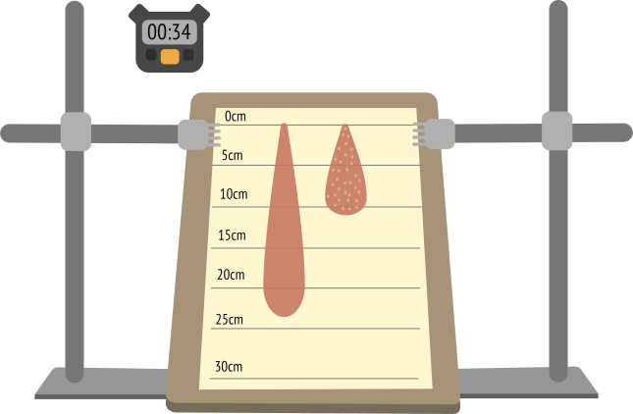
Notes:
Lava viscosity activity
Activity to show how temperature, slope angle and lava crystal content affect lava viscosity.
Full instructions can be found at www.geolsoc.org.uk/Education-and-Careers/Resources/Activity-Sheets-And-Presentations

