Slide 1


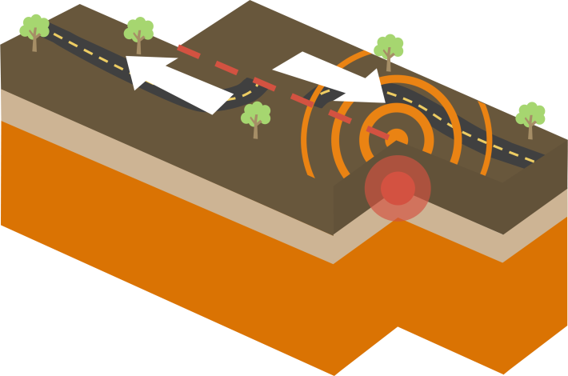
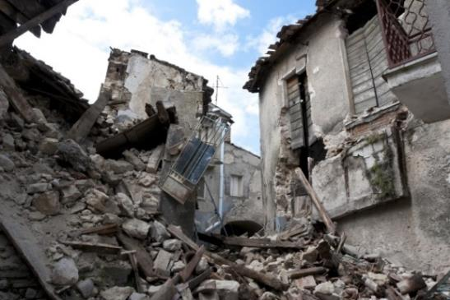
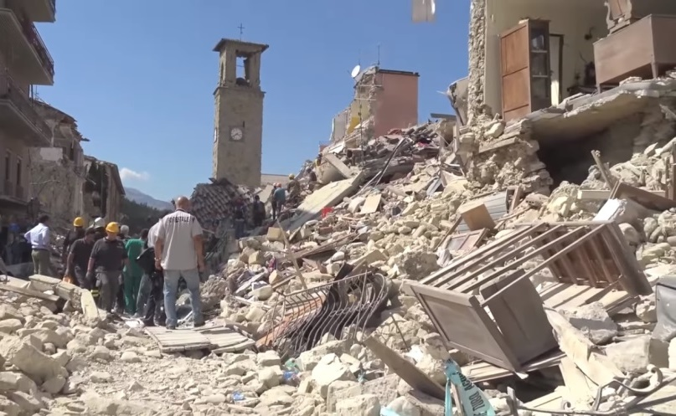
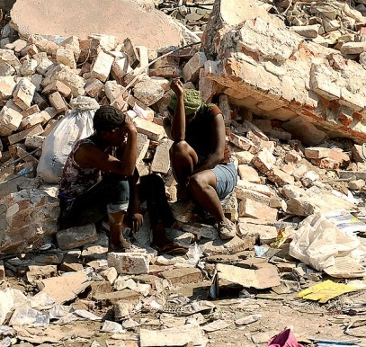
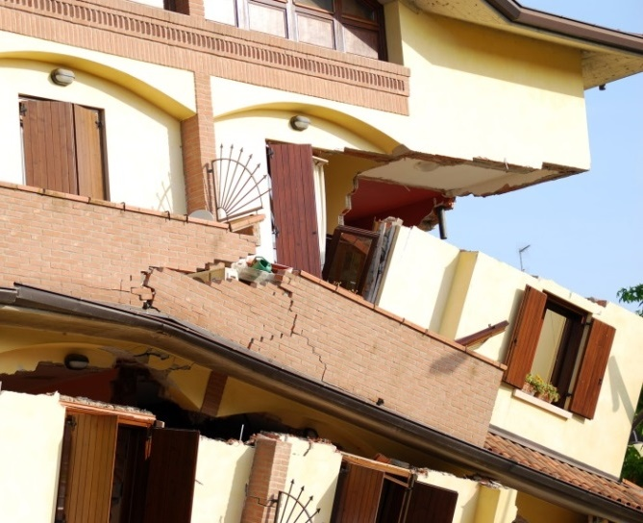
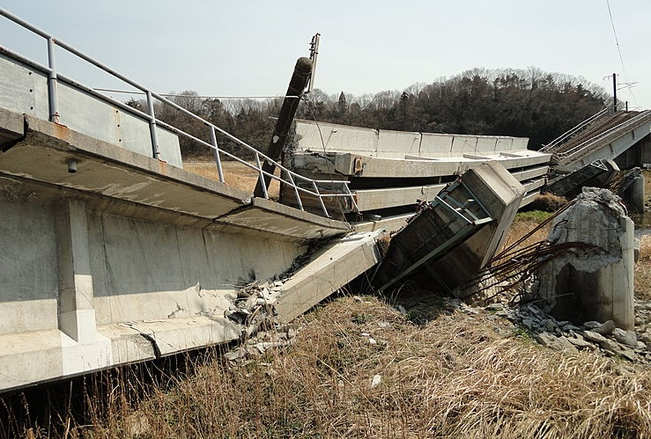

Slide 2

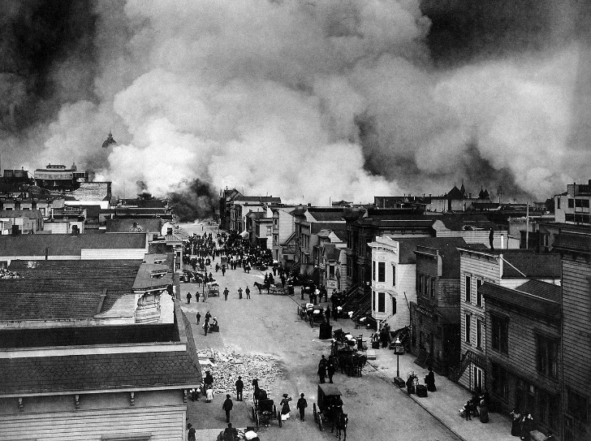
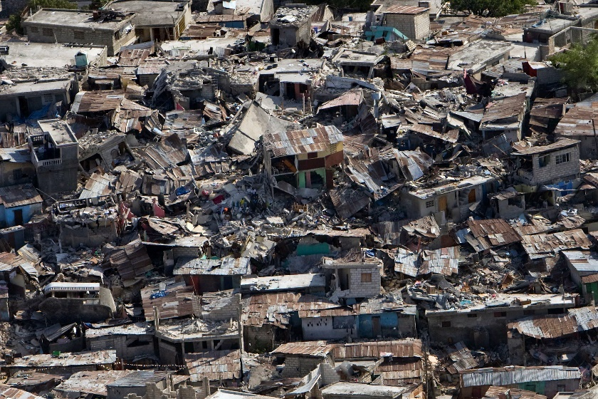
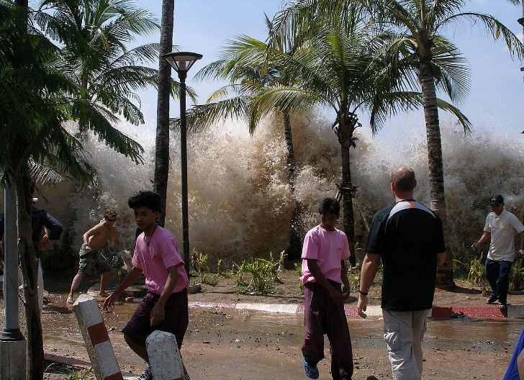
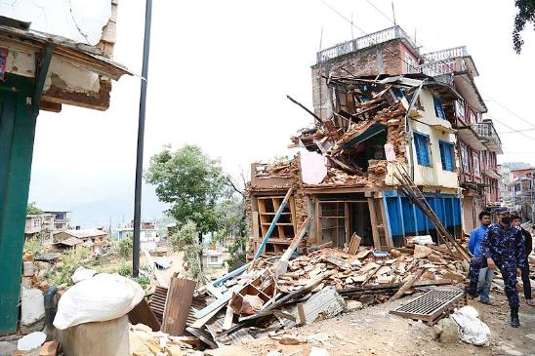
San Francisco 1906
Haiti 2010
Indian Ocean tsunami 2004
Nepal 2015
Notes:
Ascertain class knowledge
Earthquakes are vibrations caused by the movements of the Earth’s tectonic plates
They occur when stresses built up in tectonic plates are suddenly released
Earthquakes are natural hazards – extreme natural events that cause loss of life and/or extreme damage to property and create severe disruption to human activities

Slide 3
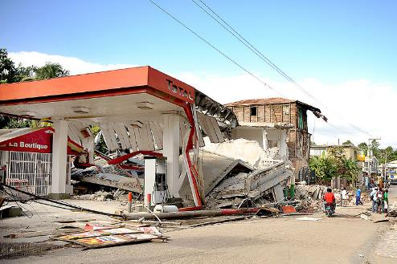

Vibrations caused by the movements of tectonic plates
Stresses build up plates are suddenly released
Natural hazards – extreme natural events that cause loss of life and/or extreme damage to property and create severe disruption to human activities
Notes:
National Geographic montage of earthquakes https://video.nationalgeographic.com/video/earthquake-montage
Earthquakes are vibrations caused by the movements of the Earth’s tectonic plates
They occur when stresses built up in tectonic plates are suddenly released
Earthquakes are natural hazards – extreme natural events that cause loss of life and/or extreme damage to property and create severe disruption to human activities

Slide 4

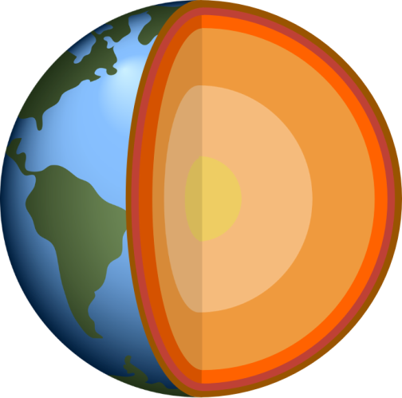
Lithosphere
Crust
(Soild)
Asthenosphere
Plates are made from the lithosphere
Crust and the very upper part of the mantle
Lithosphere is rigid and brittle so can fracture and buckle
Mantle
(Soild)
Inner core
(soild)
Outer core
(liquid)
Notes:
Plates are made from the Earths lithosphere - the Earth’s crust and the upper part of the mantle. The lithosphere is rigid and brittle so it can fracture and buckle. Earthquakes occur in the lithosphere because it is brittle and can fracture when stresses accumulate.

Slide 5
Lithosphere
Crust
(Soild)
Beneath the lithosphere is the asthenosphere
Asthenosphere is solid rock but is plastic and can flow
The lithosphere is broken up into tectonic plates which move around on top of the asthenosphere
Asthenosphere
Mantle
(Soild)
Inner core
(soild)
Outer core
(liquid)
Notes:
Beneath the lithosphere is a layer called the asthenosphere – this transition happens at temperatures of about 1300 degrees C. The asthenosphere is made from solid rock, (it is not the sea of magma that is often depicted!) but it acts plastically meaning that over time it can flow - a bit like a chocolate bar in a warm room.
Because the Earth is a sphere, the lithosphere is broken up into huge slabs (a bit like a giant jigsaw puzzle) called plates. Plates move around on top of the asthenosphere usually at rates of a mm – cm per year.

Slide 6

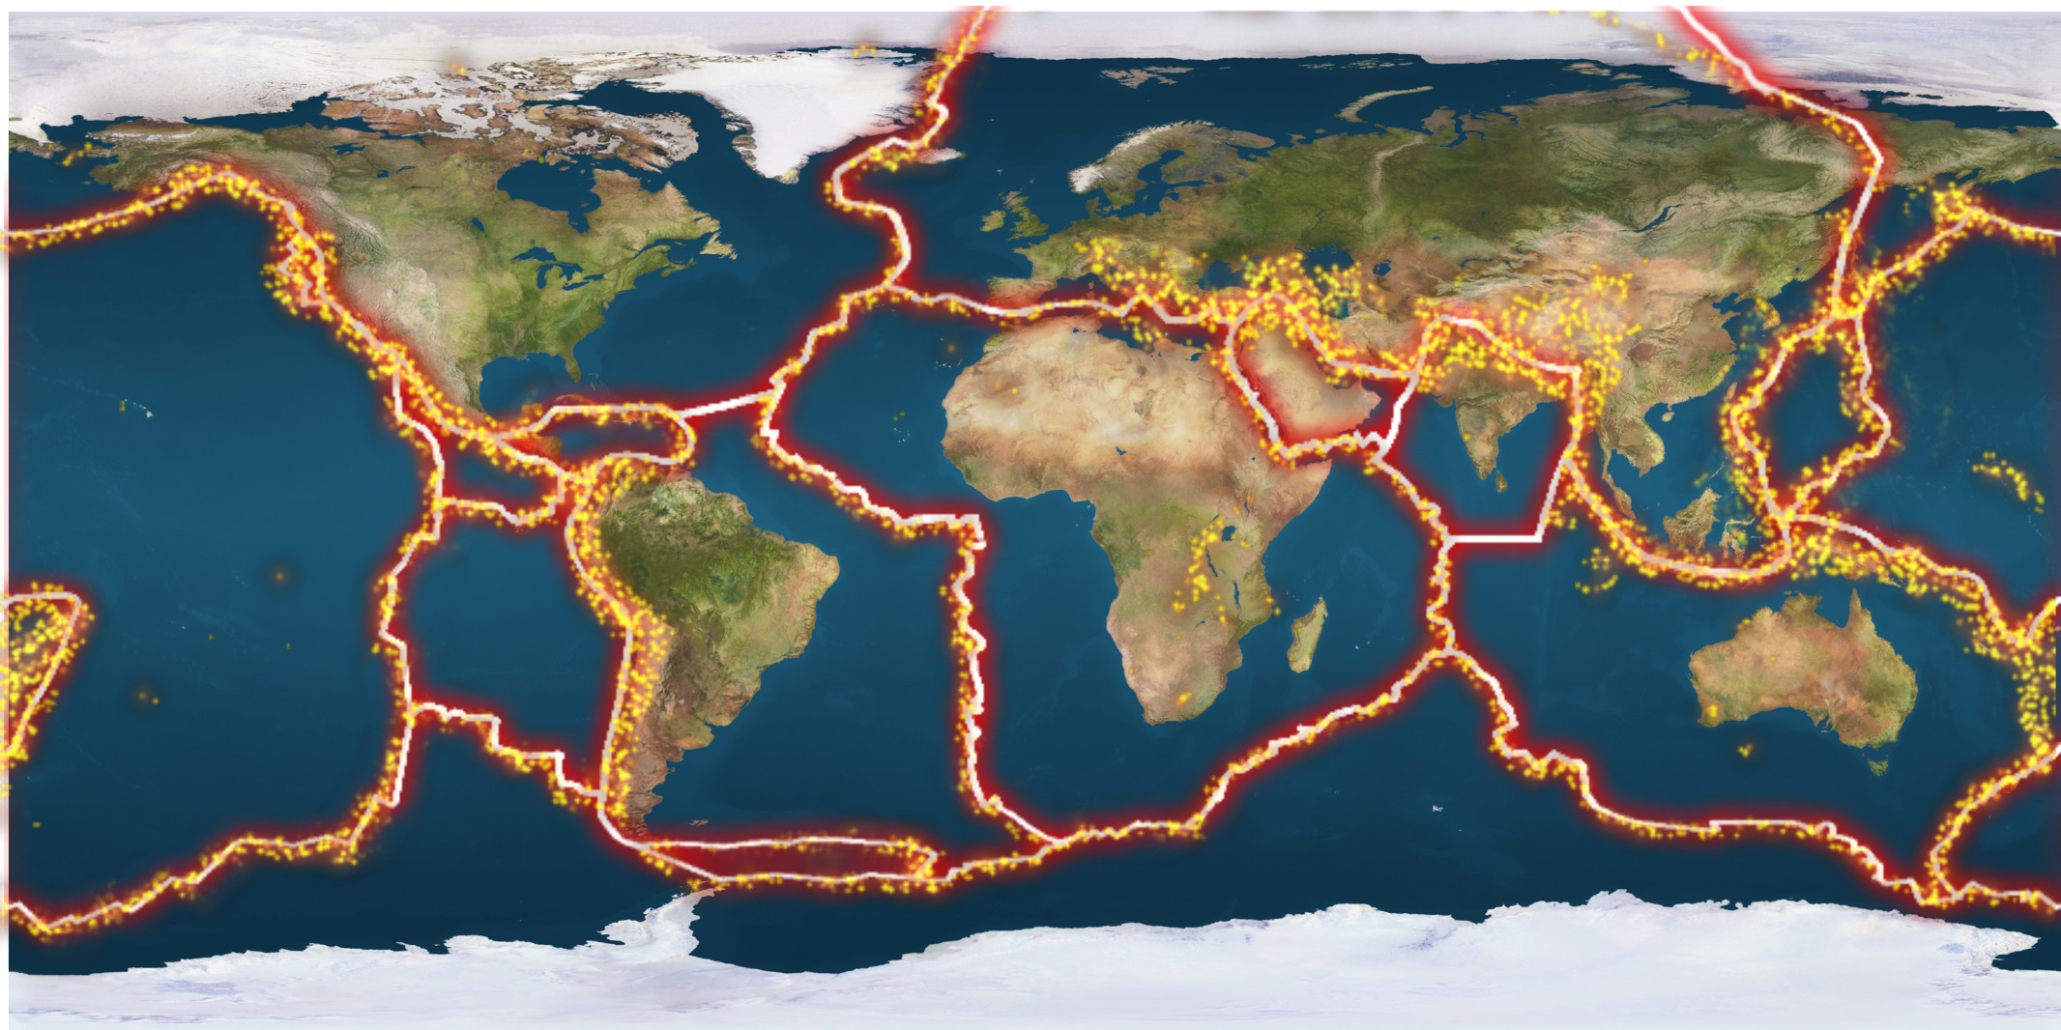
Notes:
This is a map showing the Earth’s plate boundaries (redlines) and the location of major earthquakes. As you can see from the map earthquakes are heavily concentrated around plate boundaries and rarely occur within plates.
Intra plate earthquakes do exist though – e.g. East African rift valley, western China, Pacific Ocean – why might this be?

Slide 7

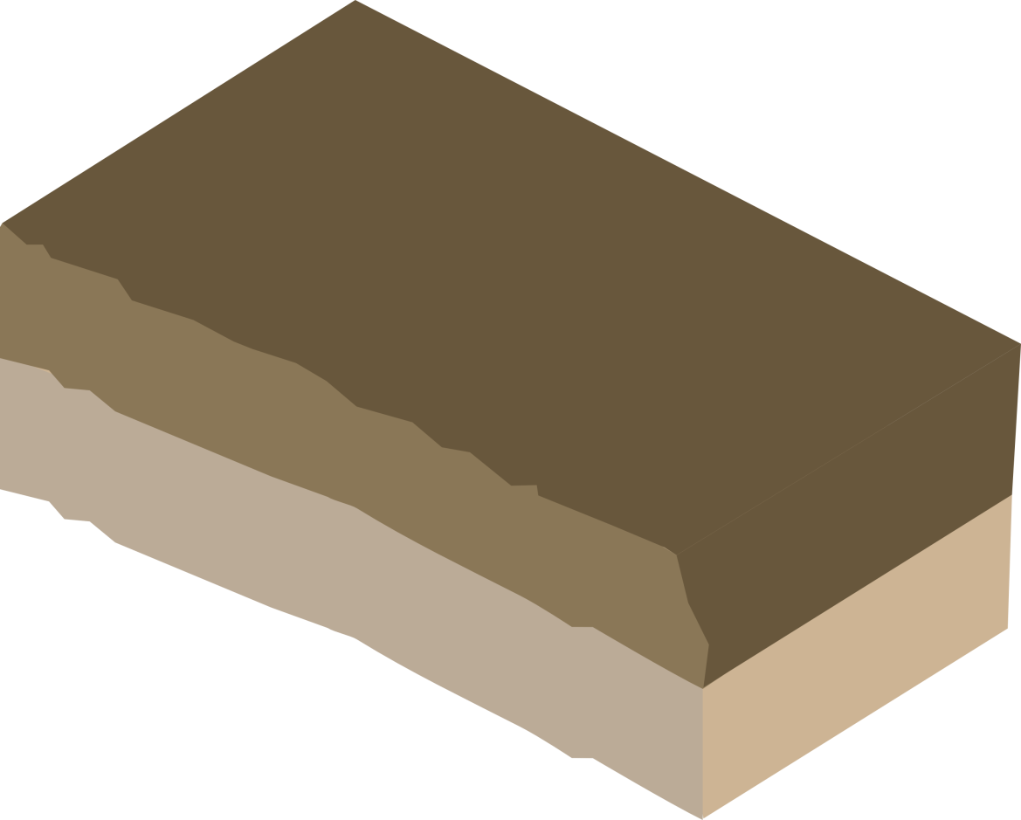
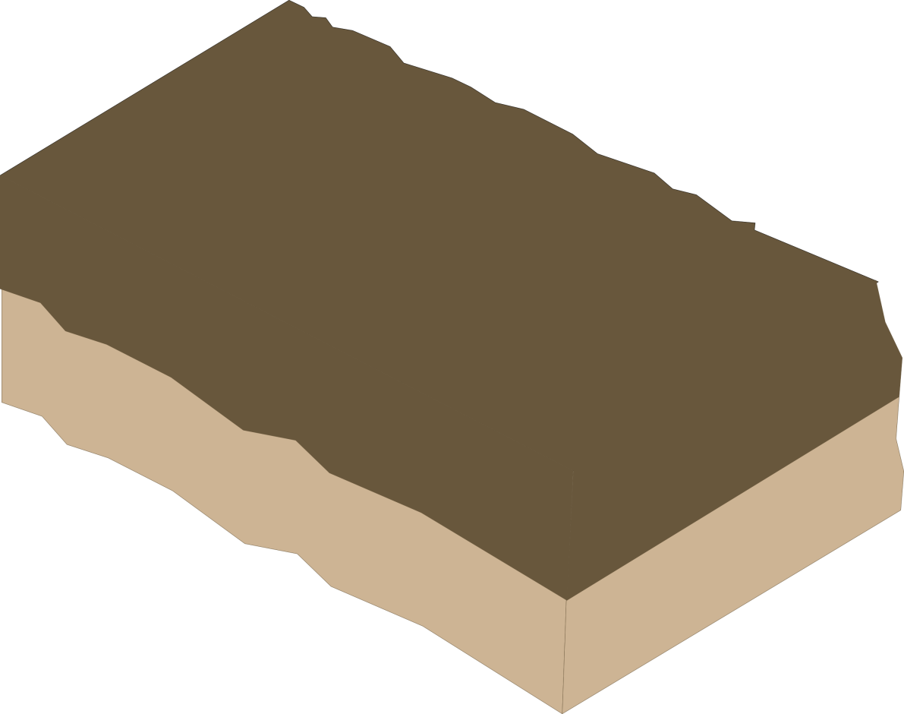
Lots of friction!
Notes:
The edges of tectonic plates are jagged and rough. This means that when they push and grind past each other, at plate boundaries they generate lots of friction.

Slide 8
HOW DO EARTHQUAKES HAPPEN?
Stress
Notes:
Sometimes blocks of rock can become locked together. When this happens, the plates get stuck together the energy that would normally cause the blocks to move past each other is stored up.

Slide 9

HOW DO EARTHQUAKES HAPPEN?
Notes:
Eventually the stress builds up so much that the plates suddenly jolt into a new position. This movement releases vibrations called seismic waves which travel through the Earth, shaking the surface, including anything on it. This is an earthquake!
Go through slides 6 -8 again if needed to show the earthquake happening

Slide 10

HOW DO EARTHQUAKES HAPPEN?
Epicentre
Focus
Notes:
The point at which the earthquake occurs below the Earth’s surface is called the focus, the point directly above the focus on the Earth’s surface is known as the epicentre.

Slide 11


Plates sliding past each other horizontally
Shallow focus earthquakes
San Andreas Fault, California – Pacific plate and North American Plate
Plates sliding past each other
Shallow
focus
Notes:
Transform plate boundaries, also known as conservative plate boundaries, occur at the edges of plates that are sliding past each other, either in opposite directions or in the same direction but at different speeds. As the plates grind past each other frictional forces lock blocks of rock together and pressure builds up. When the blocks eventually slip past each other this pressure is released as seismic energy, causing shallow focus earthquakes. The San Andreas Fault is an example of a conservative plate boundary and runs along the boundary of the Pacific and North American plate

Slide 12
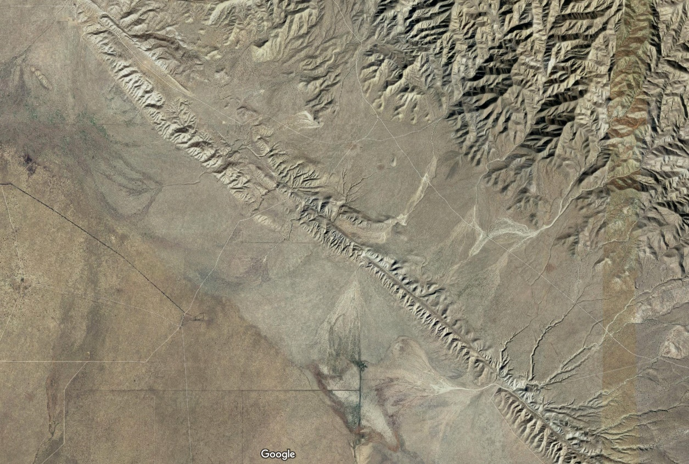
North American plate 2mm/year
San Andreas Fault
Actual motion
Relative motion
Pacific plate >6mm/year
Notes:
The San Andreas Fault marks the junction between the North American and Pacific Plates. The fault is 1300 km long, extends to at least 25 km in depth, and has a north west-south east trend. It is classified as a right lateral (dextral) strike-slip fault.
In this case the Pacific plate is moving North West, due to sea floor spreading from the East Pacific Rise. The North American plate is also moving north west (due to sea floor spreading from the Mid Atlantic Ridge) but at a slower speed, so the RELATIVE movement of the North American Plate is to the South East.
The average rate of movement along the San Andreas Fault is between 30mm and 50mm per year over the last 10 million years. If current rates of movement are maintained Los Angeles will be adjacent to San Francisco in approximately 20 million years.

Slide 13

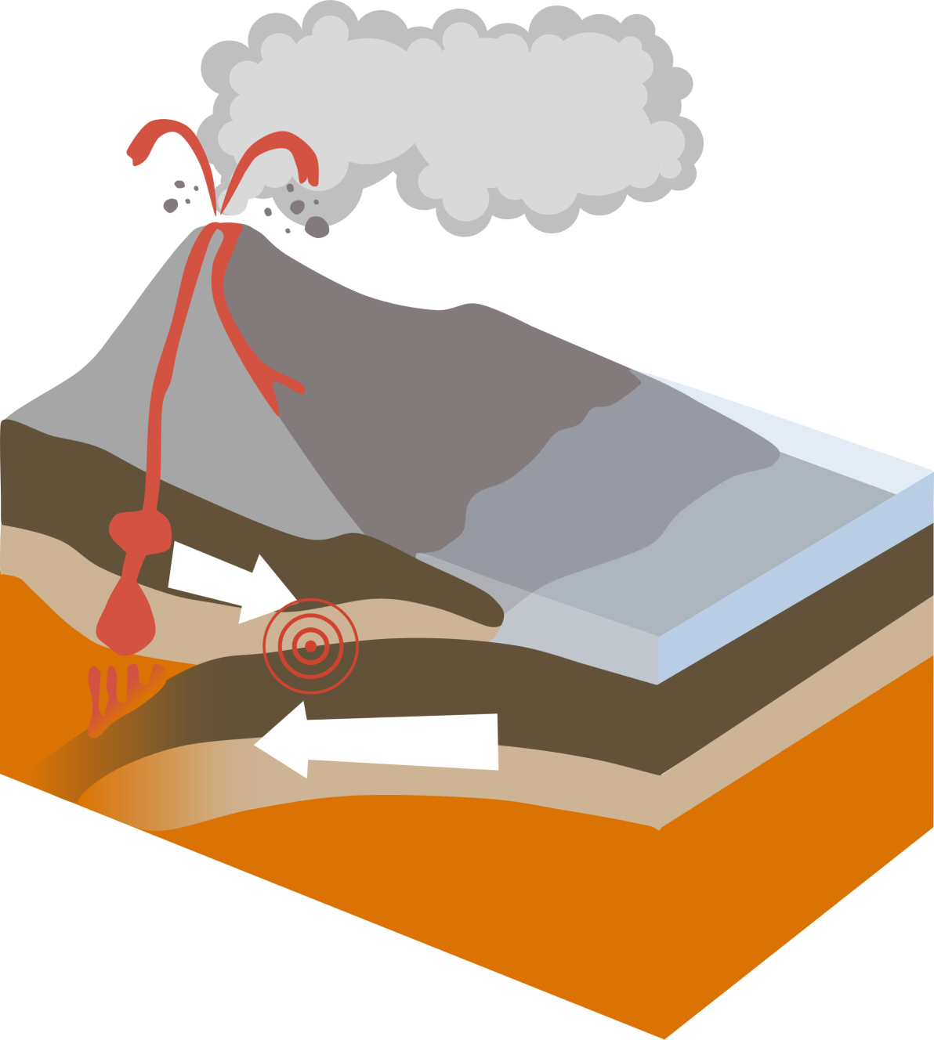




Subduction zone
Denser plate subducted beneath more buoyant plate
Wadati-Benioff Zone – inclined zone of earthquakes beneath the more buoyant plate up to 600km deep
Ocean trench
Wadati-Benioff zone
Subducted plate
Notes:
When an oceanic plate is moving towards a continental plate, at a convergent, or destructive, boundary, the denser oceanic plate (~2.9 g/cm3), will sink beneath the more buoyant continental plate (~2.7 g/cm3) in a process known as subduction.
During subduction the descending oceanic plate drags against the overlying plate, causing both to fracture and deform. This results in frequent earthquakes that get deeper as the ocean plate descends further i.e. deeper earthquakes the further you are away from the trench on the landward side. This defines an inclined narrow zone of earthquake foci known as the Wadati-Benioff zone which can extend to more than 600km in depth. The dip of the Wadati-Benioff zone coincides with the dip of the subducting plate, different plates may have shallower or steeper Wadati-Benioff zones depending on the angle of the subduction plate.

Slide 14
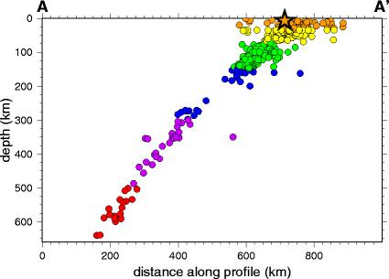
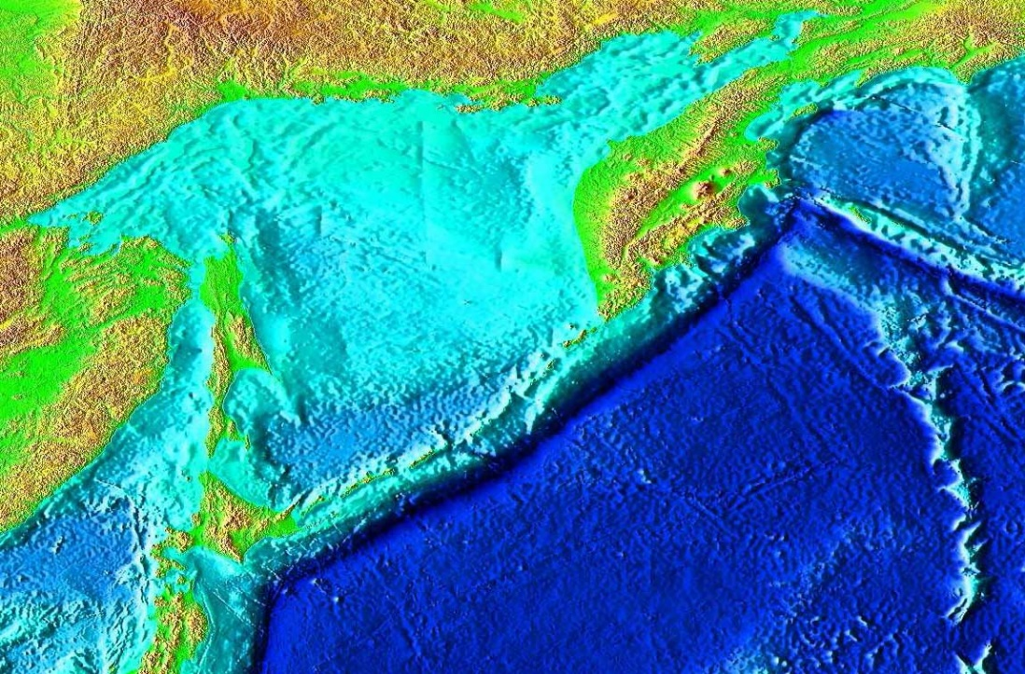
Russia
Kuril Islands
subduction zone
Japan
Notes:
Wadati-Benioff zone seen in seismicity cross-section, Kuril Islands subduction zone, 15 November 2006 8.3Mw event marked as star

Slide 15

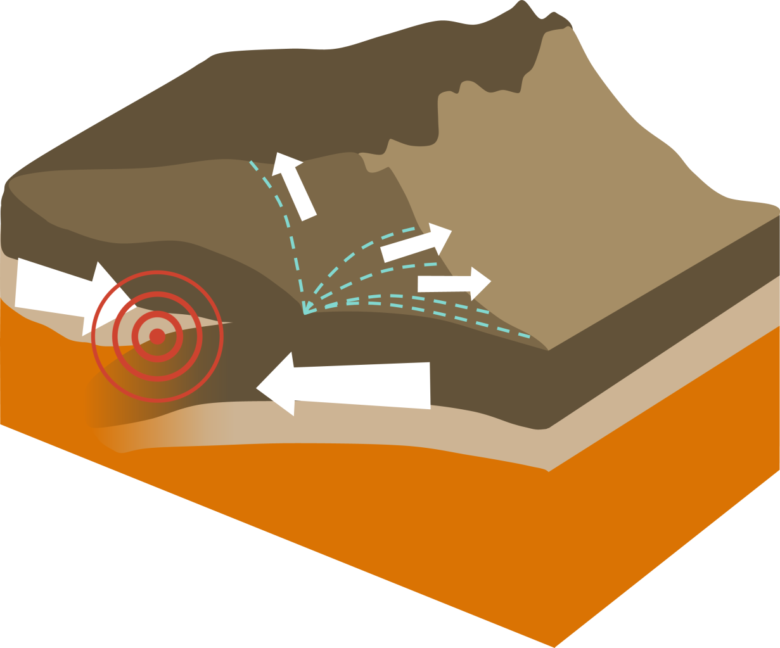





Subduction largely prevented
No Wadati- Benioff zone
Crustal thickening and deformation over large area
Broad zone (>100km) of shallow earthquakes.
Crustal thickening and deformation
Broad zone of shallow earthquakes
Notes:
When two continental plates collide at a convergent boundary they will ultimately form a wide mountain belt like the Himalaya. Because continental plates are thicker and more buoyant than oceanic plates, subduction is largely prevented during continental collision. Compressional stresses cause extensive folding and faulting of rocks within the two colliding plates. This deformation causes the crust to thicken and can extend hundreds of miles into the plate interior, causing a broad zone of shallow earthquakes.

Slide 16

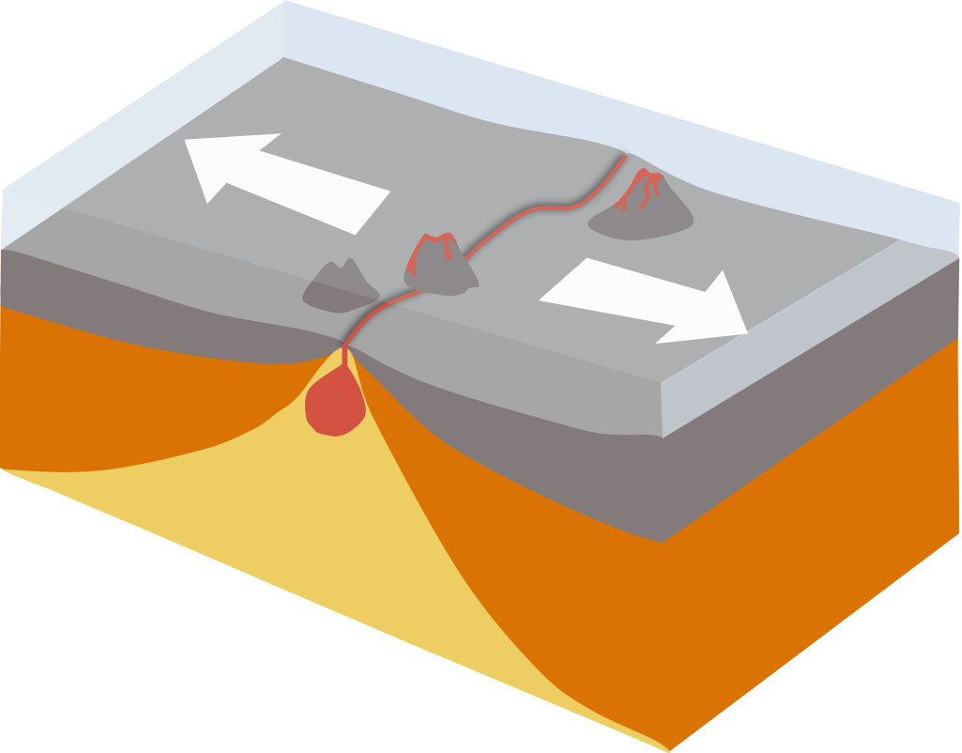


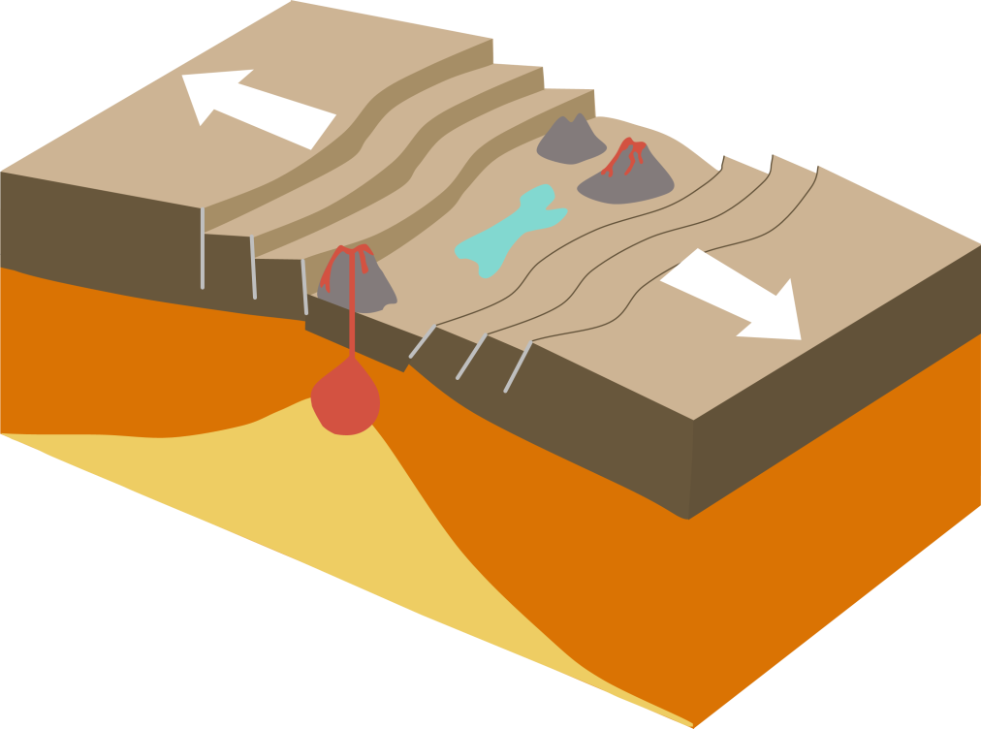





Spreading ridge
Shallow earthquakes <30km depth
Restricted to a narrow zone close to the spreading ridge
Tend to be low magnitude
Developing divergent boundary shallow earthquakes on extensional faults as crust thins
Narrow belt of earthquakes
Rift valley
Thinned crust
Earthquakes on extensional faults
Notes:
Divergent plate boundaries are sites where new oceanic crust is created by sea floor spreading. In oceans, divergent boundaries generate mid ocean ridge systems like the Mid Atlantic Ridge (slow spreading ridge) and the East Pacific Rise (fast spreading ridge). Shallow earthquakes less than 30km in depth are common at spreading ridges and are usually restricted to a narrow zone close to the spreading ridge.
Developing divergent boundaries like the East African Rift Valley (Nubian plate is pulling away from Somalian plate) have shallow earthquakes on extensional faults form crustal thinning

Slide 17

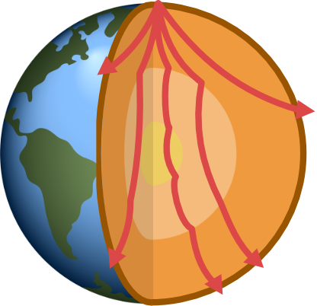
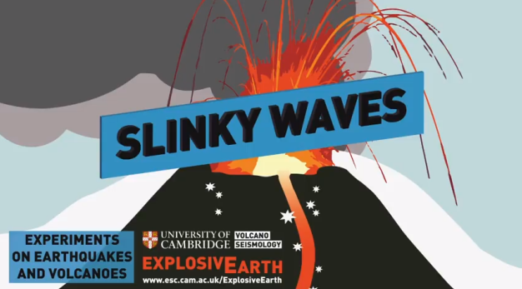

Earthquake
P Waves
Notes:
When an earthquake happens it releases vibrations which travel outward from the focus in every direction. When these vibrations reach the surface they cause the ground to shake.
The vibrations travel as waves of energy known as seismic waves. Geologists (seismologists) measure these seismic waves at different stations around the Earth to work out where an earthquake has occurred. There are a few different types of seismic waves and they move in different ways.
P waves are a type of body wave – one that moves through the interior of the Earth. P waves travel through solids and liquids and can therefore travel through the Earth’s liquid outer core and through water as well as through the Earth’s rocky layers. They travel through the Earth by pushing and pulling rocks in the direction they are travelling. P waves can also be known as compressional waves because of this pushing and pulling motion. P waves are the fastest travelling seismic wave and are the first to be detected at a seismic station after an earthquake has occurred.
Demonstrate with a slinky OR watch the first part of this YouTube video (https://www.youtube.com/watch?v=v2xhHRQkbNg)
Get two students to hold either end of a slinky (metal ones are best). To demonstrate a P- wave one student needs to push the end of the slinky towards the other student.

Slide 18

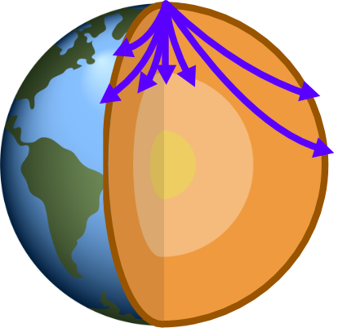
Earthquake
S Waves
Notes:
A second type of body wave is known as an S wave, these waves move from side to side or from up to down as they go forward. S waves can’t travel through liquids so they can’t travel through the Earth’s outer core which is made from liquid metal. It is this property of S waves that led geologists to work out that the Earth's outer core is liquid rather than solid.
S waves travel more slowly than P waves so arrive later at seismic stations.
Demonstrate with a slinky OR watch the second part of this YouTube video (https://www.youtube.com/watch?v=v2xhHRQkbNg)
Get two students to hold either end of a slinky (metal ones are best). To demonstrate an S wave one student move the slinky from side to side horizontally.

Slide 19

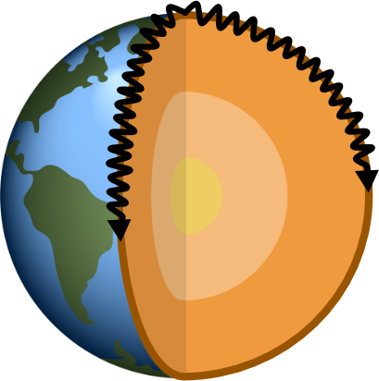
Earthquake
Surface Waves
Notes:
Surface waves are a third type of seismic wave (two types of surface wave: Rayleigh waves and Love waves). They only travel through the Earth’s crust away from the focus in all directions. They move from side to side and up and down.
Surface waves arrive after both P and S waves and are a much lower frequency wave so can be distinguished on a seismograph. It is surface waves that are almost entirely responsible for the damage and destruction associated with earthquakes.
Click to show building damage

Slide 20

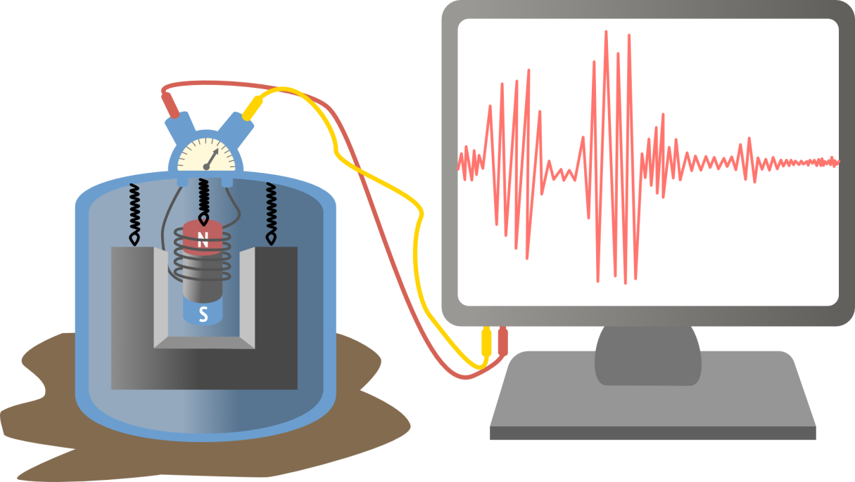
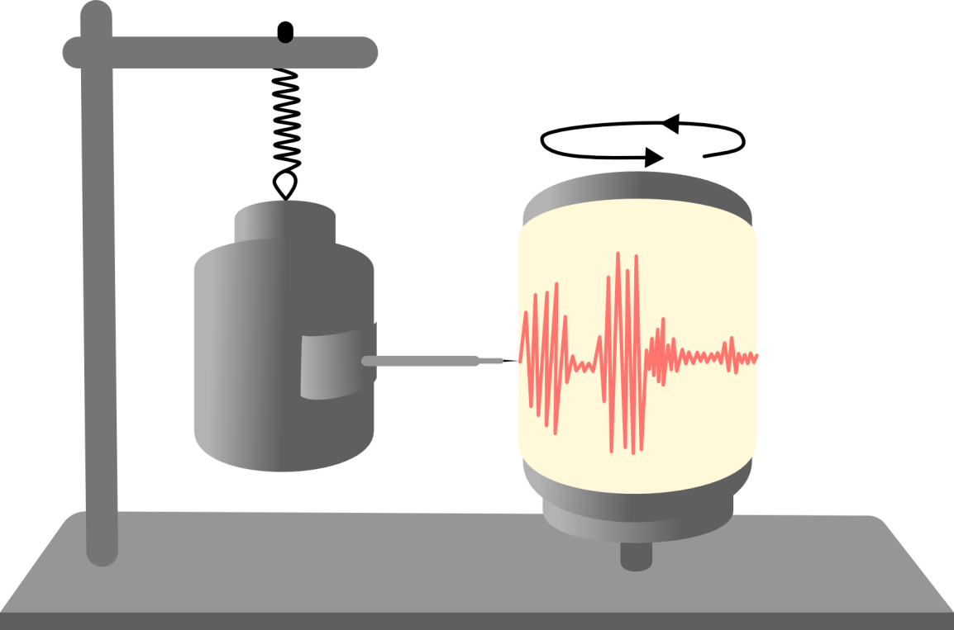
Monitor
Voltmeter
Old fashioned seismometer
Spring
Electromagnet
Weight
Rotating drum
Pen
Modern seismometer
Notes:
Seismologists measure seismic waves using instruments called seismographs. In the past, seismographs worked by having a pen suspended on a weight that then drew a line onto a rotating drum covered with graph paper. When the ground shook in an earthquake, the drum would move up and down and the pen would draw on the rotating drum. The more the ground shook the greater the amplitude and frequency of the wave. Today geologists use seismographs which operate using a similar process but instead of pen and paper they use electromagnets which generate a voltage when there is an earthquake and this voltage is then transmitted to a computer display.
The strength or size of an earthquake is called its magnitude. The bigger the earthquake, the more energy released and the bigger the earthquake’s magnitude. An earthquake with a large magnitude will make the Earth’s surface shake more and usually cause more damage than a smaller magnitude earthquake.

Slide 21

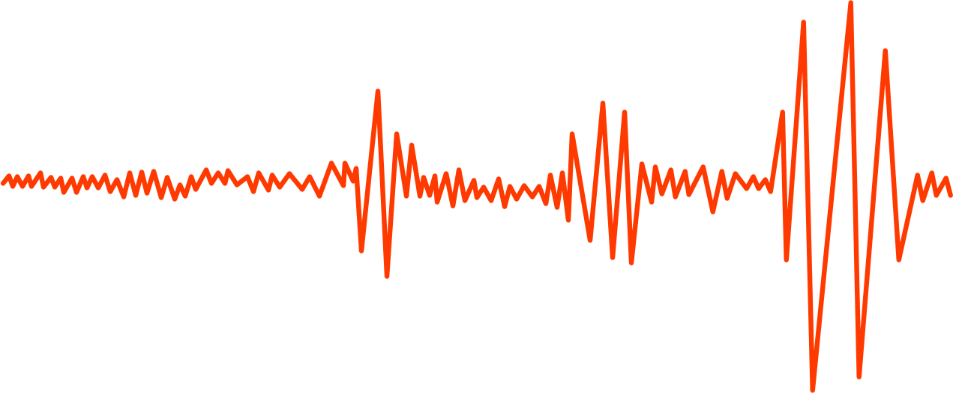
Surface waves arrive last
P waves arrive first
S waves arrive next
P - S wave time interval
Notes:
As well as working out the magnitude of the earthquake is geologists also need to work out where the epicentre of the earthquake was. They do this by looking at the P, S and surface waves. S waves travel slower than P waves which means that the further you are away from the earthquake the more spread apart these two waves will be on your seismograph.
The P- S wave time interval allows seismologists to work out how far away the earthquake occurred from their seismograph

Slide 22
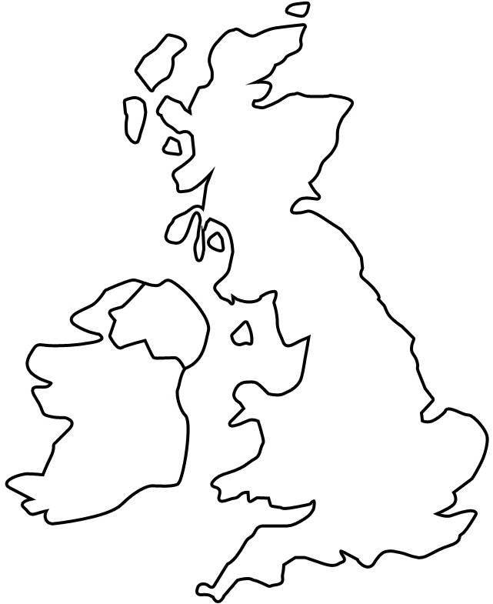
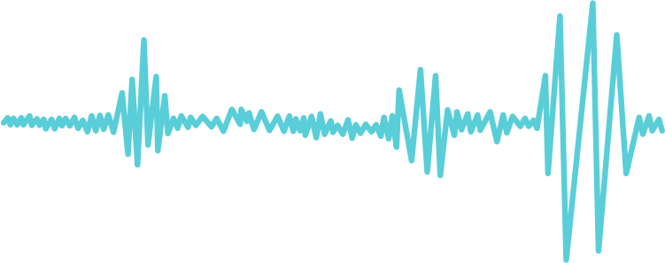
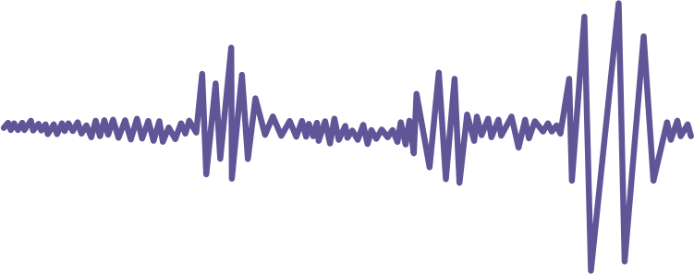
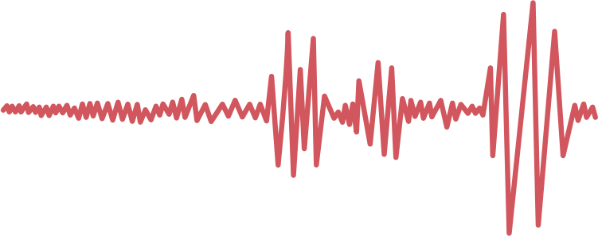
P
S
P
S
1
2
P
S
3
Notes:
Imagine an earthquake has happened in the UK – stations around the country are set up to measure seismic waves. From the seismographs, the distance from the earthquake to the recording station is calculated by the time difference between the P and S waves.
Click for Station 1
Station 1 in Newcastle detected seismic waves on their seismograph – they used the difference in time between the P and S waves to work out that an earthquake occurred 200km away but they do not know in which direction. The earthquake could have occurred at any point on the blue line so we haven’t really narrowed it down very much!
Click for Station 2
Station 2 in Belfast detected seismic waves on their seismograph too – the P and S waves they detected were slightly closer together than those detected in Newcastle. They worked out that an earthquake occurred 125km away from them. We now have two cross overs one in west Scotland and one in North Wales so we have 2 possible locations for our earthquake.
Click for Station 3
Station 3 in Cardiff also detected seismic waves. The P and S waves they detected were even closer together so the earthquake must have been closest to Cardiff out of the three cities. We now only have one spot which overlaps each of the circles so this is where the earthquake must have happened!
You need at least 3 seismic stations to be able to locate and earthquake epicenter.

Slide 23

The size of an earthquake is called its magnitude – the bigger the magnitude the more energy released
Moment Magnitude Scale (MMS or MW) is a more accurate measure of the earthquake size than the Richter Scale (not in use anymore)
Notes:
The size of an earthquake is called its magnitude – the bigger the magnitude the more energy released
The Richter scale is not used anymore to measure magnitude (even though news websites sometimes still report it!) instead the Moment Magnitude Scale is used which is a more accurate measure of earthquake size. The Moment Magnitude Scale is logarithmic - an increase of 1 step corresponds to a 10^{1.5} (about 32) times increase in the amount of energy released, an increase of two steps corresponds to a 10³ (1,000) times increase in energy.
An earthquake of M_{w} of 7.0 releases about 32 times as much energy as one of 6.0 and nearly 1,000 times that of 5.0.
The biggest earthquake ever recorded was in Chile in 1960 with a magnitude of 9.6.

Slide 24
Logarithmic
An increase of 1 step corresponds to a 10^{1.5} (about 32) times increase in the amount of energy released
An increase of 2 steps corresponds to a 10³ (1,000) times increase in energy.
An earthquake of M_{w} of 7.0 releases ~ 32 x as much energy as one of 6.0 and ~ 1,000 x that of 5.0.
Chile 1960 earthquake had a magnitude of 9.6!
Notes:
The size of an earthquake is called its magnitude – the bigger the magnitude the more energy released
The Richter scale is not used anymore to measure magnitude (even though news websites sometimes still report it!) instead the Moment Magnitude Scale is used which is a more accurate measure of earthquake size. The Moment Magnitude Scale is logarithmic - an increase of 1 step corresponds to a 10^{1.5} (about 32) times increase in the amount of energy released, an increase of two steps corresponds to a 10³ (1,000) times increase in energy.
An earthquake of M_{w} of 7.0 releases about 32 times as much energy as one of 6.0 and nearly 1,000 times that of 5.0.
The biggest earthquake ever recorded was in Chile in 1960 with a magnitude of 9.6.

Slide 25
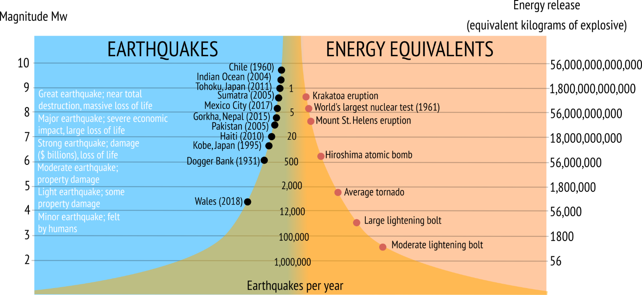

Slide 26

Measures intensity of earthquake
Qualitative
Index | Description
I | Earthquake not felt: only detected by seismometers.
III | Weak: vibrations feel like a passing truck.
V-VI | Felt by all: houses shake, windows break, furniture moves. Equivalent to 5 on the Moment Magnitude Scale
VII | Damage to poorly built structures; walls & chimneys crack
VIII-IX | Major damage. Most people unable to stand. Buildings partially collapse and shift off their foundations. Soil liquefaction can cause buildings or cars to sink into the ground or fall over.
X-XI | Severe damage. Few masonry buildings remain standing. Rails bent, bridges destroyed & damage to gas or water mains can cause fires or floods. Ground fracturing and landslides common.
XII | Damage total. Waves seen in the ground surface, objects thrown into the air.
Notes:
The effect of an earthquake on the Earth's surface is called the intensity. The intensity of an earthquake measured using the 12 point Modified Mercalli Scale which is a qualitative way of measuring the damage caused by earthquakes. It uses shaking and damage reports to describe earthquake impacts. The lower numbers of the intensity scale generally deal with the manner in which the earthquake is felt by people, higher numbers deal with structual damge to buildings. Structural engineers usually contribute information for assigning intensity values of VIII or above.

Slide 27

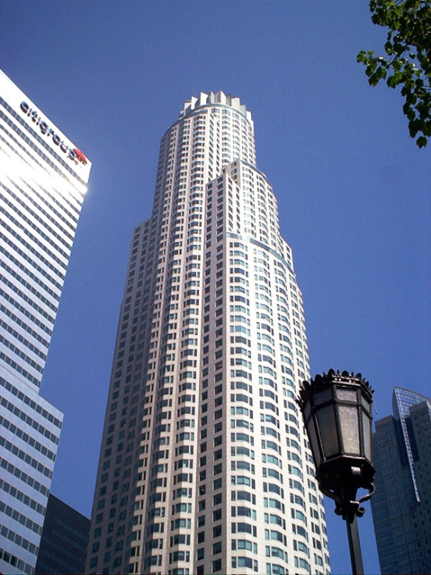
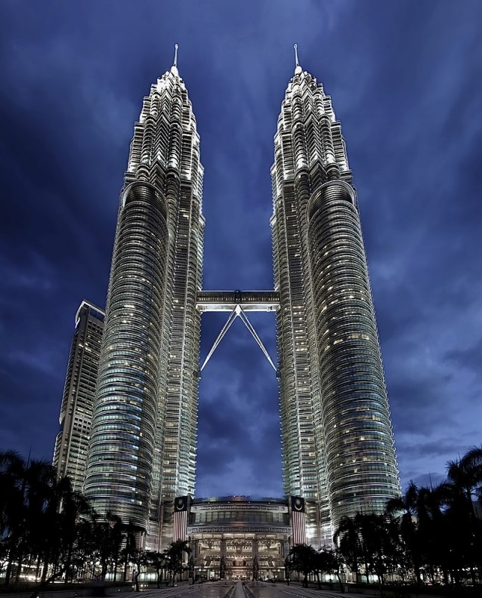
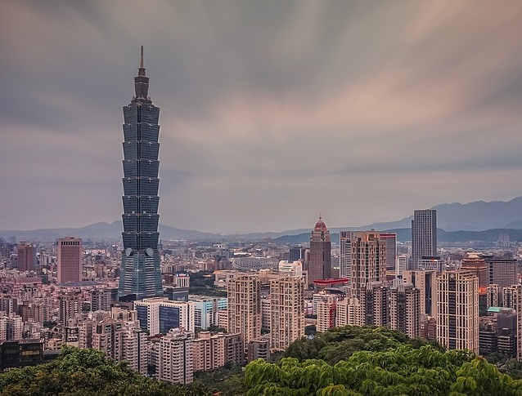
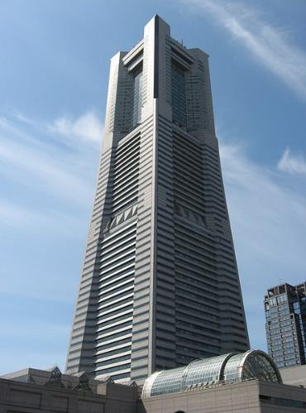

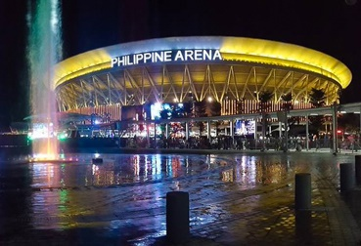
US Bank Tower
Los Angeles
Petronas Towers
Kuala Lumpur
Taipei 101
Taipei Taiwan
Yokohama\ Landmark Tower
Yokahama Japan
Transamerica Pyramid San Francisco
Philippine Arena
Bulacan, Philippines
Notes:
Over a million people have died in earthquakes over the last 2 decades from collapsing buildings. Engineering buildings to withstand earthquakes is crucial in earthquake prone regions. Here are a few buildings that have been specifically designed to withstand earthquakes.

Slide 28
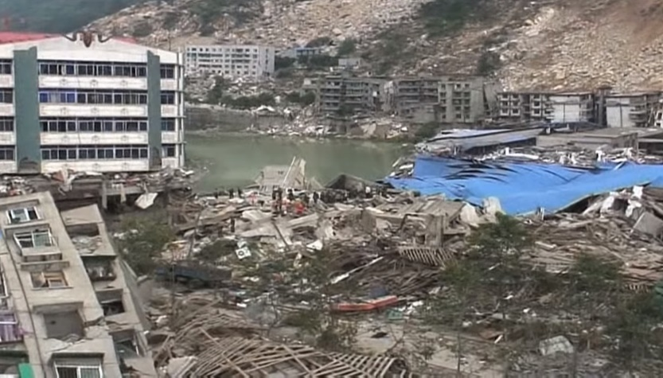
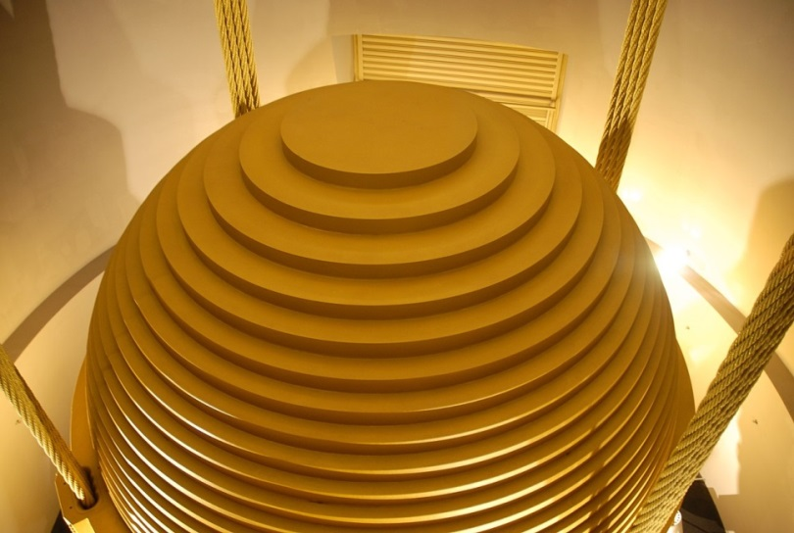
Specially designed or retrofitted
Cross bracing – diagonal supports in a X shape helps to provide strength and stop building from twisting
Sheer walls – concrete walls with steel bars helps to reduce rocking motion
66 tonne mass dampener Taipei 101
Wikimedia/guillom/CC-BY-3.0
Notes:
Watch Economist YouTube video ‘how to make a building earthquake proof’ https://www.youtube.com/watch?v=sxpi9A7_syE
All buildings can carry their own weight otherwise they would fall down by themselves. They can resist some up-and-down loads however side –to side loads and causes the worst damage during an earthquake.
Ways to make a buildings more resistant to earthquakes:
Buildings can be designed from scratch with earthquake resistant engineering in mind (expensive) or older buildings can be retrofitted to incorporate earthquake resistant engineering (less expensive)
Cross bracing – diagonal supports in a X shape helps to provide strength and stop building from twisting
Sheer walls – concrete walls with steel bars helps to reduce rocking motion
Base isolation/shock absorbers - Rubbery devices are installed near the foundation of the building to absorb the energy from an earthquake, preventing it from dissipating throughout the frame
Mass dampener - device mounted in structures to reduce the amplitude of mechanical vibrations. The Taipei 101 tower has the world’s biggest mass dampener sphere at 660-tonnes. It is suspended from the 92nd to the 87th floor and is a pendulum that sways to offset movements in the building caused by strong gusts and earthquakes.

Slide 29

EARTHQUAKE PROOFING
Other things to consider:
Building shape – symmetrical, pyramid shapes are much less likely to collapse – Japanese pagodas
Automatic shutters and windows made from shatter proof glass
Automatic shut off for gas and electricity to prevent fires
Secure bookshelves and other heavy objects to walls and floor
Open areas for safe evacuations
Good road access
Earthquake safety training
Notes:
Other things to consider:
Building shape – symmetrical, pyramid shapes are much less likely to collapse – Japanese pagodas
Automatic shutters and windows made from shatter proof glass
Automatic shut off for gas and electricity to prevent fires
Secure bookshelves and other heavy objects to walls and floor
Open areas for safe evacuations
Good road access
Earthquake safety training

Slide 30





In teams build an earthquake resistant structure that is at least 30cm tall and has a minimum of three floors.
Each floor must support one weight.
Masking tape
Lollipop sticks
Card
Notes:
Activity sheet available at www.geolsoc.org.uk/Education-and-Careers/Resources/Activity-Sheets-And-Presentations
You will need lots of paper straws or lollipop sticks, card and masking tape.
In groups students should create an earthquake resistant structure from their materials 0 structure must be at least 30cm tall, have three floors and each floor must support a 50g weight
Place structure on a tray/ shake table and test how earthquake resistant each groups structure is.
Structures with wide bases, solid foundations, symmetrical designs and cross bracing supports (two diagonal supports in an X shape) are likely to withstand the ‘earthquake’ better.

Slide 31



North American plate
Eurasian plate
Pacific plate
Honshu
Tohoku earthquake
11 March 2011
Philippine plate
Notes:
The islands of Japan lie at a point where four major tectonic plates meet: the North American, Eurasian, Philippine and the Pacific plate. Over millions of years these tectonic plates have been moving around and the Pacific plate is slowly being pushed underneath Japan. This means that Japan has had a long history of earthquakes, volcanoes and associated tsunamis.
In 2011 and earthquake occurred in Tohoku in Japan which resulted one of the most costly natural disasters of all time.

Slide 32
CASE STUDY: TOHOKU, JAPAN
Magnitude 9.0 MW earthquake occurred 72km east of Tohoku on 11 March 2011 at 14:46 local time.
The earthquake generated a huge tsunami – waves reached 39m in height when they hit the coast of Honshu
Japan's earthquake early warning system gave Tokyo residents 1 minute of warning. High-speed trains and factory assembly lines were stopped
Notes:
The earthquake occurred in the ocean 72 km off the coast of the Tohoku region of Japan (yellow on the map) on the 11 March 2011 at 14:46 local time.
It was a magnitude of 9 making it one of the largest ever earthquakes recorded. Because earthquake occurred beneath the sea it triggered a tsunami that was 39 m high when it hit the coast of northern Honshu, the largest island of Japan.
The tsunami caused widespread flooding, destroyed buildings and shutdown the Fukushima nuclear power station (more next slide).
Japan's earthquake early warning system gave Tokyo residents 1 minute of warning before earthquake struck. High-speed trains and factory assembly lines were stopped potentially saving thousands of lives.

Slide 33
CASE STUDY: TOHOKU, JAPAN
People received texted alerts of the earthquake and tsunami warnings on their phones
15,894 fatalities and 6,156 injuries, estimated cost $235 billion
400km of Japan's northern Honshu coastline dropped by 0.6m
The earthquake shifted Earth on its axis of rotation and shortened the length of a day by about a microsecond.
Notes:
People across Japan received texted alerts of the earthquake and tsunami warnings on their phones so they could try and get to safety.
As a result of the earthquake and tsunami 15,894 people died, over 6000 were injured and 230,000 people were left homeless. This natural disaster cost the Japanese government $235 billion dollars.
400km of Japan's northern Honshu coastline dropped by 0.6m
The earthquake shifted Earth on its axis of rotation and shortened the length of a day by about a microsecond.

Slide 34

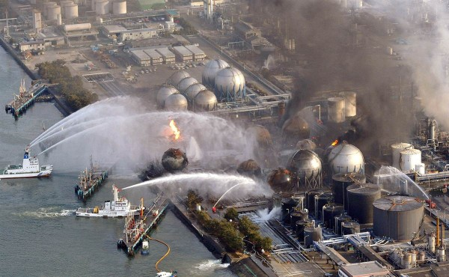
Flood waters from tsunami shut down electric power to the Fukushima Daiichi nuclear power station which caused a cooling system failure and meltdown of the radioactive cores.
Harmful radioactive materials were released into the sea water
People within 20km of the power station were evacuated those living within 20-30km were advised to stay indoors
Fukishima nuclear power station
© www.fukishimawatch.com
Notes:
Flood waters from tsunami shut down electric power to the Fukushima Daiichi nuclear power station which caused a cooling system failure and meltdown of the radioactive cores.
Harmful radioactive materials were released into the sea water
People within 20km of the power station were evacuated those living within 20-30km were advised to stay indoors

Slide 35

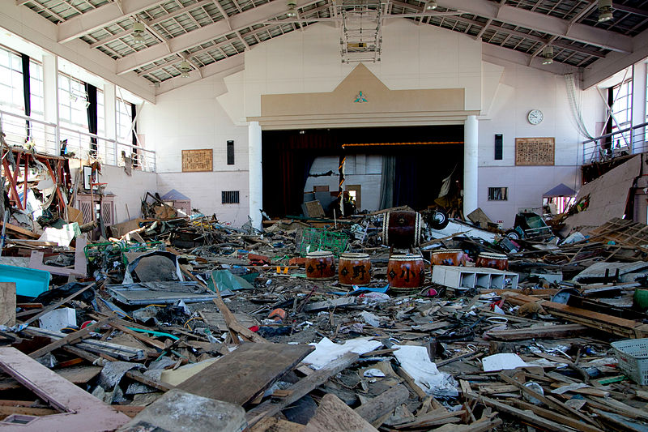
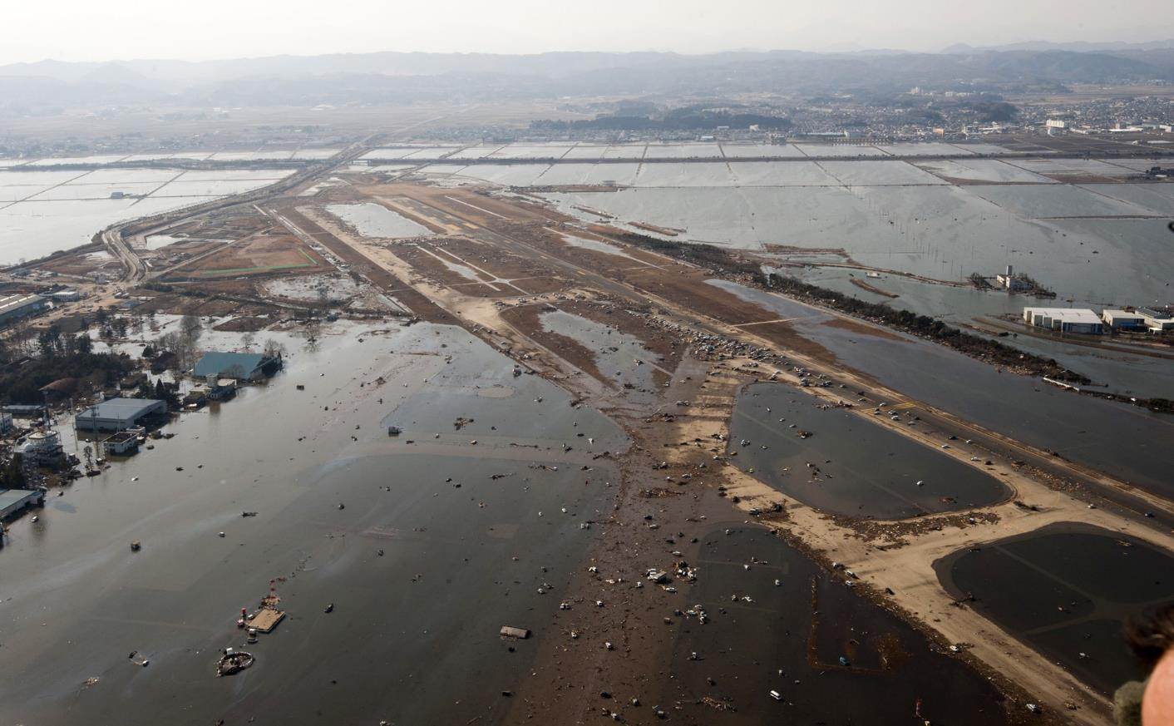
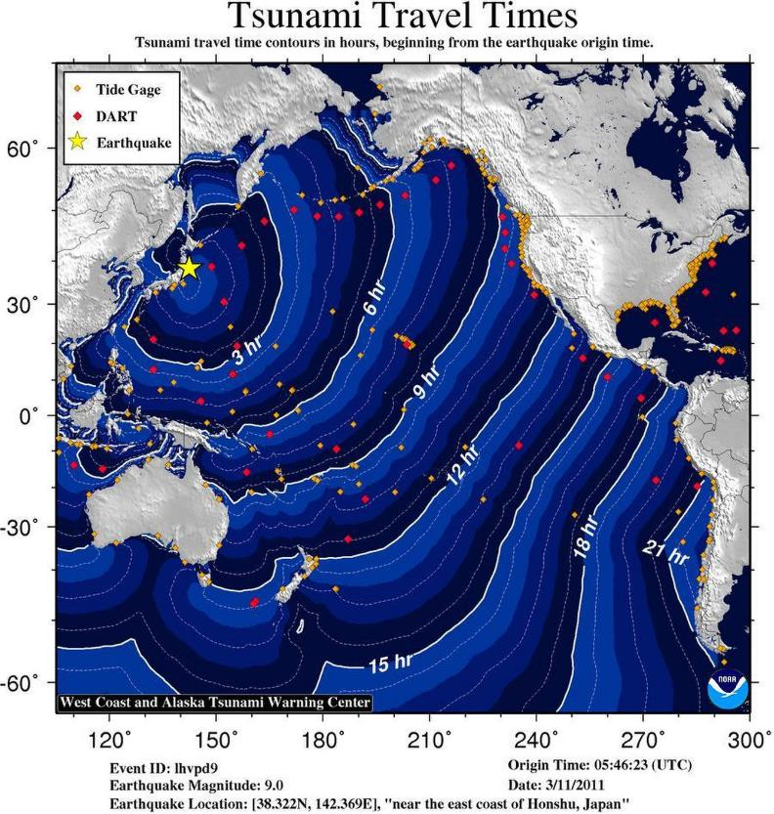
Damage to a primary school gymnasium in Nakano, Japan
The tsunami carried ~5 million tons of debris out to sea. Japanese docks and ships, and countless household items, have arrived on U.S. and Canadian shores in the years since.
Flooding in Sendai Airport from the tsunami
Notes:
Damage to a school gymnasium
Flooding of Sendai airport
Map of the tsunami wave. The tsunami carried ~5 million tons of debris out to sea. Japanese docks and ships, and countless household items, have arrived on U.S. and Canadian shores in the years since.

Slide 36


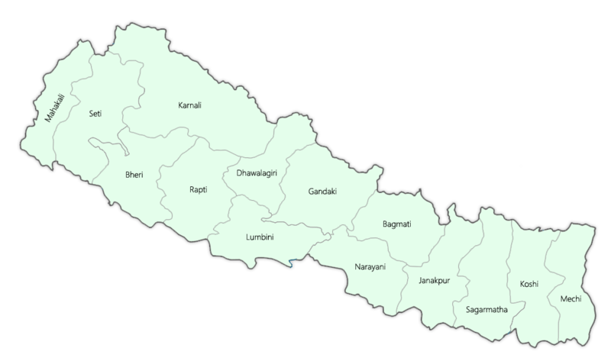

China
Nepal
Gorkha earthquake
25 April 2015
Mount Everest
India
Kathmandu
Notes:
For the past 50 million years, the Indian plate has been travelling northwards into the Eurasian plate. This collision has caused the land to crumple, building the Himalayas, the largest mountain chain currently on Earth. As India moves into Eurasia, friction causes stress to build up. The stress is released when the plates suddenly move. These earthquakes greatly affect the countries of the Himalayas, such as Nepal, India and Pakistan.
In 2015 an earthquake struck the Gorkha region of Nepal.

Slide 37
Magnitude 7.8 MW earthquake
25 April 2015 at 11:56 local time in Gorkha, Nepal
8,964 fatalities and 100,000s made homeless
Fatalities may have been minimized as most villagers were outdoors working when the quake hit and also because the earthquake hit on a Saturday which meant that children and teachers were not inside the collapsing school buildings.
Notes:
The earthquake occurred on the 25 April 2015 at 11:56 local time. It had a magnitude of 7.8.
Almost 9000 people were killed in the earthquake however this death toll may have been minimized by the fact that most villagers were outdoors working when the quake hit meaning that they were not crushed by falling buildings, and also because the earthquake hit on a Saturday which meant that children and teachers were not inside the collapsing school buildings.
At Mount Everest, the earthquake resulted in an avalanche at base camp which killed 22 people, making it the deadliest day in Everest history.
Because Nepal is a very poor country the effects of the Gorkha earthquake will affect its economy for many years to come. Since the earthquake UNESCO has helped to rebuild damaged sites with extra reinforcements to protect them from future earthquakes. Other public buildings such, as schools, are also being built with earthquakes in mind and students are receiving disaster emergency training so that they know how to react should another earthquake occur.

Slide 38
Mount Everest avalanche killed 22 people
Since the earthquake UNESCO has helped to rebuild damaged sites with extra reinforcements to protect them from future earthquakes.
Other public buildings such as schools are being built to be more resistant to earthquakes
Notes:
The earthquake occurred on the 25 April 2015 at 11:56 local time. It had a magnitude of 7.8.
Almost 9000 people were killed in the earthquake however this death toll may have been minimized by the fact that most villagers were outdoors working when the quake hit meaning that they were not crushed by falling buildings, and also because the earthquake hit on a Saturday which meant that children and teachers were not inside the collapsing school buildings.
At Mount Everest, the earthquake resulted in an avalanche at base camp which killed 22 people, making it the deadliest day in Everest history.
Because Nepal is a very poor country the effects of the Gorkha earthquake will affect its economy for many years to come. Since the earthquake UNESCO has helped to rebuild damaged sites with extra reinforcements to protect them from future earthquakes. Other public buildings such, as schools, are also being built with earthquakes in mind and students are receiving disaster emergency training so that they know how to react should another earthquake occur.

Slide 39

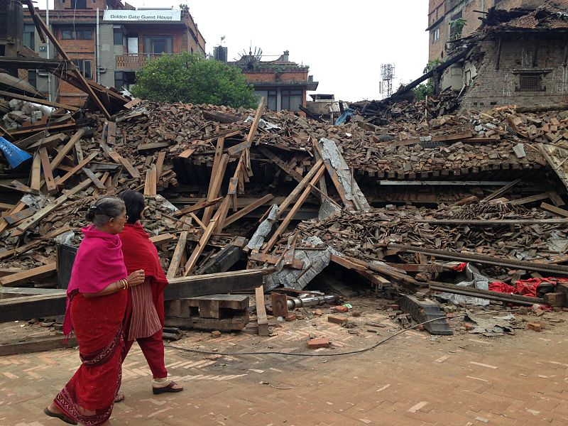
Collapsed buildings in Chautara, Nepal
Earthquake destruction in Bhaktapur, Nepal

Slide 40

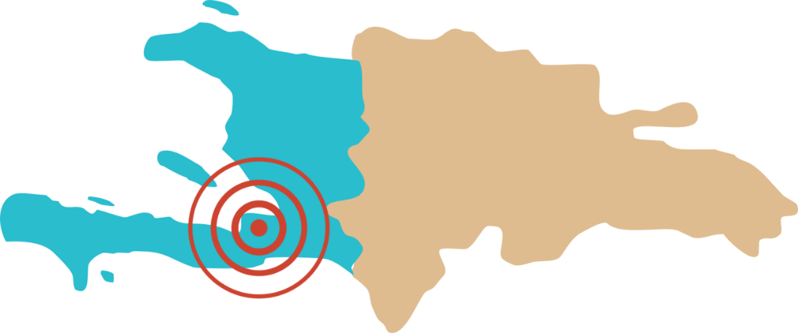
Haiti earthquake
12 January 2010
Haiti
Dominican Republic
Port-au-Prince
Notes:
Haiti lies on a conservative or transform boundary between the Caribbean plate and the North American Plate. Haiti is a very poor country with a GDP of $739 per person therefore earthquakes have catastrophic effect the country’s economy and loss of life.

Slide 41
CASE STUDY: HAITI
Magnitude 7.0 MW earthquake
January 12 2010 at 16:53 local time – Enriquillo-Plantain Garden Fault
Epicentre 25km east of capital city Port-au-Prince
180,000 homes, 5000 schools and 30,000 commercial buildings destroyed – lack of building regulations
230,000 fatalities
Notes:
At 16:53 on January 12th 2010 the island of Haiti was struck by a powerful 7.0 magnitude earthquake which occurred 25km east of the capital city Port-au-Prince. The earthquake occurred 13km below the surface on the Enriquillo-Plantain Garden Fault which slipped 1.8m over a distance of 65km.
The earthquake devastated large parts of the capital Port-au-Prince and resulted in massive loss of life making it one of the most destructive earthquakes of all time.
180,000 homes and 5000 schools were damaged or destroyed. The international airport was unusable as the control tower was badly damaged. A lack of building regulations meant that buildings in Haiti were built with poor quality, cheap materials and these simply crumbled when the earthquake struck.
230,000 people were killed and 1.5 million people were made homeless. Homeless people had to live in 1100 squalid camps with limited services such as water and sanitation for over a year. Cholera claimed the lives of several hundred people mainly children.
Service such as electricity, water , sanitation and communications were badly disrupted or destroyed.
Total damage bill was around $11.5 billion.

Slide 42
CASE STUDY: HAITI
Electricity, water, sanitation and communications badly disrupted – no signal for mobile phones
1.5 million made homeless – 1100 camps set up for people to live in for more than a year. Camps had limited fresh water and sanitation and there were outbreaks of cholera.
Estimated cost $11.5 billion
Notes:
At 16:53 on January 12th 2010 the island of Haiti was struck by a powerful 7.0 magnitude earthquake which occurred 25km east of the capital city Port-au-Prince. The earthquake occurred 13km below the surface on the Enriquillo-Plantain Garden Fault which slipped 1.8m over a distance of 65km.
The earthquake devastated large parts of the capital Port-au-Prince and resulted in massive loss of life making it one of the most destructive earthquakes of all time.
180,000 homes and 5000 schools were damaged or destroyed. The international airport was unusable as the control tower was badly damaged. A lack of building regulations meant that buildings in Haiti were built with poor quality, cheap materials and these simply crumbled when the earthquake struck.
230,000 people were killed and 1.5 million people were made homeless. Homeless people had to live in 1100 squalid camps with limited services such as water and sanitation for over a year. Cholera claimed the lives of several hundred people mainly children.
Service such as electricity, water , sanitation and communications were badly disrupted or destroyed.
Total damage bill was around $11.5 billion.

Slide 43
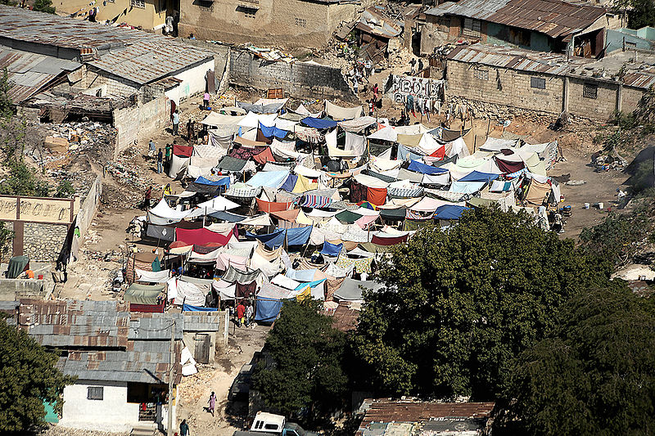
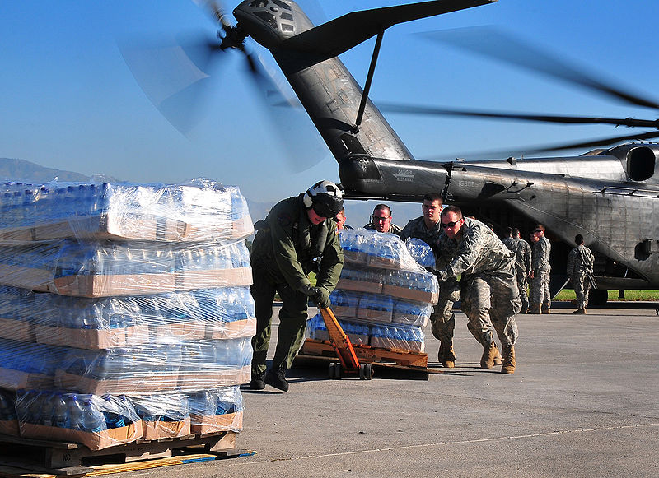



Make shift shelters in Port-au-Prince
US Army and Navy soldiers help unload food and supplies in Port-au-Prince
Haitian woman pulled out from rubble
Damage in a poor neighbourhood
UN Photo/Logan Abassi/CC-BY-2.0

Slide 44

Earthquakes are vibrations caused by the movements of the Earth’s tectonic plates. They occur when stresses built up in tectonic plates are suddenly released.
Earthquakes occur at plate boundaries.
Earthquakes release seismic waves – P waves, S waves and surface waves which are measured using a seismograph
Notes:
Earthquakes are vibrations caused by the movements of the Earth’s tectonic plates. They occur when stresses built up in tectonic plates are suddenly released.
Earthquakes occur at plate boundaries.
Earthquakes release seismic waves – P waves, S waves and surface waves which are measured using a seismograph
The Moment Magnitude Scale measures the magnitude of an earthquake – quantitative
The Modified Mercalli Scale measures the intensity of an earthquake – qualitative
Buildings can be designed or retrofitted to be more resistant to earthquakes

Slide 45
The Modified Mercalli Scale measures the intensity of an earthquake – qualitative
Buildings can be designed or retrofitted to be more resistant to earthquakes
Haiti 2010, Nepal 2015 and Tohoku 2011 earthquake case studies

