Slide 1



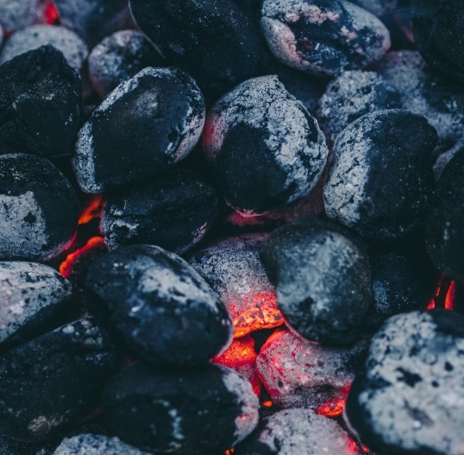
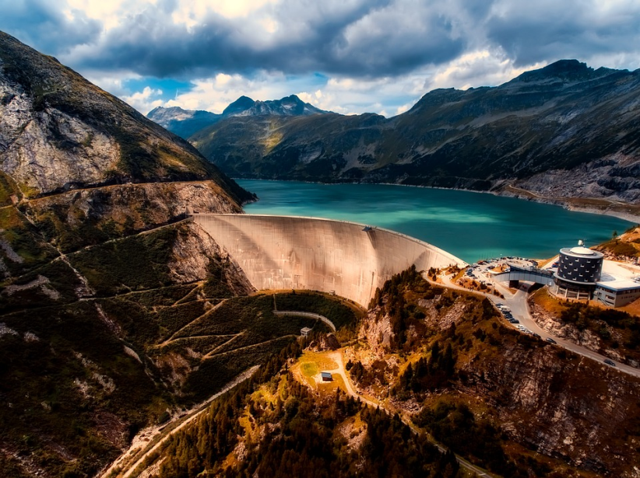
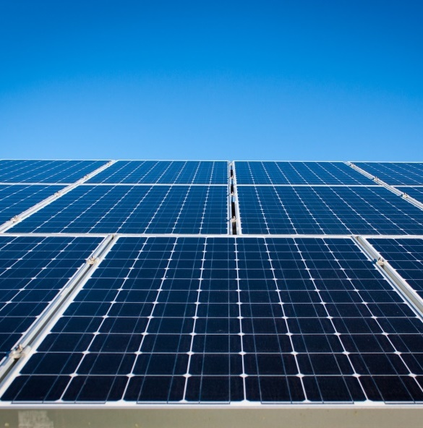
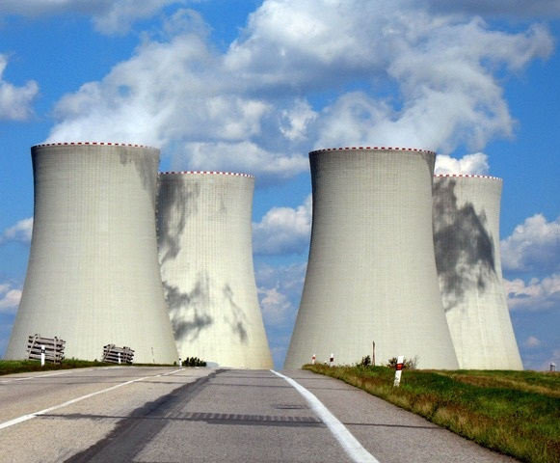
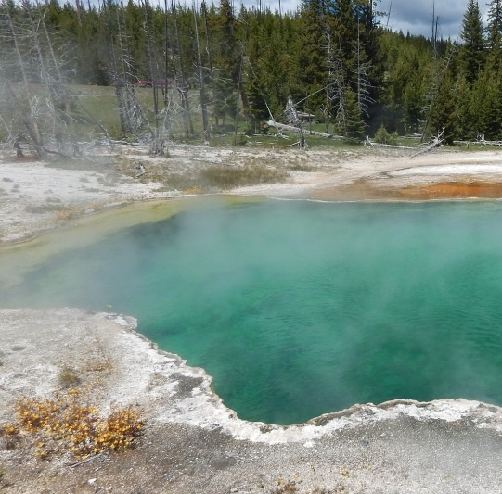
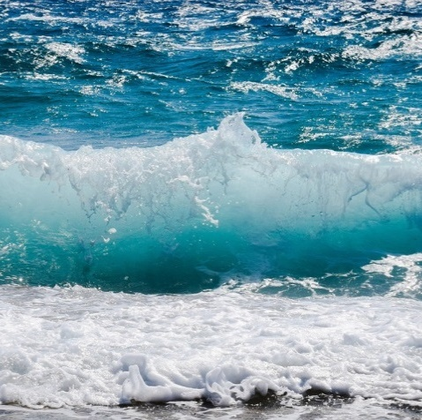
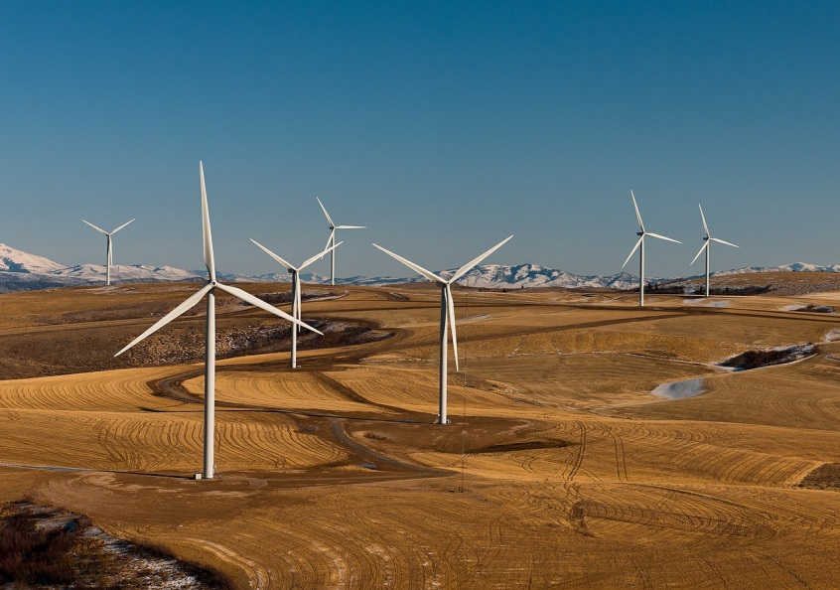
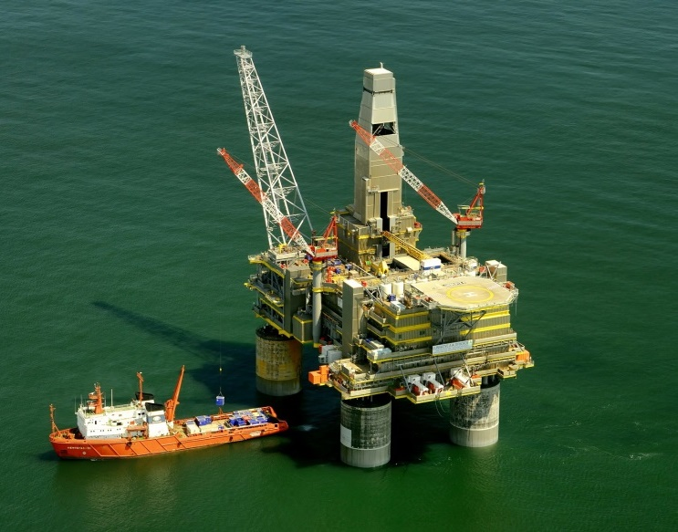
Notes:
Learning objectives
To understand and that energy resources are a type of natural resource
To understand the difference between non-renewable and renewable energy resources
To be able to describe examples of non-renewable and renewable resources and discuss some of the positives and negatives
To understand the basics of how energy sources are used to produce heat and energy
To understand that appliances in the home use energy
To understand that recycling products is a way of saving energy

Slide 2


What is a natural resource?
What natural resources do you know?
Notes:
Teachers to ascertain class knowledge

Slide 3
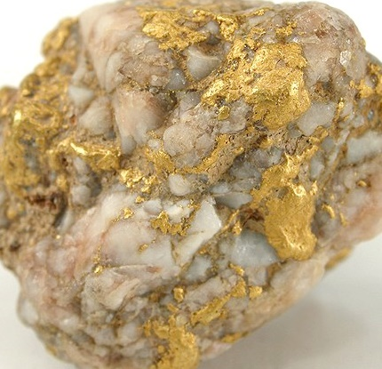
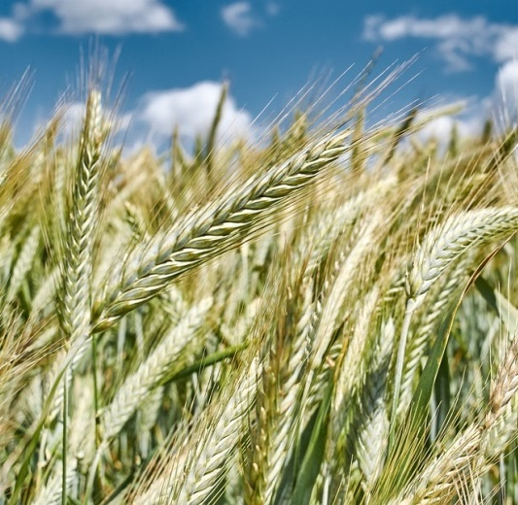

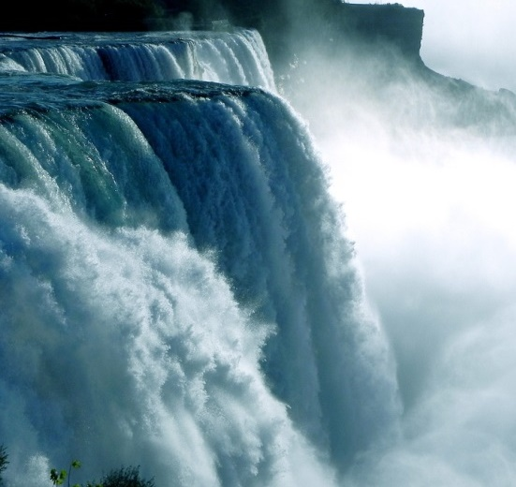
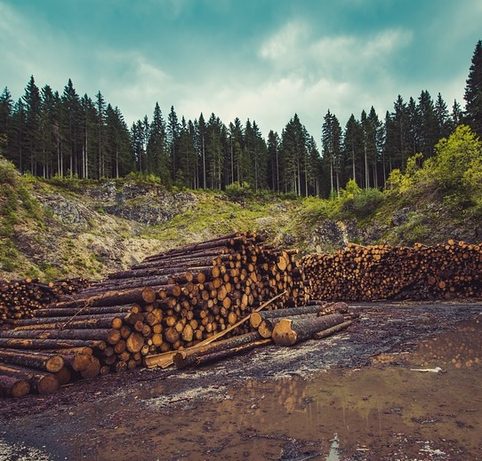
Natural resources – natural substances required by humans for different needs.
Metals and minerals
Rainforests
Crops
Water
Coal, oil and gas
Forests
Notes:
Natural resources are any kind of natural substance which is required (or desired) by humans. Different natural resources occur in different countries and regions and are not are spread equally. As a result, countries trade their natural resources to ensure that their needs can be met.
Some examples of natural resources – discuss why they are important e.g. minerals and metals like iron, gold, copper, silicon are used as building materials and in technology such as computers, phones and cars, forests and rainforests are used for timber and medicines as well as being important habitats for thousands of species of animals, plants and fungi, crops like wheat, vegetables and fruits are grown for food, water is used for drinking, washing, and generating energy, animals such as fish are caught for eating, fossil fuels like coal, oil and gas are burnt for energy.

Slide 4

What is an energy resource?
What energy resources do you know?
Notes:
Teachers to ascertain class knowledge

Slide 5


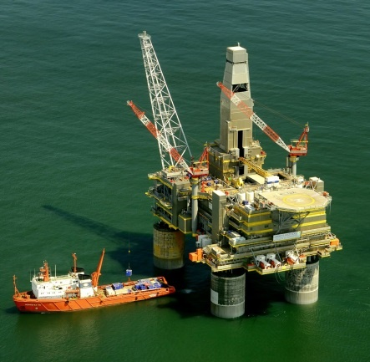
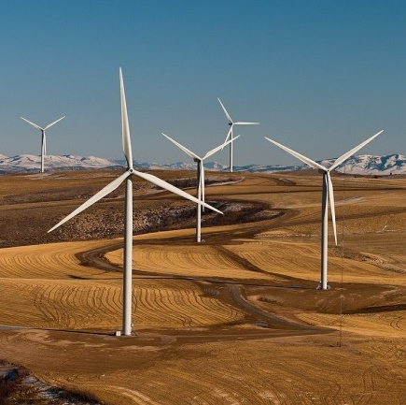
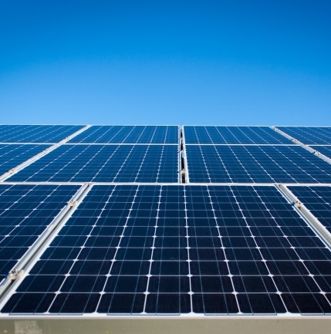
Natural resources such as oil, gas, coal, wood, wind, sunlight and waves can be used to produce energy. These are energy resources.
Waves/
Water
Coal
Oil & gas
Sunlight
Wind
Notes:
Energy resources such as oil, gas, coal, wood, wind, waves, sunlight, heat from the ground (geothermal) are types of natural resources. They can be used to produce heat and electricity.
Get students to guess which energy resources are being represented in the images – click for answers

Slide 6




What is a non-renewable energy resource?
What is a renewable energy resource?
Notes:
Teachers to ascertain class knowledge

Slide 7
Non-renewable energy sources are things like oil, natural gas and coal. They cannot be easily replaced, because they have taken millions of years to form.
We are using them faster than they are being made. This means that one day they will run out!
Renewable energy resources like wind power, wave power, solar power and biofuel can be easily replaced and will not run out.
Notes:
Energy sources are either renewable or non-renewable. At present in the UK we use a mixture of non-renewable and renewable energies.
Non-renewable energy sources are things like oil, natural gas and coal. They cannot be easily replaced, because they have taken millions of years to form. A problem with non-renewable energy source is that we as a planet are using them up faster than they are being made. This means that one day they will run out
Renewable energy resources like wind power, wave power, solar power and biofuel will not run out or can be easily replaced so economies are trying to move towards greater reliance on renewable energy sources.

Slide 8






Oil (petroleum)
Natural gas
Non- renewable
Coal
Nuclear power
Notes:
Non renewable energy resources include coal, gas, oil and nuclear power. Coal gas and oil are sometimes known as fossil fuels. Fossil fuels are finite resources they will not be around for ever. They are no longer being made or are being made extremely slowly so they cannot be easily replaced. Nuclear power is also considered a non-renewable energy source (although it is not traditionally grouped with the fossil fuels) there is only a certain amount of uranium in the Earth that can be used to made nuclear power so it is a finite resource.
About three-quarters of the electricity generated in the UK comes from power stations fueled by fossil fuels. Energy from the burning fuel is used to boil water. The steam from the boiling water turns turbines, and these power generators which generate electricity.
Pros
Fossil fuels and nuclear power are very efficient this means that a burning a small amount of oil, gas or coal, or reacting a small amount of uranium releases a lot of energy.
Fossil fuels are convenient because they can be used whenever (they don’t rely on certain environmental conditions e.g. lots of wind) they can be transported easily
It is relatively cheap to generate electricity from burning fossil fuels
Fossil fuels are well established – humans have ben using fossil fuels for the past 200 years so our towns and cities are built to make transporting and using fossil fuels easy
Cons
Unfortunately, the use of fossil fuels releases large amounts of carbon dioxide and other gases into the atmosphere. Carbon dioxide is a greenhouse gases (meaning that is causes the atmosphere to become warmer) and is contributing to dangerous levels of global warming and climate change.
Fossil fuels also release pollutants such as sulfur dioxide and nitrogen dioxide which cause acid rain. Acid rain harms sensitive ecosystems such as lakes and forests.
Methods used to access fossil fuels such as mining and drilling for oil can harm the environment e.g. oil spills can devastate marine wildlife.

Slide 9


Earth’s crude oil and natural gas is formed from marine plants and animals that died millions of years ago
1. Dead microscopic animals and plants sink to the bottom of the ocean and become buried with other sediments (sand and mud)
Phytoplankton & zooplankton
Organic rich sediments
Layers of sediment
Notes:
All of Earth’s crude oil and natural gas is formed from marine plants and animals (microscopic ones not dinosaurs!) that died millions of years ago. When they died the microorganisms sank to the bottom of the ocean and were gradually covered in layers of sediment (sand, mud and silt).

Slide 10

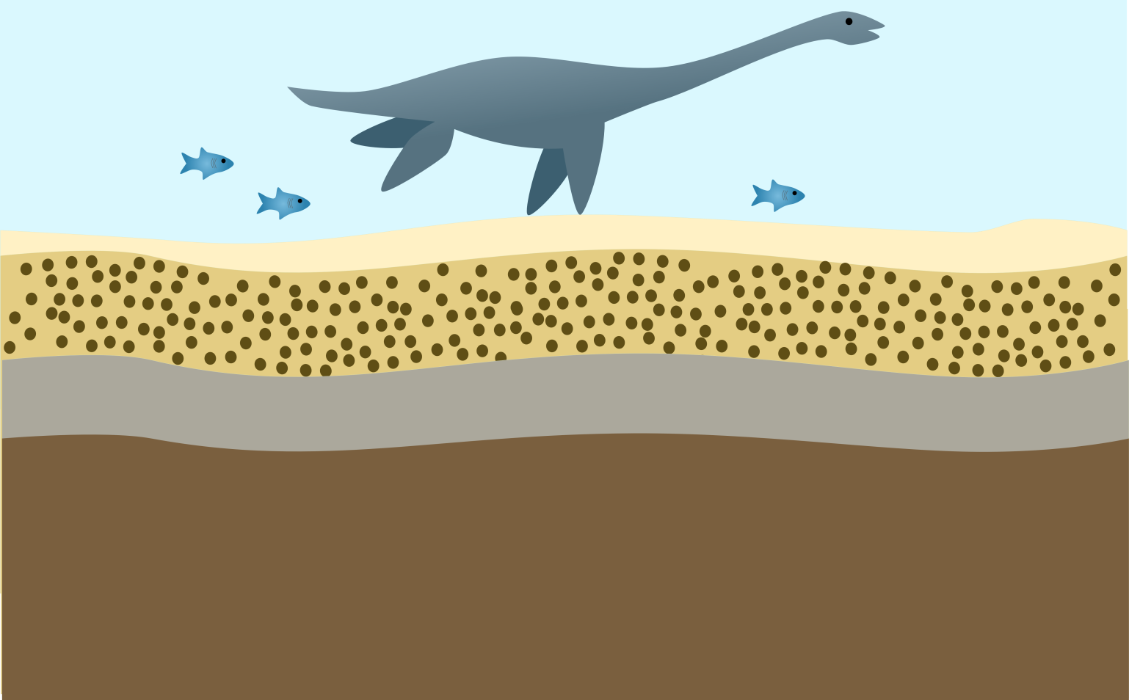
2. Over millions of years these sediments get buried deeper and deeper. Temperature and pressure rises and the microorganisms in the sediment are turned into gas and oil
Organic rich sediments
Notes:
Over millions of years the organic rich sediments (sediments containing microorganisms) become buried deeper and deeper as layers of new sediment piles up on top. As they are buried, heat and pressure rises turning the microorganisms into oil and natural gas.

Slide 11

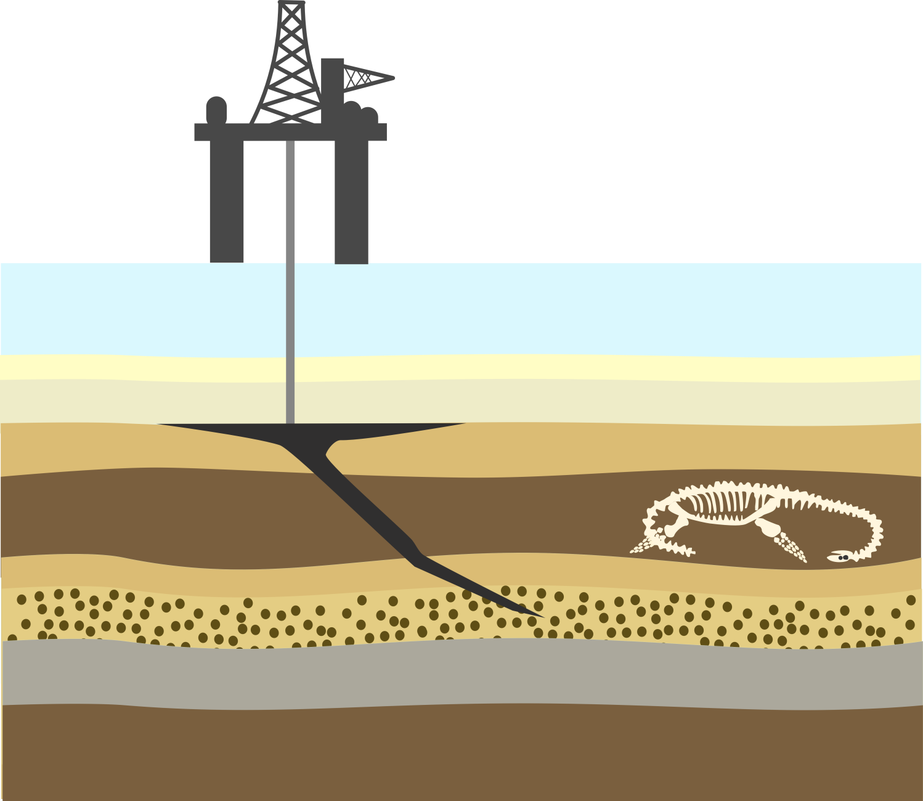
3. Oil and gas move upwards through tiny pores in the rock. Oil and gas gets trapped under impermeable layers of rock and can be then be taken out using long powerful drills.
Oil rig
Drill
Sea
Impermeable rock
Oil
Oil rich source rock
Notes:
Oil and natural gas are lighter than the surrounding rock so once they have formed they move upwards through tiny pores (gaps) and fractures in the surrounding rock. Some oil and natural gas manages to get all way to the surface and escapes through vents into the atmosphere. Other oil and natural gas deposits get trapped under impermeable layers of rock or clay (layers with no pores). These trapped deposits are where we find oil and natural gas today and they are extracted by using long powerful drills.

Slide 12









Oil & gas
burned to heat water
steam propels turbine
Electricity
Crude oil is turned into jet engine oil, petrol and diesel which are used as a fuel in planes and cars.
When oil and gas are burnt they release carbon dioxide gas into the atmosphere. CO2 is a greenhouse gas and contributes to global warming.
Notes:
Oil and gas can be burnt to produce electricity, to do this oil is burned in power plants to heat water and produce steam. This steam (which has kinetic energy) then propels the blades of a turbine (mechanical energy), a sort of engine that rotates. The turbine is attached to a generator and when it spins it produces electricity (electrical energy).
Oil is also be used as fuel in cars, planes, buses and trains (chemical energy). Before it can be put into cars at the petrol station, crude oil has to be refined in an oil refinery to turn it into different fuels like petrol, diesel and jet engine fuel.
Oil can also be turned into various different types of plastic and chemical products so it is an extremely valuable natural resource.
When oil and gas are burnt they release carbon dioxide gas (CO2) into the atmosphere. CO2 is a greenhouse gas and contributes to global warming.

Slide 13

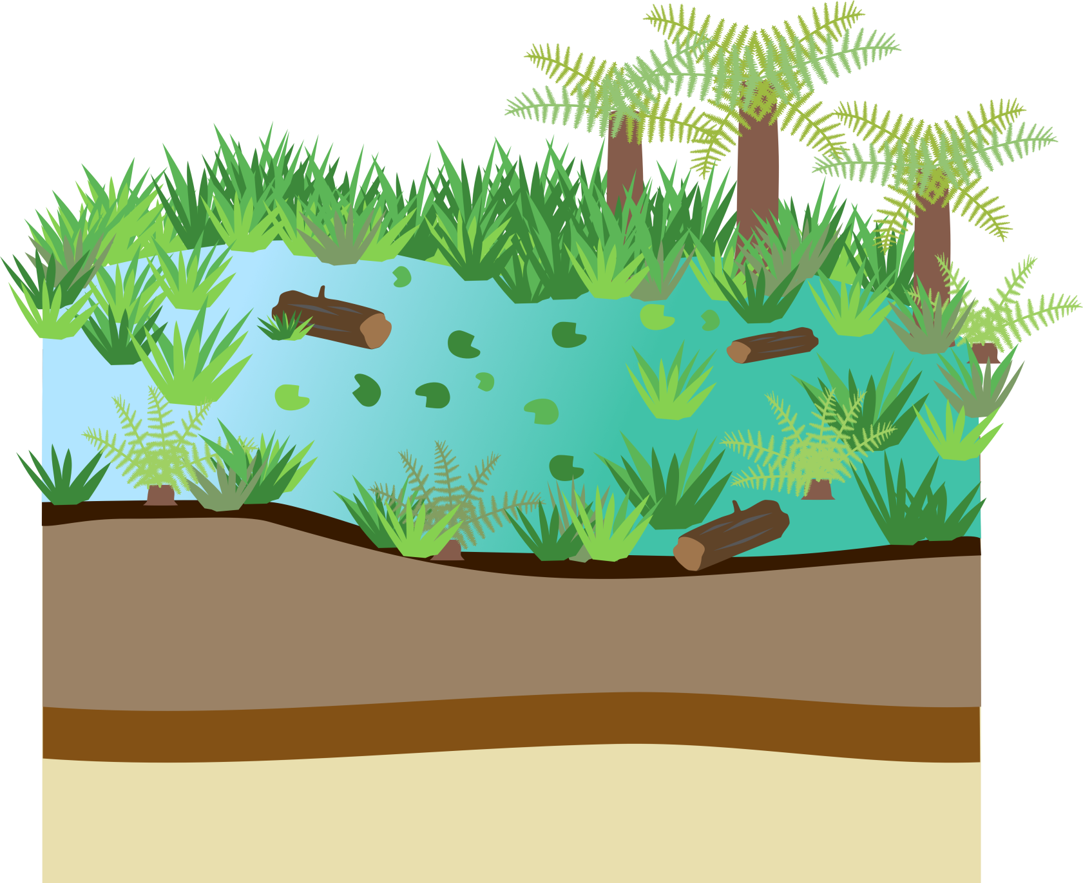
Carboniferous Period 360-299 million years ago
Tropical swamp
Older rock layers
Notes:
Most of the coal we have on Earth today was formed during a time called the Carboniferous period 360 – 299 million years ago (before the dinosaurs!) when much of the Earth including the UK was covered in tropical swamps.

Slide 14
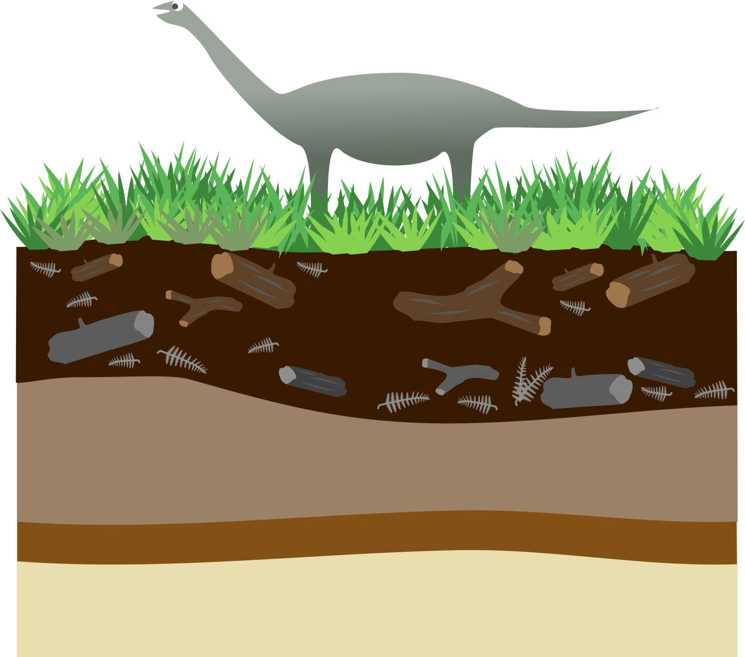
Jurassic Period
201- 145 million years ago
Dead plants turn into peat
Older rock layers
Notes:
As the plants died their remains sank to the bottom of the swampy areas, making layers and layers of squashed plant material. This eventually turned into a brown spongey material called peat.

Slide 15
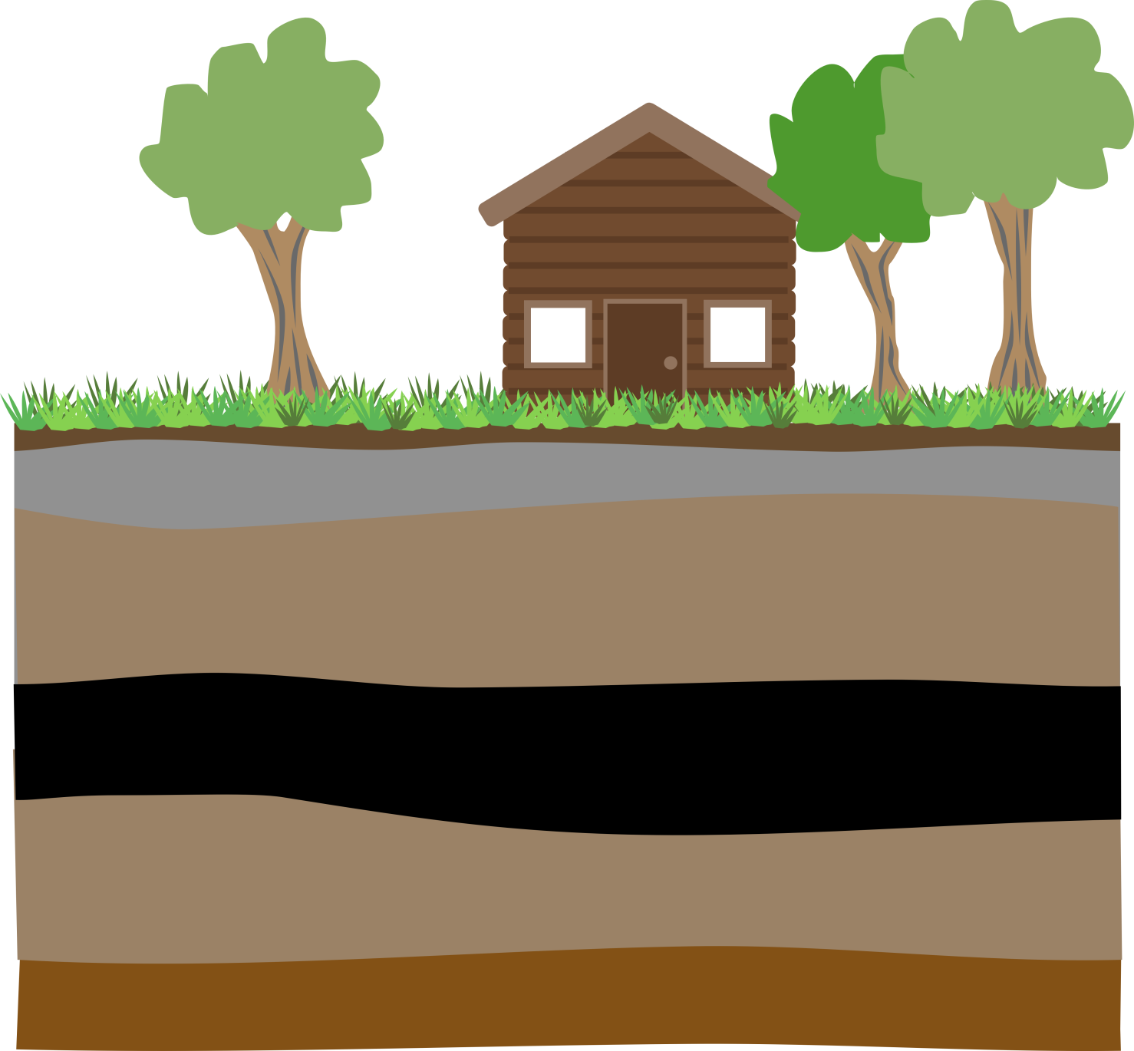
Modern day
Heat
Pressure
Peat turns into Coal
Older rocks
Notes:
Over millions of years and with changing environments layers rock began to build up on top of the peat and became buried. As the peat was buried further and further heat and pressure acting upon it turned it into coal. The hotter the temperature, the deeper the coal is buried and the longer the amount of time the coal is buried, the better (more efficient) coal you get – anthracite is the name of the most efficient coal.
Coal is still being produced today in swampy tropical regions but because it takes millions of years to form it is not a renewable resource.

Slide 16




Coal
burned to heat water
steam propels turbine
Electricity
Coal is cheap and there is lots of it!
When coal is are burnt it releases carbon dioxide, sulphur dioxide and nitrogen dioxide into the atmosphere contributing to global warming and acid rain.
burned for heat
Notes:
Coal can be burned for heating (think BBQs!) or for electricity in the same way as oil and gas.
Pros
Coal is very abundant and it is a cheap energy source
Cons
When coal is burnt it releases lots of carbon dioxide even more than oil and gas so it is the one of the worst contributors to global warming. When coal is burnt it also releases sulphur dioxide and nitrogen dioxide into the atmosphere which contributes to acid rain.
Coal mining is harmful to the environment

Slide 17



steam propels turbine
Nuclear reactions
Heat
Electricity
Uranium and plutonium are nuclear fuels
Nuclear fuels do not produce harmful greenhouse gases
Nuclear power is very efficient
Nuclear power produces radioactive waste which is dangerous and has to be seal in containers and buried for thousands of years
Notes:
The main nuclear fuels are uranium and plutonium these are radioactive chemical elements. Nuclear fuels are not burnt to release energy, they are involved in nuclear reactions where atoms are split to release large amounts of energy as heat. The rest of the process of generating electricity is then the same as in coal oil and gas, the heat energy is used to boil water which generates steam. This steam then spins turbines, which drives generators to produce electricity.
Pros
Nuclear fuels do not release harmful greenhouse gases
They are very efficient, a tiny amount of nuclear fuel produces a lot of energy
Cons
Nuclear power produces radioactive waste, which is very dangerous. When animals (including humans) and plants are exposed to large amounts of radiation, it can be very harmful to their survival. Radioactive waste must be removed and disposed of from power plants it has to be sealed in containers and buried for thousands of years until it is no longer radioactive.
Nuclear power is reliable but a lot of money has to be spent on safety so it is expensive.

Slide 18



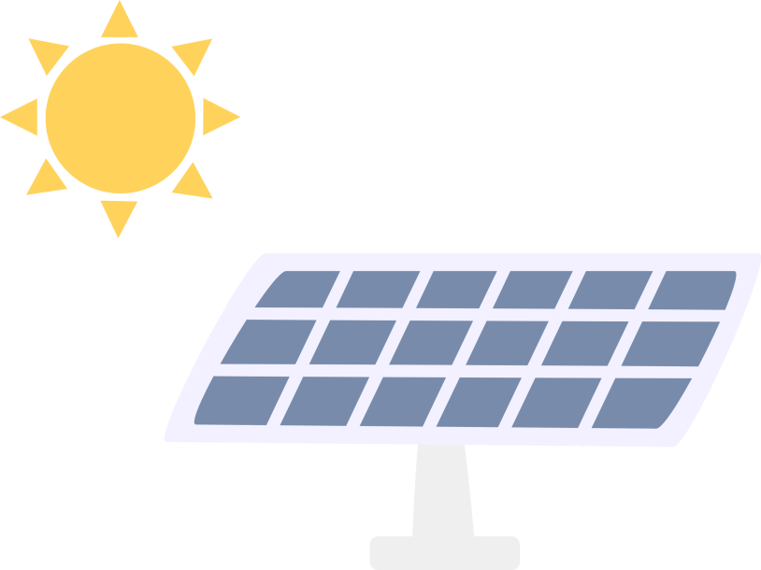

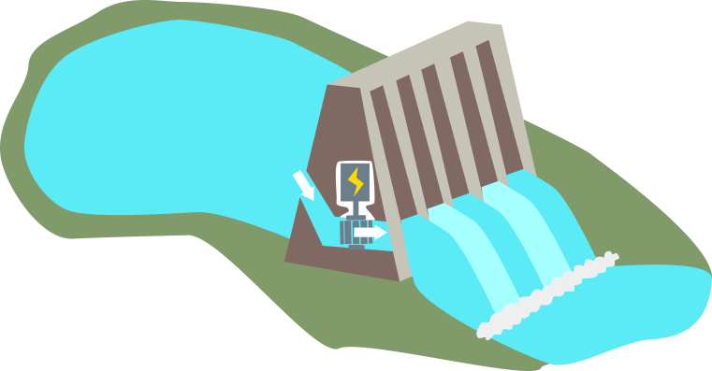
Solar
Biofuel
Geothermal
Renewable
Wind
Hydroelectric
Notes:
Non-renewable energy sources won’t last for ever. Once we have used up our supplied of oil, gas, coal and uranium there will be no more! Because of the planets increasing energy demand (more people want bigger TVs, better smart phones, want to fly to far away countries etc.) we need to look for different ways of producing energy that is sustainable. Renewable energy sources such as wind, solar power, wave power and geothermal (heat from the Earth) are sustainable as they will not run out and can be reused again and again.
Renewable energy resources do not release harmful greenhouse gases into the atmosphere so they are much more environmentally friendly.
Generating electricity from renewable sources is much more complicated than from fossil fuels so it requires lots of new technology which can be expensive to develop.

Slide 19


Large windmills are called wind turbines
When the wind blows, the blades move and this spins a turbine which is connected to a generator which generates electricity.
Wind farms are made up of lots of wind turbines this allows lots of electricity to be generated
Wind farms are built in windy areas
No wind = no electricity
Notes:
Large windmills are called wind turbines and are built to harness wind energy (kinetic energy). When the wind blows the blades move and spin a turbine connected to a generator which produces electricity. Wind turbines essentially work in the opposite way to a fan, instead of using electricity to make wind, they use wind to make electricity!
In order to create enough energy capable of powering thousands of homes, energy companies build large wind farms with lots of wind turbines. They usually build these in windy places for example in Scotland. Wind farms can also be built out in the ocean where it is very windy.
If there isn’t any wind, then no electricity will be generated by the wind turbine. Engineers do a lot of measurements and calculations before they build wind turbines to figure out the best areas to place them. The wind doesn’t blow all the time but the important thing is how much the wind blows on average.
One major issue that people have with wind turbines is that they can ruin the look of the landscape, they can also be harmful to birds who might fly into them.

Slide 20



Solar panel
Heat
Sunlight
Electricity
Solar energy is from sunlight
Solar energy can be used to generate heat or electricity
Solar panels filled with water are used to produce heat
Photovoltaic cells are used to turn sunlight into electricity
Solar panels can be put of building roofs
Solar panels are expensive and you need a lot of them!
Notes:
The primary source of all energy on planet Earth is from the sun - plants get energy from the sun for photosynthesis and we/other animals eat the plants to gain energy, heat from the sun also drives atmospheric circulation which controls the wind, tides and waves. Solar power is power generated directly from sunlight.
There are two types of solar panels which allow us to generate either heat or electricity. Solar thermal panels are filled with water which heats up in the sunlight. The heated water is then pumped through a tank heating the water that is connected to the taps in the house. Solar panels called photovoltaic cells are used to turn sunlight directly into electricity. Photovoltaic cells are made from the chemical element silicon. When silicon is exposed to lots of sunlight it generates an electrical charge.
A good thing about both types of solar cells is that they can be placed on the roof of a building or home, not taking up any extra space.
It is quite difficult to generate a lot of electricity using solar energy this is because individual photovoltaic cells are expensive and they can’t generate a lot of electricity so you need thousands of them in order to generate enough electricity to power a town.
Solar power can’t be harnessed in places where the sunlight isn’t very strong, solar power is best in countries where the sun is strong and regular such as California.

Slide 21

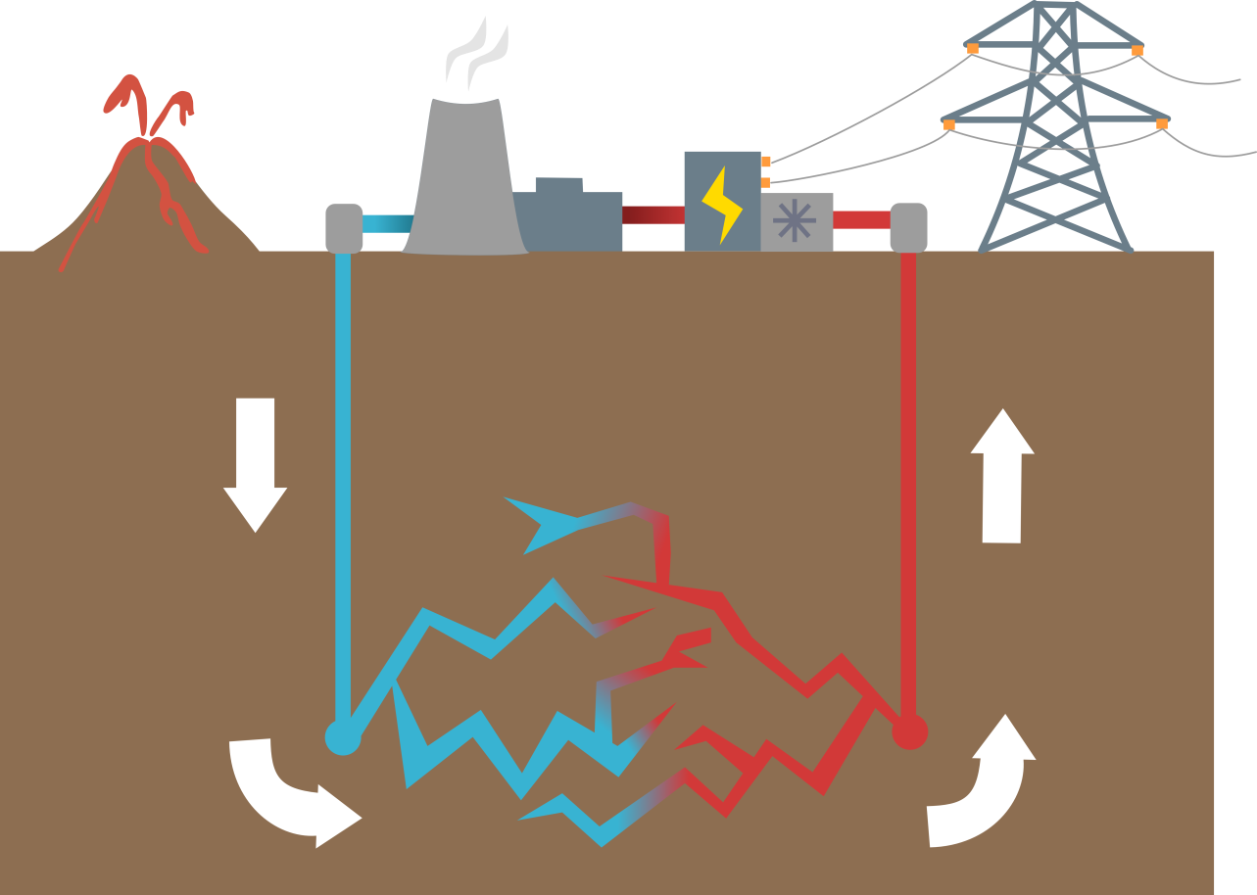
Electricity pylon
Geothermal energy is heat energy from the Earth
Water can be pumped down into hot rock where it is heated.
Geothermal energy can be used to produce heat or electricity
Iceland is very volcanic so uses a lot of geothermal energy.
Cooling tower
Generator
Turbine
Steam
Cold water
Hot water
Water is heated
Notes:
Discuss that ‘geo’ means Earth when it is part of a word e.g. geography and ‘thermal’ or ‘therm’ means heat e.g. thermometer. Geothermal energy is heat energy from the Earth. It is always warmer underground than it is at the surface but in some areas, like Iceland and New Zealand, if you dig just a few kilometres underground it can be up to 70°C. Water can be pumped into these rocks through pipes. When this water comes back up to the surface it can be used directly to heat people’s homes, or the steam can be used to generate electricity using a turbine and a generator.
The only issue with geothermal energy is it can only be done where the rocks are hot enough.
85% of Iceland heating and 25% of its electricity comes from geothermal energy
Iceland is a very volcanic country so the rocks beneath its surface are very hot. Iceland also gets a lot of rain, much of this rain filters down into the Earth’s crust through cracks and pores. As it filters down it is naturally heated but he hot surrounding rocks and it then travels upwards to the surface. Sometimes this hot water explodes out as geysers other times it creates hot springs like the blue lagoon. This hot water is used for heating buildings and for generating electricity. Approximately 2/3s of Iceland’s energy (heating and electricity) comes from geothermal energy.

Slide 22

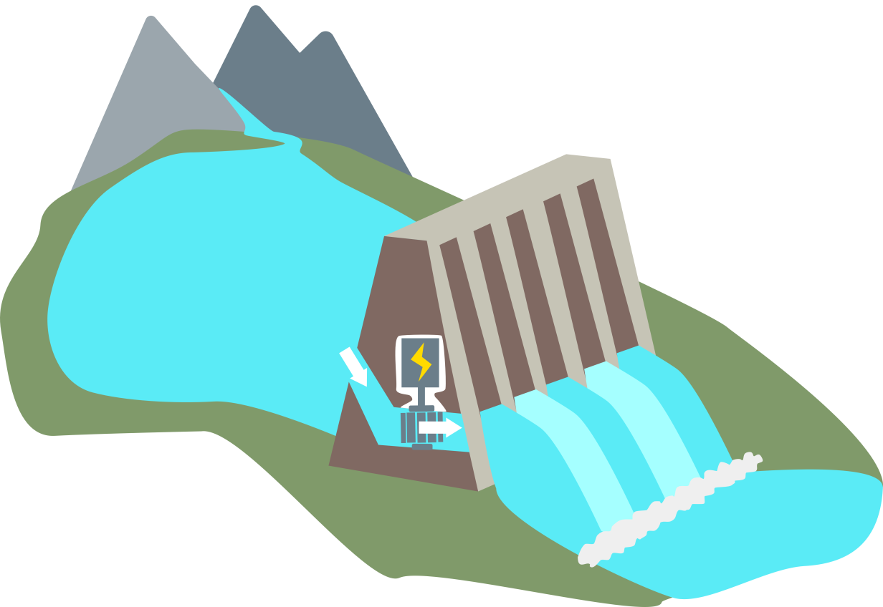
Hydroelectric power is a way of harnessing energy from running water.
Hydroelectric dams trap water in reservoirs
When electricity is needed, water is released and flows downwards with gravity to spin a turbine.
More reliable that solar and wind power.
Hydroelectric dams are very expensive and can harm wildlife.
Hydroelectric dam
Reservoir of water
Generator
Turbine
Notes:
Discuss that ‘hydro’ or ‘hydra’ means ‘ water’ when it is part of a word e.g. dehydrated. Hydroelectric power is therefore a way of harnessing electricity from running water. Hydroelectric dams are built to store large amounts of water in reservoirs, large man-made lakes made from flooding river valleys. When electricity is needed, water is allowed to escape through pipes in the dam. The water flows downwards under the influence of gravity and turns turbines linked to generators, generating electricity.
Mountainous regions like the Scottish highlands and North Wales are good for hydroelectric power because they are steep and have lots of rain water.
Hydroelectric power is more reliable than wind and solar power, although it does depend on enough rain.
Hydroelectric dams are very expensive to build. When a dam is built, a huge area is flooded to make a lake which effects the people and animals living there, it can also badly affect fish migration patterns. It can be difficult to find a suitable sites to build reservoirs.
The UK currently generates about 1.5% of its electricity from hydroelectric schemes - most of which are in the Scottish Highlands.

Slide 23


Biofuels are made from crops.
Ideally biofuels should be carbon neutral – absorb carbon dioxide as they grow and then give off carbon dioxide when they are burnt.
However fossil fuels are used in the production of biofuels, for example in making fertilizers so they are not carbon neutral.
Crops for biofuels could be used to feed people instead
Notes:
Discuss that ‘bio’ means ‘living things’ when it is part of a word e.g. biology. Biomass is plant and animal matter such as wood, straw, sewage and waste food. Biomass can be burnt to produce heat and electricity.
Biofuels such as biodiesel and bioethanol are fuels produced from crops like rapeseed and sugar cane. They similar to fossil fuels but they are made from plants grown today rather than plants that grew millions of years ago. They can be made quickly so they are renewable.
Ideally biofuels should be carbon neutral. This means that they absorb as much carbon dioxide from the atmosphere as they grow as they give off when they are burnt. However at present because fossil fuels are used in the production of biofuels, for example in making fertilizers and in fueling farm equipment they are not currently carbon neutral, although they do still release less CO2 than burning fossil fuels directly.
There are also ethical issues surrounding the use of biofuels. For example, crops that could be used to feed people are being used to provide the raw materials for biofuels instead.

Slide 24



Notes:
In groups of 6 students could play our generating electricity game – you will need a die for each group and to print off our game sheets and tokens available at www.geolsoc.org.uk/Education-and-Careers/Resources/Activity-Sheets-And-Presentations - Generating Electricity Game.
Further activity – have students choose and draw their own energy resource game sheets using the energy game template available at www.geolsoc.org.uk/Education-and-Careers/Resources/Activity-Sheets-And-Presentations – Generating Electricity Game template. Energy sources they could choose include hydroelectric power, biofuels, wave power, oil and tidal power. You could also choose to show students only a couple of the other energy source game sheets so they have a greater choice of what to choose.

Slide 25

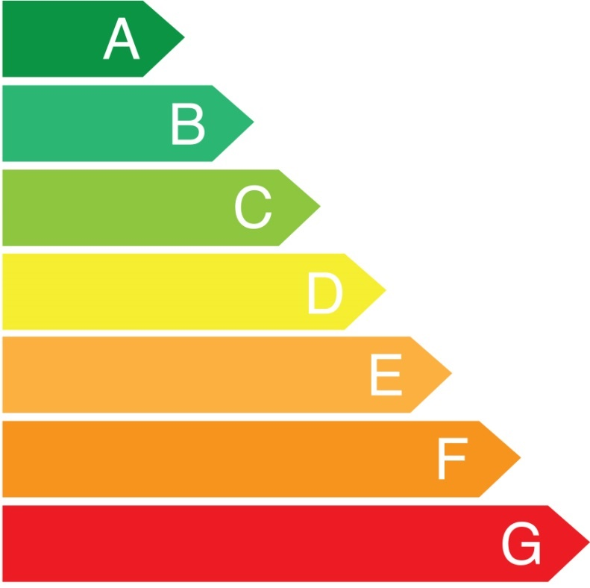
Have a look at some electrical appliances around the classroom or school.
See if you can find their energy ratings.
Notes:
Children can find appliances in the classroom/around the school and locate their energy rating or teacher could have some devices to show.

Slide 26
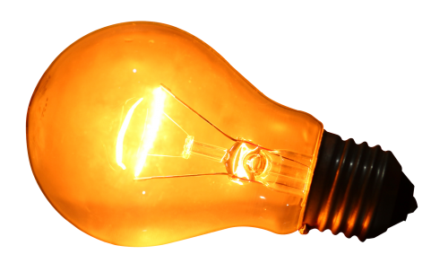
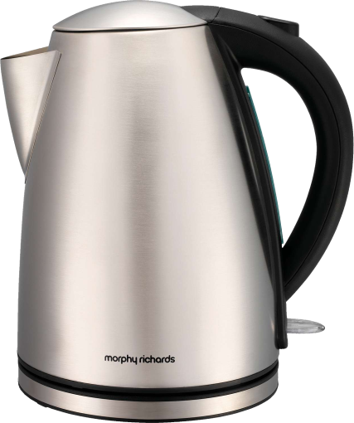


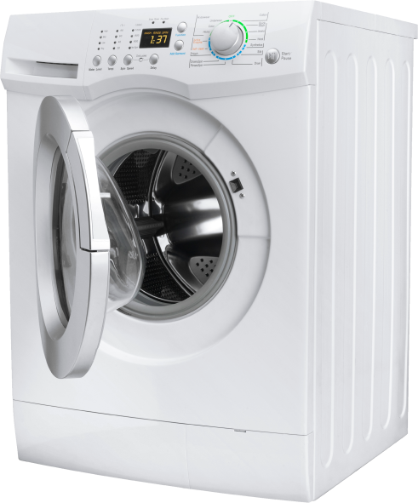
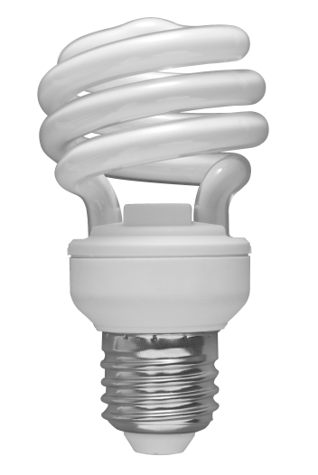


50 w
Power (watts) =
Energy (joules) ÷ Time (seconds)
2400 w
150 w
4w (charging)
100w
10 w
800w
700 w
Notes:
Appliances in the home have a power rating which tells you how much energy is used by the device every second: power (watts) = energy (joules) / time (seconds). The more powerful the appliance, the more energy it needs every second. Power is measured in watts which is equal to joules per second e.g. a 50 watt lightbulb uses 50 joules of energy every second. Sometimes power is shown in kilowatts rather than watts 1 Kw = 1000 w.
Have students guess which appliances use the more energy. Click for answers.
Things to think about - the kettle and toaster use a lot of energy but are only used for a short amount of time. Televisions and laptops use less energy but can be used for hours in a row. The energy efficient lightbulb is more expensive than the regular lightbulb however over time it uses less energy. Why should we make sure we switch off lights when we leave a room?

Slide 27


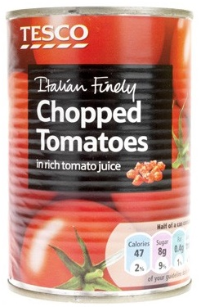


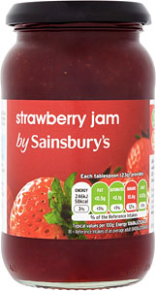

Everyday products like food containers, smartphones, computers and cars require a lot of energy to produce
Recycling products saves energy
The amount of energy you save depends on the product but it is always worth recycling!
Energy saved = 94%
Recycled aluminium can
Energy saved = 10-15%
Recycled glass jar
Notes:
The products we use every day take a lot of energy to produce. Smartphones for example need electrical energy to charge up, but they also need a huge amount of energy in the first place to find and mine the metals and other minerals they are made from such as silicon, tin, gold, aluminium, cobalt and many more.
Recycling is very important as it helps us to saves energy that would need to be used to make new products from scratch, this is because the products being recycled usually require much less processing to turn them into usable materials. Exactly how much energy is saved depends on the material in question.
Aluminium - Aluminum is produced from aluminum ore which needs to be processed to isolate the aluminum metal. This processing requires a huge amount of heat and electricity. None of this processing is required for recycled aluminum metal (e.g., in the form of cans), which can be simply cleaned and re-melted. This saves 94% of the energy that would be required to produce the aluminum from the ore!
Glass – Glass is made by melting sand and other minerals at very high temperatures. The molten mixture is then cooled to form glass. The heat necessary to melt the mineral mixture is the most energy intensive part of the process. Because recycled glass still needs to be re-melted to make new glass products, the energy savings from recycling glass are roughly 10-15%. This doesn’t mean we shouldn’t recycle glass though – every time you recycle glass you are saving energy!

Slide 28

Renewable
Energy resources
Coal
Non-renewable
Solar
Oil
Geothermal
Natural resources
1. ____________ are natural substances required by humans for different needs.
2. Heat energy from the Earth is known as _______________ energy.
3. __________ resources can be replaced and will not run out
4. Oil, coal, wind, sunlight and waves can be used to produce energy they are examples of _____________.
Notes:
This lesson also lends itself to a list of key terms and definitions- students have to match the terms and definition. For differentiation more advanced students can write the meaning themselves.

Slide 29
Renewable
Energy resources
Coal
Non-renewable
Solar
Oil
Geothermal
Natural resources
5. _______ is a non-renewable fuel formed from ancient land plants
6. _____________ resources cannot be easily replaced, because they have taken millions of years to form.
7. _____ and gas are formed from marine microscopic plankton
8. The energy from sunlight is known as ________ energy and can be used to make electricity or heat.

