Slide 1



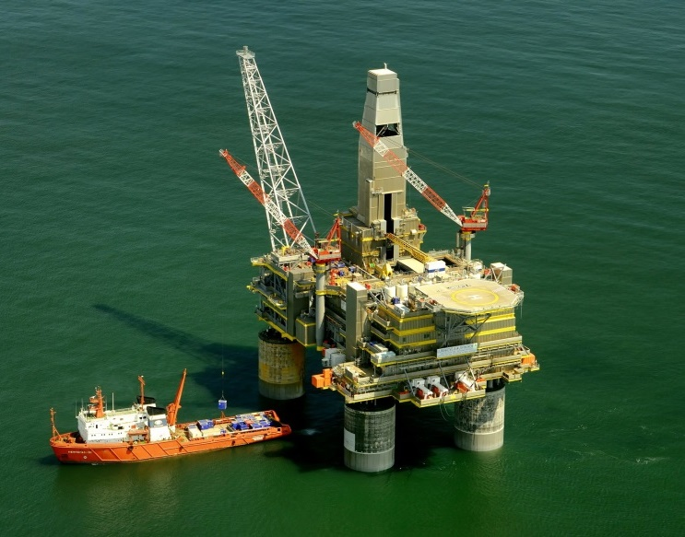
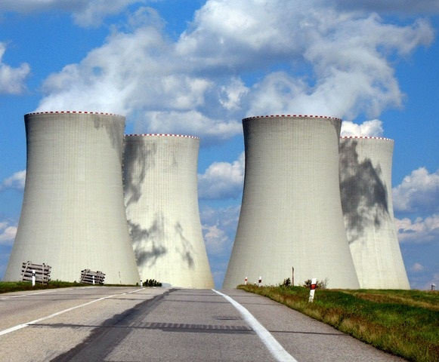
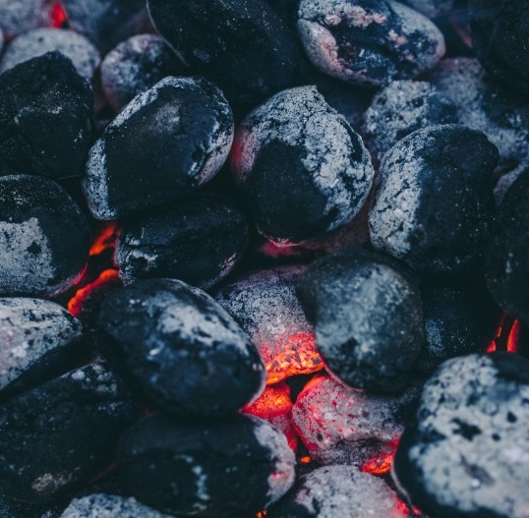
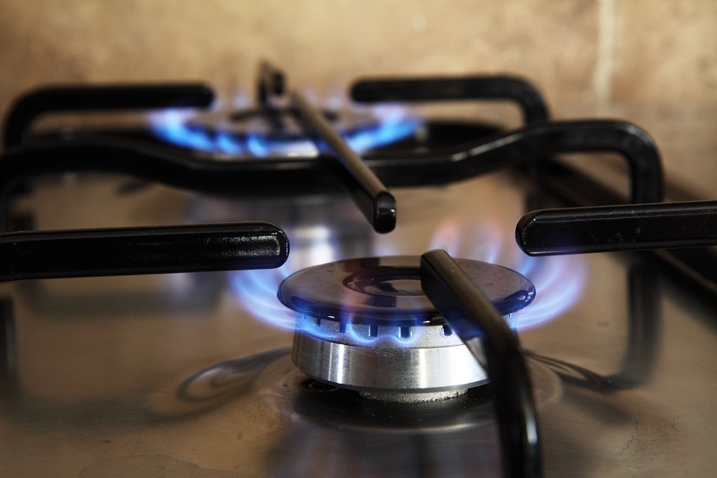
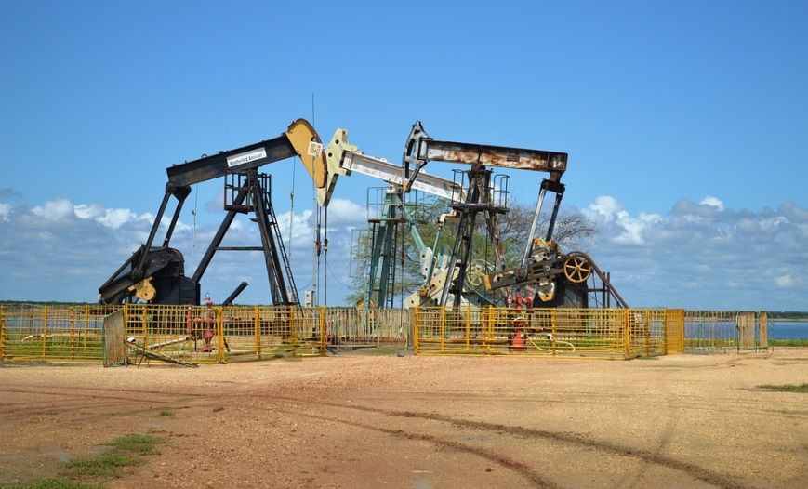

Slide 2

Natural resources and energy resources
Non-renewable & renewable energy
Oil and gas
Coal
Nuclear power
Unconventional fossil fuels
‘Energy resources - renewables’ presentation follows on from this on and covers renewable energy

Slide 3


What are natural resources?
What are some examples of natural resources and what are they used for?
What can nations try to do if they don’t have all the natural resources they need?
Notes:
Teachers to ascertain class knowledge

Slide 4
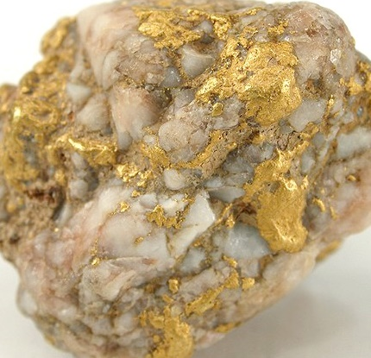
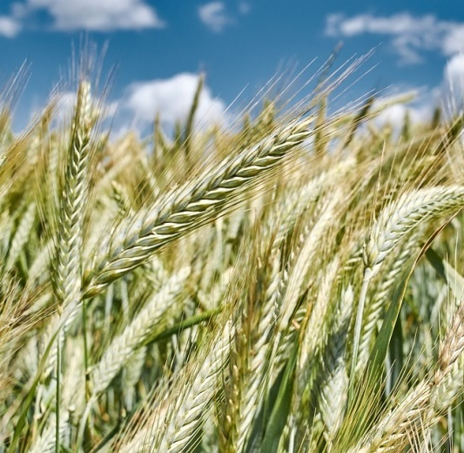

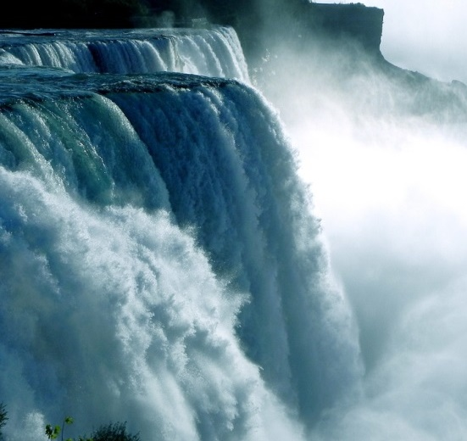
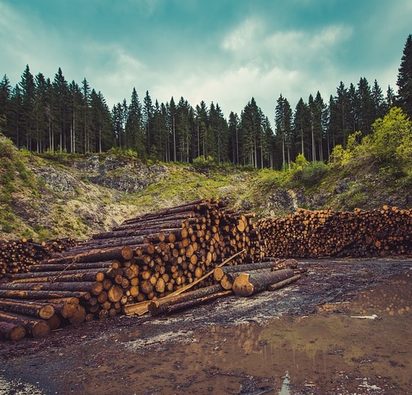
Natural resources – natural substances required by humans for different needs.
Metals and minerals
Rainforests
Crops
Water
Coal, oil and gas
Forests
Notes:
Natural resources are any kind of natural substance which is required (or desired) by humans. Different natural resources are not equally spread out across the Earth, as a result, countries must trade their natural resources to ensure that their needs can be met.
Discuss why different types of natural resource are important e.g. minerals and metals like iron, gold, copper, silicon, cobalt etc. are used as building materials and in technology such as computers, smartphones and cars, forests and rainforests are used for timber and medicines as well as being important habitats for thousands of species of animals, plants and fungi, crops like wheat, vegetables and fruits are grown for food, water is used for drinking, washing, and generating energy, animals such as fish are caught for eating, fossil fuels like coal, oil and gas are burnt for energy.

Slide 5

What are energy resources?
What are some of the different types of energy resource?
Notes:
Teachers ascertain class knowledge

Slide 6







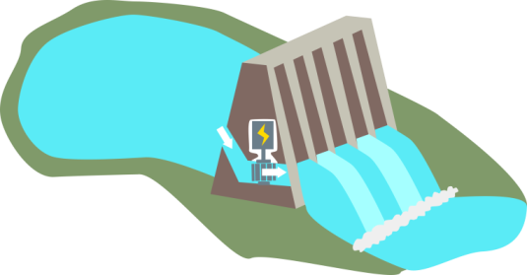




Solar
Biofuel
Coal
Wind
Natural gas
Biomass
Nuclear
Hydroelectric
Geothermal
Energy mix - the specific combination of different energy sources a country uses to meet its energy consumption needs
Notes:
Energy resources such as oil, gas, coal, wood, wind, waves, sunlight, heat from the ground (geothermal) are all types of natural resources. They can be used to produce heat and electricity.
A country’s energy mix is the specific combination of different energy sources a country uses to meet its energy consumption needs. At present in the UK we use a mixture of non-renewable and renewable energies. Non-renewable energy resources are finite and cannot be easily replaced, we as a planet are using them up faster than they are being made so they will inevitably run out.
Renewable energy resources will not run out or can be easily replaced, so economies are trying to move towards greater reliance on renewable energy sources.

Slide 7




What is a renewable energy resource?
What is a non-renewable energy resource?
Notes:
Teachers to ascertain class knowledge

Slide 8
Depends
Renewable
Non-renewable
Notes:
Discuss which of the resources are renewable and non-renewable. Is wood (biomass) a renewable or non-renewable resource? Yes and no - wood can be a renewable resource but only if all the trees that are chopped down are replanted otherwise it is non-renewable. Note that renewable doesn’t necessarily mean no carbon dioxide emissions – burning biofuel and wood releases CO2 (but these plants also take CO2 when they are growing though photosynthesis), in the process of building hydroelectric dams and wind turbines non-renewable energy sources must be used (at present). Can students think of any other energy resources not on this slide? (wave power, tidal power, hydrogen fuel, tar sands, shale gas)

Slide 9

Depends
Renewable
Non-renewable
Notes:
Discuss which of the resources are renewable and non-renewable. Is wood (biomass) a renewable or non-renewable resource? Yes and no - wood can be a renewable resource but only if all the trees that are chopped down are replanted otherwise it is non-renewable. Note that renewable doesn’t necessarily mean no carbon dioxide emissions – burning biofuel and wood releases CO2 (but these plants also take CO2 when they are growing though photosynthesis), in the process of building hydroelectric dams and wind turbines non-renewable energy sources must be used (at present). Can students think of any other energy resources not on this slide? (wave power, tidal power, hydrogen fuel, tar sands, shale gas)

Slide 10

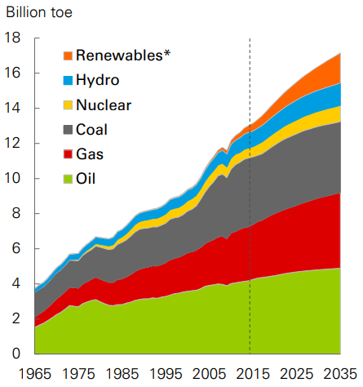
*renewables includes wind, solar, geothermal, biomass and biofuels
Billion toe = billion tonnes of oil equivalent
BP 2017 Energy Outlook © BP p.l.c. 2017
Notes:
Graph of global energy consumption from BP 2017 Energy Outlook. Renewables in orange includes wind, solar, geothermal, biomass and biofuels.
Discuss what the current dominant sources of energy are and how this are projected to change in the near future - in 2035 oil, gas and coal are still predicted to account for more than 75% of total energy supplies, however hydroelectric power, nuclear and renewables are predicted to increase.
There is a dip in the graph for energy consumption in 2009 why might this be? - global recession caused demand for energy to shrink – for the world as a whole, primary energy consumption fell by 1.1% in 2009 (BP Statistical Review of World Energy).

Slide 11





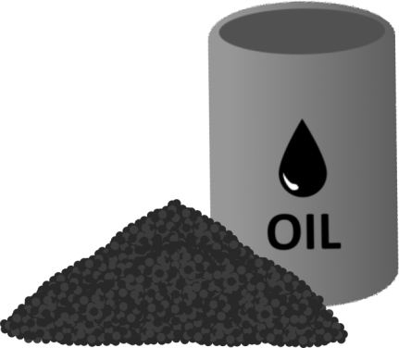
Oil
Natural gas
Coal
Nuclear
Unconventional non-renewables: tar sands, methane hydrates
Notes:
Non-renewable energy sources include the conventional fossil fuels – coal oil and gas, and nuclear energy. It also includes unconventional fossil fuels such as methane hydrates and tar sands.

Slide 12


Crude oil and natural gas are formed from phytoplankton and zooplankton
Microorganisms sink to the bottom of the ocean when they die forming layers of organic rich sediment
High primary production, stagnant, stratified water column, lack of sea floor decomposers, low oxygen (anoxic) = good conditions for forming oil and gas source rocks
Phytoplankton & zooplankton
Organic rich sediments
Layers of sediment
Notes:
Crude oil and natural gas are hydrocarbons formed from organic matter – phytoplankton (plant plankton) and zooplankton (animal plankton).
Oil and gas formation: microorganisms sink to the bottom of the ocean creating layers of organic rich sediment. Environments with high primary productivity, low hydrodynamics (stagnant water), stratified water column (no mixing between layers of the water column), poor benthic (sea floor) fauna, and anoxic (low oxygen) conditions prevailing at the bottom, are the best prospects for the development of organic rich source rocks as these conditions prevent the organic matter from decomposing.

Slide 13

Organic rich sediments are buried by layers and layers of sediment
Increased and sustained heat and pressure ‘cooks’ the organic matter in the source rock into petroleum
Temperature and burial depth determine which hydrocarbons are produced
Organic rich sediments
Notes:
As the phytoplankton and zooplankton are buried over thousands and millions of years the heat and pressure rises and the organic matter in the sediment is turned into petroleum (oil and gas). Temperature and burial depth determine whether oil, gas or other hydrocarbons are produced – graph on next slide

Slide 14
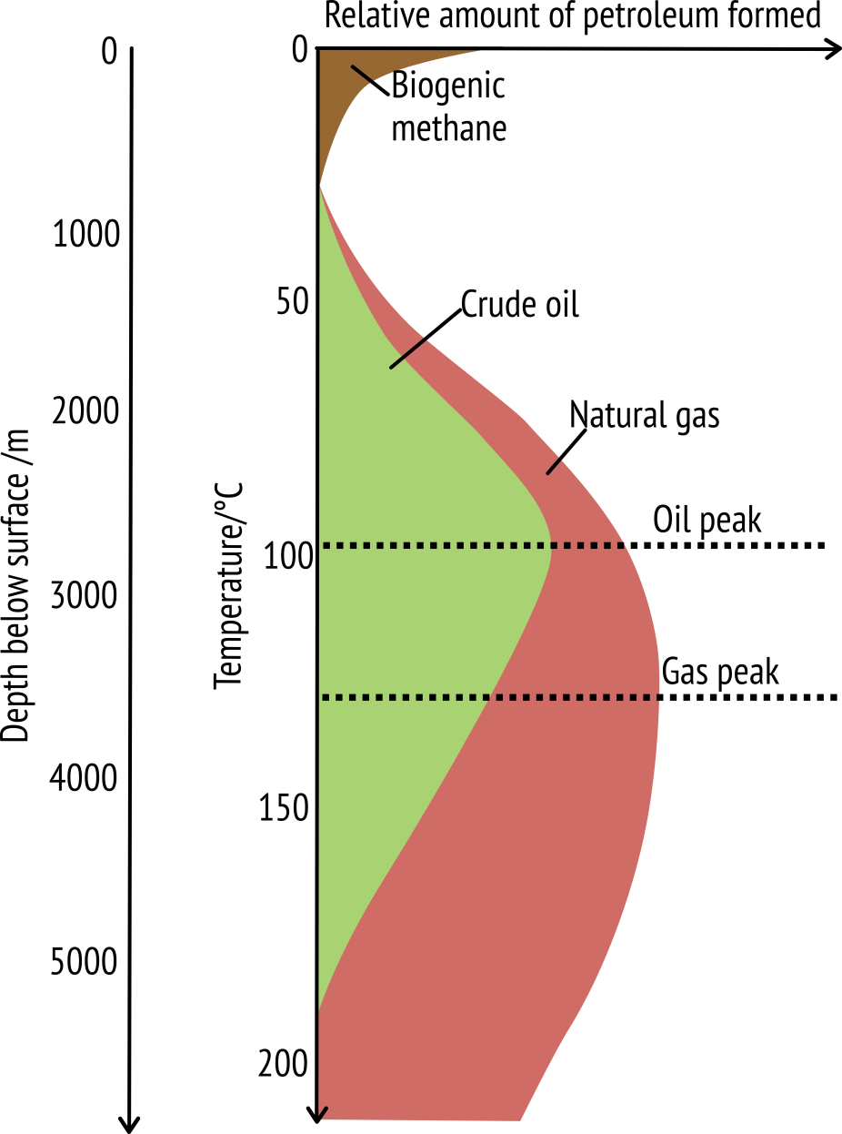
Temperature and burial depth determine whether you get oil or gas and how much is formed.

Slide 15
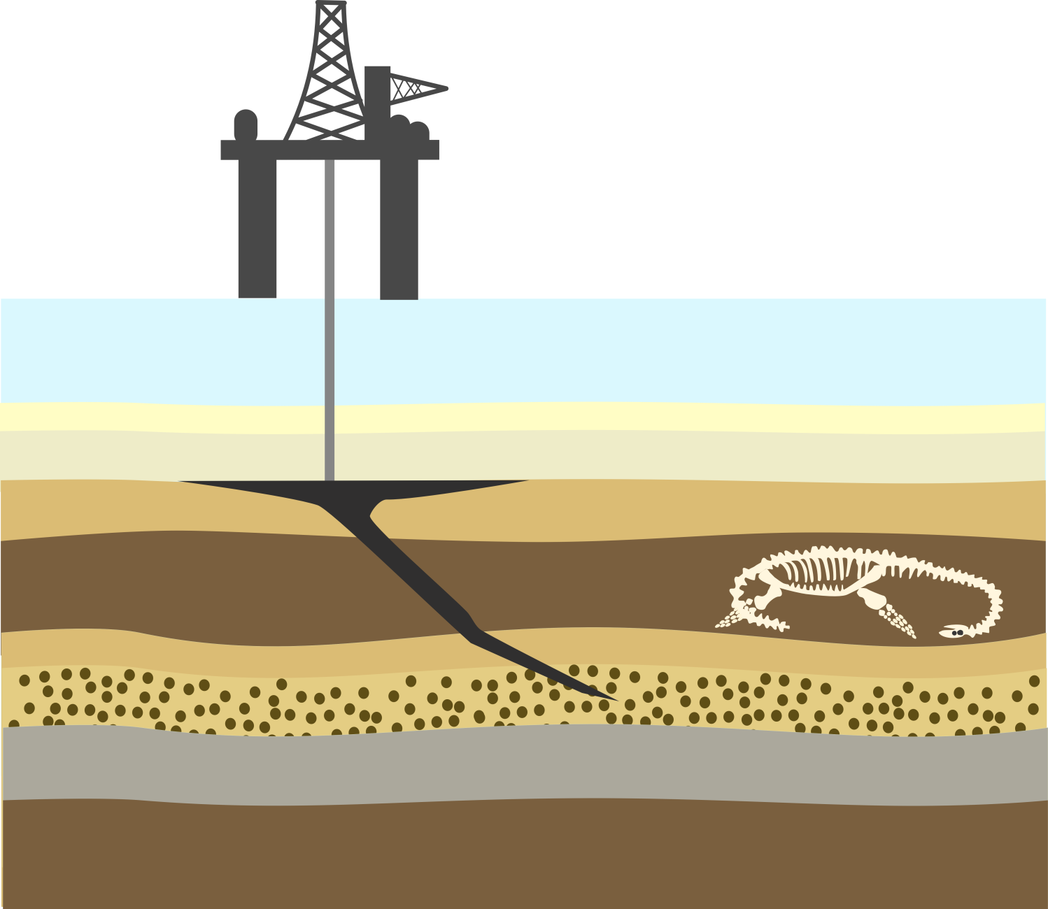
Oil and gas migrate upwards form the source rock into reservoir rocks capped by impermeable seals
Can sometimes migrate all the way to the surface e.g. La Brae tarpits
Trapped deposits are drilled to release oil and gas
Hydraulic fracking can also be used to extract gas
Oil rig
Drill
Sea
Impermeable seal rock
Oil
Reservoir rock
Oil rich source rock
Notes:
Oil and natural gas is less dense than the surrounding rock so migrates upwards through tiny pores and fractures in the surrounding rock. Some oil and natural gas manages to get all way to the surface and escapes through vents into the atmosphere e.g. La Brae tarpits in California. Other oil and natural gas get trapped in reservoirs under impermeable layers of rock – known as seals or cap rocks. These trapped deposits are then drilled (after extensive exploration and testing) to release the oil and gas e.g. in the North Sea oil fields.
Natural gas can be also extracted using hydraulic fracking. This process uses high-pressure water to split apart the rocks underground, releasing the natural gas that is trapped in rock formations.

Slide 16







Oil & gas
burned to heat water
steam propels turbine
Electricity
Crude oil is refined by fractional distillation into kerosene, petrol, diesel etc. before it is used as a fuel.
Relatively inexpensive to extract.
Reliable and dependable source of energy and income for local community e.g. in Aberdeen, Scotland.
Natural gas can be converted into liquid form
When oil and gas are burnt they release gas into the atmosphere. carbon dioxide
Oil spills are environmental disasters – e.g. BP Mexico oil spill 2010
Notes:
Oil and gas can be burnt to produce electricity, to do this oil/ gas (chemical energy) is burned in power plants to heat water and produce steam. The kinetic energy of the steam then propels the blades of a turbine. The turbine is attached to a generator and when it spins it produces electricity.
Oil is also used as fuel in cars, planes, buses and trains (chemical energy → mechanical energy → kinetic energy). Before it can be put into cars and planes or used as wax etc. crude oil extracted from the Earth must be refined in an oil refinery by fractional distillation to turn it into different fuels like petrol, diesel and jet engine fuel (diagram on next slide).
Oil can also be turned into various different types of plastic and chemical products so it is an extremely valuable natural resource.
Natural gas is mostly made from methane and can be used for heating and cooking as well as generating electricity. Natural gas can be condensed into a liquid - liquid natural gas (LNG) which is much cleaner than any other fossil fuel and takes up less space so can be it transported and stored easily.
Pros
Oil and natural gas are relatively inexpensive to extract. They are relatively reliable and dependable sources of energy and provide jobs and income money for the local community e.g. Aberdeen. Natural gas is a much cleaner fossil fuel than coal.
Cons
When oil and gas are burnt they release carbon dioxide gas into the atmosphere. CO2 is a greenhouse gas and contributes to global warming. Oil spills are environmental disasters, oil penetrates bird feathers and mammal fur reducing insulation, buoyancy and flight ability. Oil and gas are often geopolitical issues

Slide 17

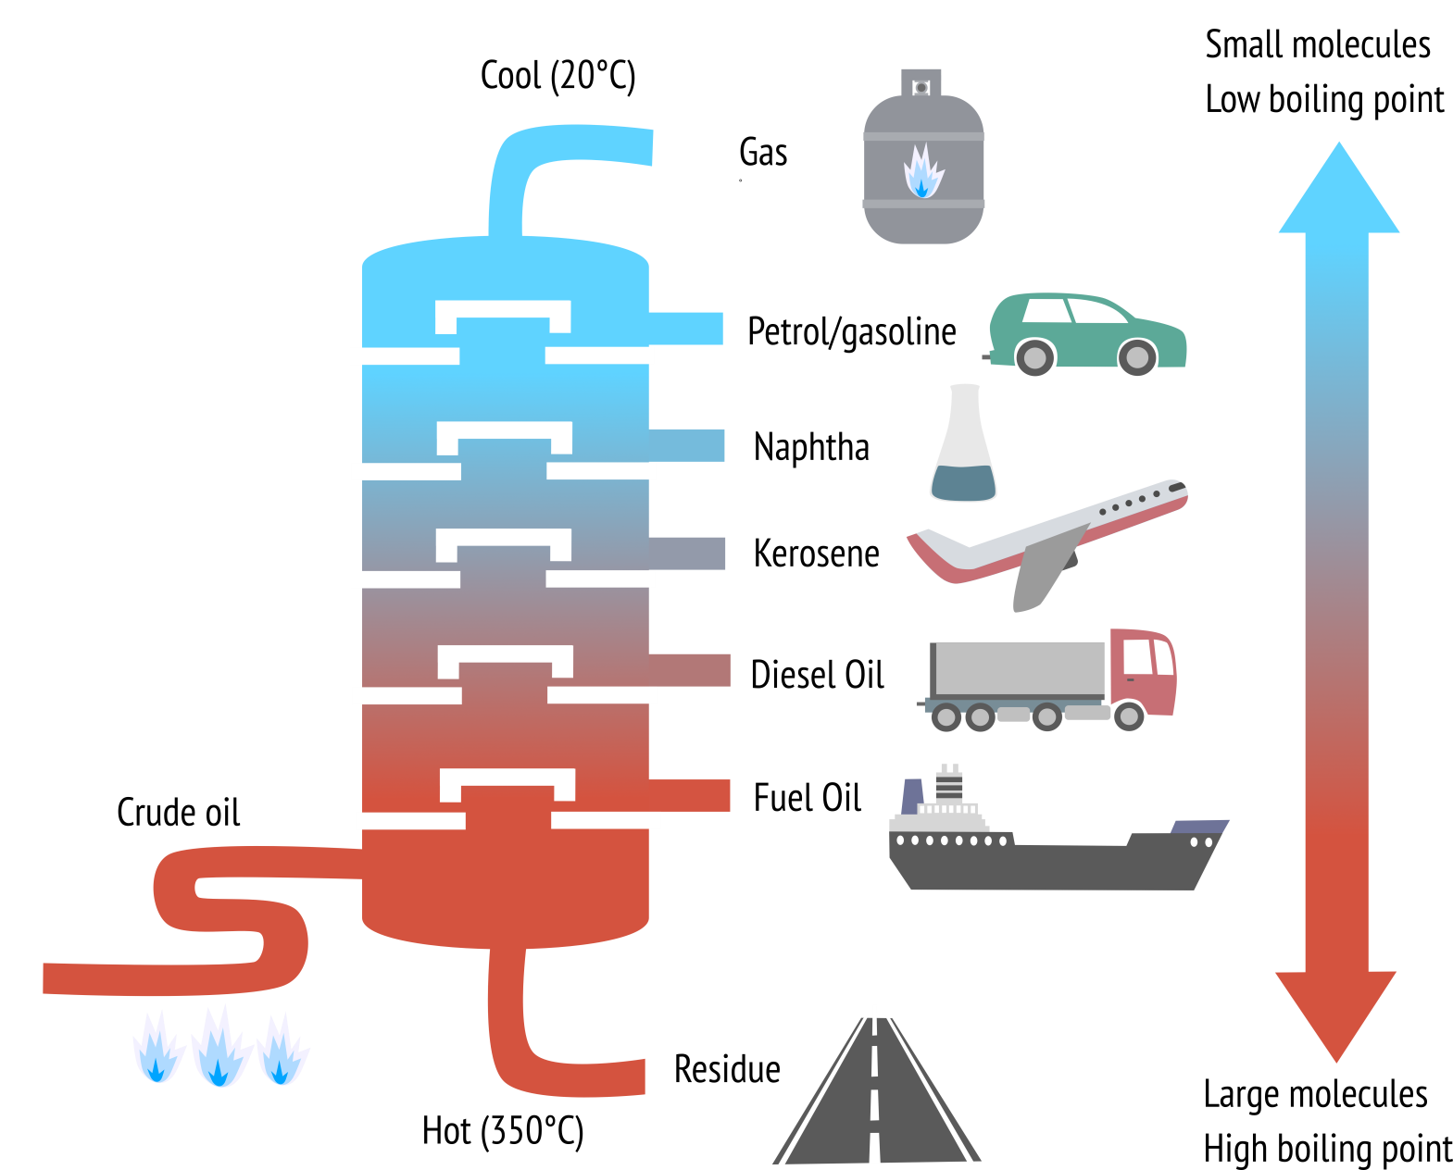
Notes:
Fractional distillation diagram - because they have different boiling points, the substances in crude oil can be separated using fractional distillation. Crude oil is evaporated and hydrocarbons condense at different temperatures in the fractionating column. Each fraction contains hydrocarbon molecules with a similar number of carbon atoms. Larger molecules have higher boiling points and do not ignite as easily so they condense low in the fractionation column e.g. bitumen used in roads and fuel oil for ships. The smaller molecules have lower boiling points so condense high up in the fractionation column, these hydrocarbons such as bottled gas and gasoline ignite more easily which means they make better fuels.

Slide 18


Most of the coal we have on Earth today was formed in the Carboniferous period 360 – 299 million years ago
Tropical, swampy climate
Plants die and over time form layers of squashed plant material
Swamp
Older rock layers
Notes:
Most of the coal we have on Earth today was formed during a time called the Carboniferous period 360 – 299 million years ago when much of the Earth including the UK was covered in tropical swamps. As the swamp plants died their remains sank to the bottom of the swampy areas, making layers and layers of squashed plant material.

Slide 19

Squashed plant material accumulates over thousands of years.
Plant material turns into peat.
Peat is used for fuel Ireland, Scotland and Finland
Peat
Notes:
The thick layers of plant material eventually turned into a brown spongey material called peat. Peat is the lowest rank of coal (i.e. the least efficient) but it is an important fuel in places like Ireland, Scotland and Finland.

Slide 20

Peat is buried by layers of sediment and subjected to increased heat and pressure
‘Cooked’ into coal
The type of coal you get depends on how long it was buried, how deep and how hot it got.
Younger rock layers
Coal seam
Older rock layers
Notes:
Over millions of years and with changing environments layers of mud and silt build up on top of the peat and it becomes buried. As the peat is buried further and further over millions of years heat and pressure acting upon it turn it into coal. Coal is still being produced today in swampy tropical regions but because it takes millions of years to form and very specific environmental conditions (needs a slowly subsiding basin to accommodate the thick layers of plant material) it is not a renewable resource. Areas of the UK with coal - south wales, north England, south Scotland.

Slide 21

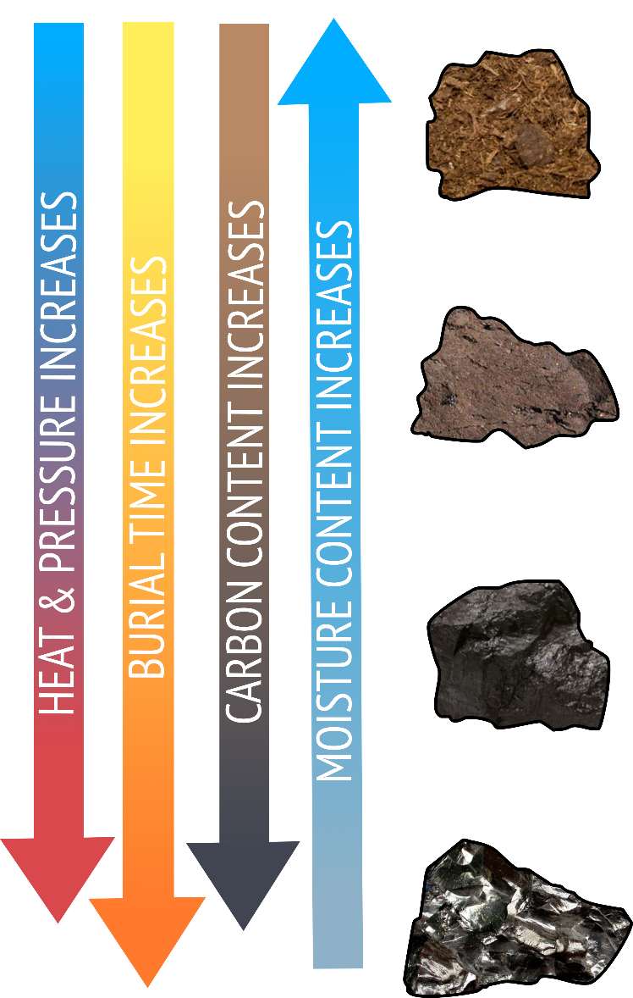
Peat
The hotter the temperature, the deeper the coal is buried, and the longer the amount of time the coal is buried, the more efficient coal you get.
Lignite
Bituminous coal
Anthracite
Notes:
The hotter the temperature, the deeper the coal is buried, and the longer the amount of time the coal is buried, the better (more efficient) coal you get – lignite, brown coal is the first type of coal (peat isn’t technically coal) it has a low carbon content and a high moisture and volatiles content which means it doesn’t burn very efficiently. Anthracite is the most efficient coal it has a high carbon content, very low moisture and volatiles content and burns with a short pale blue flame (complete combustion). Most of the coal we use is bituminous coal in between lignite and anthracite in terms of carbon and moisture content.

Slide 22



Coal
burned to heat water
steam propels turbine
Electricity
Coal is cheap and there is lots of it!
When coal is are burnt it releases carbon dioxide, sulphur dioxide and nitrogen dioxide into the atmosphere contributing to global warming and acid rain.
Coal mining is harmful to the environment and mine workers – toxic dust, cave-ins and explosions.
burned for heat
Notes:
We mine coal from the ground so that we can burn it for heating (think open fires and BBQs!) or to make for electricity.
Pros
Coal is very abundant across the Eover 70 countries have coal reserves and it is a cheap energy source.
Coal powered the UKs industrial revolution.
Cons
When coal is burnt it releases lots of carbon dioxide even more than oil and gas so it is the one of the worst contributors to global warming. When coal is burnt it also releases sulphur dioxide and nitrogen dioxide into the atmosphere which contributes to acid rain.
Coal mining is harmful to the environment and to workers, coal miners are exposed to toxic dust and face the dangers of cave-ins and explosions at work.

Slide 23



steam propels turbine
Nuclear reactions
Heat
Electricity
Uranium and plutonium are nuclear fuels – fission reactions
Nuclear fuels do not produce harmful greenhouse gases
Nuclear power is very efficient
Produces radioactive waste which is dangerous and has to be sealed in containers and buried for thousands of years.
Nuclear cores can melt down releasing harmful radiation e.g. Fukushima Daiichi plant in 2011
Safety is expensive
Notes:
The main nuclear fuels are uranium and plutonium these are radioactive chemical elements. Nuclear fuels are not burnt to release energy, they are involved in nuclear reactions where atoms are split to release large amounts of energy as heat in a chain reaction (nuclear fission). The rest of the process of generating electricity is then the same as in coal, oil and gas, the heat energy released by the nuclear reactions causes the reactor vessel to heat to about 300 ºC. This heat is used to boil water generating steam that spins turbines ad drives generators to produce electricity.
Pros
Nuclear fuels do not release harmful greenhouse gases. The vast majority of carbon dioxide emissions associated with nuclear power stations arise during construction and fuel processing, not during electricity generation.
They are very efficient, a tiny amount of nuclear fuel produces a lot of energy
Cons
Nuclear power produces radioactive waste, which is very dangerous. When animals (including humans) and plants are exposed to large amounts of radiation, it can be very harmful to their survival. Radioactive waste must be removed and disposed of from power plants it has to be sealed in containers and buried for thousands of years until it is no longer radioactive.
Nuclear accidents can occur releasing harmful radiation into the environment when e.g. the Fukushima Daachi nuclear plant melt down in 2011 as a result of the Tohoku tsunami
Nuclear power is reliable but a lot of money has to be spent on safety so it is expensive.

Slide 24

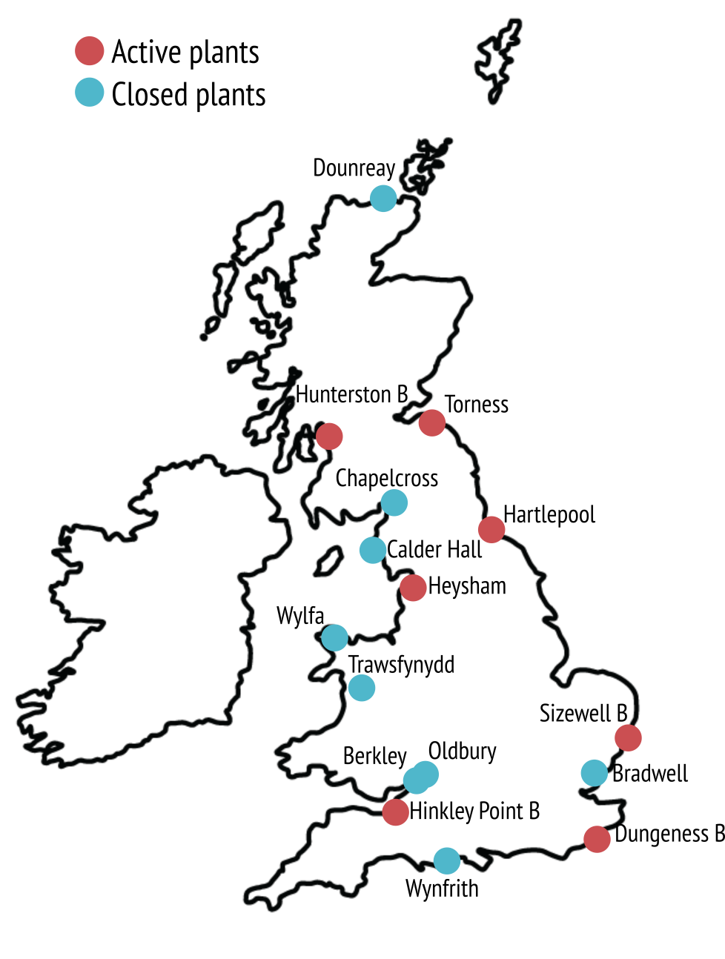
Nuclear power currently generates 21% total UK electricity (2018 Department of Business, Energy & Industrial Strategy)
15 operational reactors across the UK (2018)
Hinkley Point C in Somerset estimated to cost £20.3 billion
Scotland have banned any future nuclear plants
Notes:
In the late 1990s, nuclear power plants contributed around 25% of total annual electricity generation in the UK, but this has gradually declined as old plants have been shut down. The UK currently has 7 nuclear plants with 15 operational nuclear reactors generating about 21% of total energy demand (2016 figure from Department for Business, Energy & Industrial Strategy).
Half of this capacity is to be retired by 2025 so there are further sites in planning or in construction including Hinkley Point C in Somerset, currently Europe’s largest building site. At present, the estimated total bill for Hinkley Point C is £20.3bn, more than twice the London Olympics.
The Scottish Government, with the backing of the Scottish Parliament, has stated that no new nuclear power stations will be constructed in Scotland.

Slide 25

Fractional distillation
Energy resource formed from ancient plants
Natural substances required by humans for different needs
Crude oil & natural gas
Nuclear power
How the different components of crude oil are separated
The specific combination of different energy sources a country uses to meet its energy consumption needs
Coal
Uses uranium and plutonium to generate heat in fission reactions
Energy Mix
Energy resources formed from marine organisms
Natural resources

Slide 26

Generates 21% of UK electricity (2018)
Temperature and burial depth
Time period when most of the world’s coal was made
Carbon dioxide
Released in the combustion of fossil fuels (hydrocarbons)
Radioactive waste
Brown spongey precursor to coal
Carboniferous
Determines which hydrocarbons are produced
Peat
By product of using nuclear power
Nuclear power

Slide 27

Energy resource formed from ancient plants
Coal
Natural substances required by humans for different needs
Natural resources
How the different components of crude oil are separated
Fractional distillation
The specific combination of different energy sources a country uses to meet its energy consumption needs
Energy Mix
Uses uranium and plutonium to generate heat in fission reactions
Nuclear power
Energy resources formed from marine organisms
Crude oil & natural gas

Slide 28

Generates 21% of UK electricity (2018)
Nuclear power
Time period when most of the world’s coal was made
Carboniferous
Released in the combustion of fossil fuels (hydrocarbons)
Carbon dioxide
Brown spongey precursor to coal
Peat
Determines which hydrocarbons are produced
Temperature and burial depth
By product of using nuclear power
Radioactive waste

Slide 29

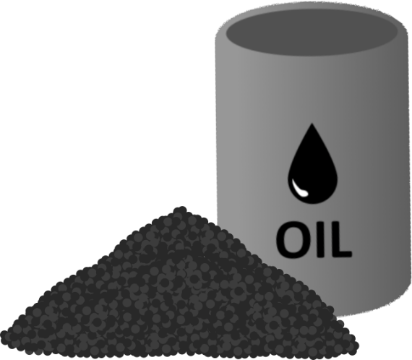
Tar sands - mixtures of clay, sand, water, and bitumen
Bitumen can’t be pumped so tar sands are mined.
Vast reserve of untapped oil.
Provided a massive economic growth and thousands of jobs in Alberta.
Uses large amounts of land, water, and energy, when compared to other oil resources
Carbon dioxide emissions are ~15% higher compared with standard crude oil extraction
Open-pit mining produces a lot of waste - leftover sand, clays, and contaminants
Notes:
Tar sands are sands or sometimes sandstones (consolidated sand) made from a combination of clay, sand, water, and bitumen, a heavy black viscous oil. Bitumen can form in many ways but it is usually formed when lighter oil is degraded by bacteria. Bitumen is too thick and sticky to be pumped like oil and gas so tar sands have to be mined in order to extract the oil-rich bitumen. Once extracted the bitumen can be refined into oil. The largest deposits of tar sands are found in Alberta, Canada and thought to contain about 1.7 trillion barrels of bitumen.
Pros – we only have a finite amount of oil reserves left to use, tar sands represent a vast reserve of oil.
Tar sands have provided a massive economic growth in Alberta, generating huge profits and providing thousands of jobs.
Cons - oil production from tar sands uses large amounts of land (for open-pit mining), water, and energy, when compared to other oil resources.
Carbon dioxide emissions are on average 15% higher when extracting bitumen from tar sands compared with standard crude oil extraction.
Open-pit mining also produces a lot of waste (leftover sand, clays, and contaminants contained within the tar sands) that may pose a risk to nearby water supplies.
The Athabasca Delta, where the Canadian tar sands are located, is a breeding ground for hundreds of species of birds.

Slide 30

Methane hydrates are methane (natural gas) trapped lattices of ice.
Arctic permafrost and sea floor sediments at 300-500m depth
Untapped reserve of fossil fuel
Warming or depressurising → turns into water + natural gas
Global warming is likely to liberate methane hydrates
Past climate warming events in geological history are linked with methane hydrate
CH4 is 20x more potent than CO2 – accelerate global warming
Notes:
Methane hydrate is a cage-like lattice of ice inside of which are trapped molecules of methane. If methane hydrate is either warmed or depressurized, it will revert back to water and natural gas.
Originally they were thought to occur only in the outer regions of the Solar System, where temperatures are low and water ice is common, but significant deposits of methane hydrate have been found under the Arctic permafrost and beneath the ocean floor. They form either from biological matter or from heat processes deep within the Earth.
Pros
Methane hydrates represent an untapped reserve of fossils fuels which could provide the world with greater energy security. Countries including India, Japan and the US are currently developing mining techniques in order to be able to use methane hydrates as a source of energy in the future.
Cons
CH4 is 20x more potent than CO2 which means that is has a much greater warming affect on the atmosphere.
As methane hydrates are temperature sensitive global warming may liberate methane hydrates from the Arctic permafrost and sea floor sediments.
Previous climate warming events in geological history – e.g. the Paleocene-Eocene Thermal Maximum ~55 million years ago have been linked with the release of methane hydrates
Discuss – should we be burning methane hydrates?

Slide 31

Energy resources are natural resources - non-renewable or renewable
Oil, gas and coal are fossil fuels formed from marine plankton (oil and gas) and land plants in swampy conditions (coal).
Fossils fuels can be burned directly for heat or used to generate electricity through heating water.
Nuclear power is generated from the radioactive elements uranium ad plutonium. No greenhouse gases but issues with radioactive waste disposal.
Unconventional fossil fuels include methane hydrates and tar sands.
Notes:
Follow on activity – energy resources activity available to download at https://www.geolsoc.org.uk/Education-and-Careers/Resources/Activity-Sheets-And-Presentations

