Slide 1

VOLCANO CASE STUDIES

Slide 2

Eyjafjallajökull, Iceland – 2010 (HIC)
Merapi, Indonesia – 2010 (LIC)
Nyiragongo, Democratic Republic of Congo – 2002 (LIC)
Kilauea, Hawaii – 2018 (HIC)
Notes:
Eyjafjallajökull, Iceland – 2010 , high income country – explosive eruption, main issue ash disruption to air travel
Merapi, Indonesia – 2010, low income country – explosive eruption, main issue pyroclastic flows and huge scale evacuations
Nyiragongo, Democratic Republic of Congo – 2002- low income country – effusive eruption, main issue lava flows
Kilauea, Hawaii, USA – 2018, high income country – effusive eruption, main issue lava flows

Slide 3

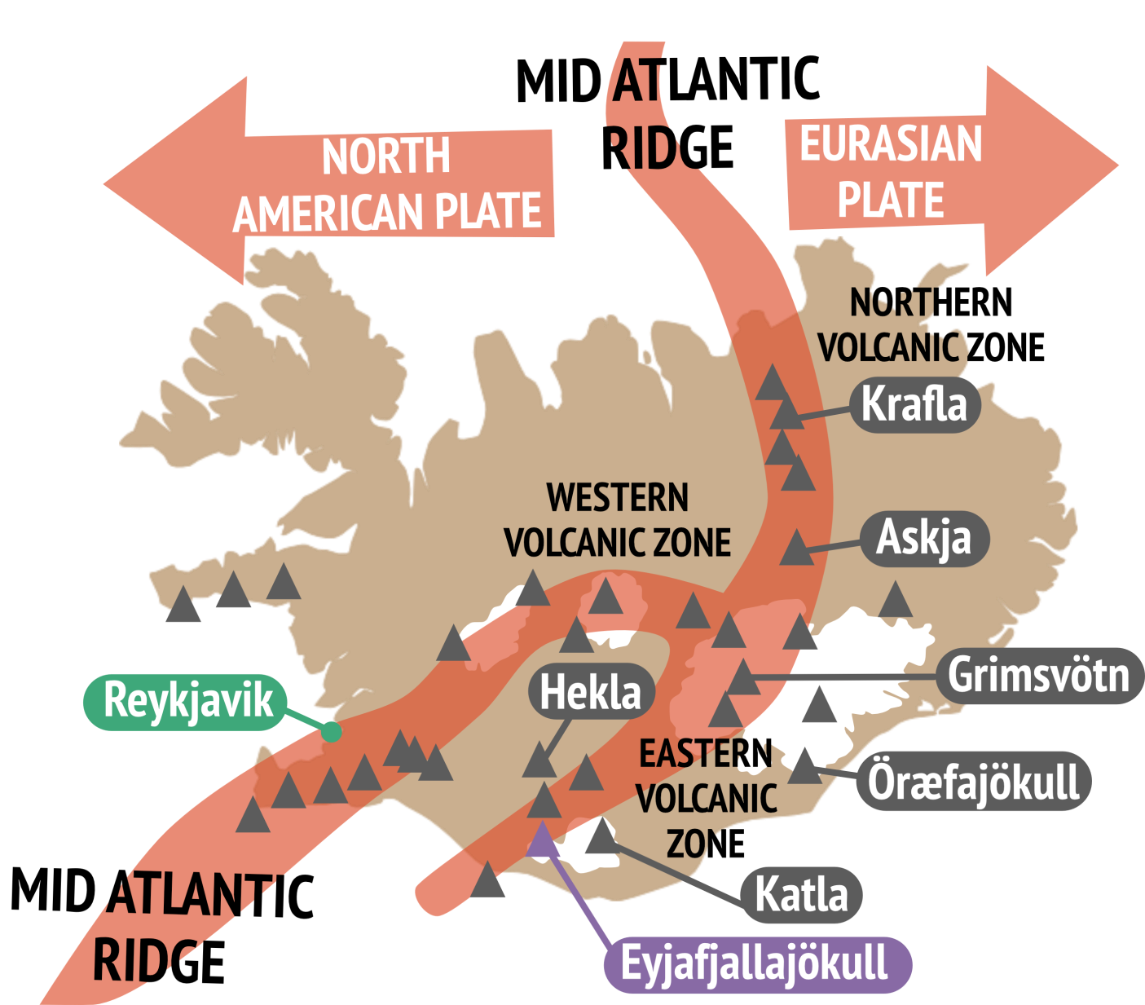
Mid Atlantic Ridge – divergent plate boundary
North American and Eurasian plates moving apart at 25mm/year
Iceland also lies above a ‘hotspot’
Eyjafjallajökull is in Iceland's Eastern Volcanic Zone
200km thick ice cap
Notes:
Iceland (High Income Country) lies on the Mid-Atlantic Ridge, a divergent plate boundary where the Eurasian and North American plates are moving apart at
approximately 25 mm yr-1. As the plates separate, magma upwells and is either extruded as lava and ash from a volcano or intruded within the crust as igneous bodies such as plutons, sills and dykes. Iceland also lies above a ‘hotspot’, an upwelling of superheated rock from the mantle which produces even more magma and volcanism. This extra magma production explains why Iceland is a significant island above sea level, while the rest of the Mid-Atlantic ridge remains underwater.
Eyjafjallajökull (ey-yah-fyal-lah-yo-kul) is a stratovolcano situated in southern Iceland. Like other volcanoes in Iceland, Eyjafjallajökull lies beneath an ice cap which is 200m thick and 100km2 in area.

Slide 4

Eruption began on 20 March 2010 – effusive fissure eruption in ice-free area of Fimmvörðuháls
14 April 2010 – site of eruption moved to the ice-capped crater of Eyjafjallajökull and became explosive
Heat from the rising magma melted the ice in the volcano’s crater.
Cold meltwater infiltrated and chilled the magma causing it to shatter into very fine ash fragments. Ash and steam exploded out from the volcano as a huge 10km high plume.
Notes:
On 20 March 2010, following months of increased shallow earthquake activity around the area of Eyjafjallajökull, fountains of lava began to erupt through fissures in the ice-free area of Fimmvörðuháls, to the northeast of the Eyjafjallajökull volcano. This effusive eruption did no damage and was considered a welcome tourist attraction, drawing in thousands of visitors each day.
On the 14 April 2010, the site of the eruption moved abruptly from the ice-free Fimmvörðuháls region to the ice-capped crater of Eyjafjallajökull. Heat from the rising magma melted the ice in the volcano’s crater. Cold meltwater mixed with the liquid magma, chilling it rapidly and causing it to shatter into very fine ash fragments. Ash and steam exploded out from the volcano (phreatomagmatic eruption) as a huge 10km high plume. This second explosive eruptive stage lasted 39 days until 22 May.

Slide 5
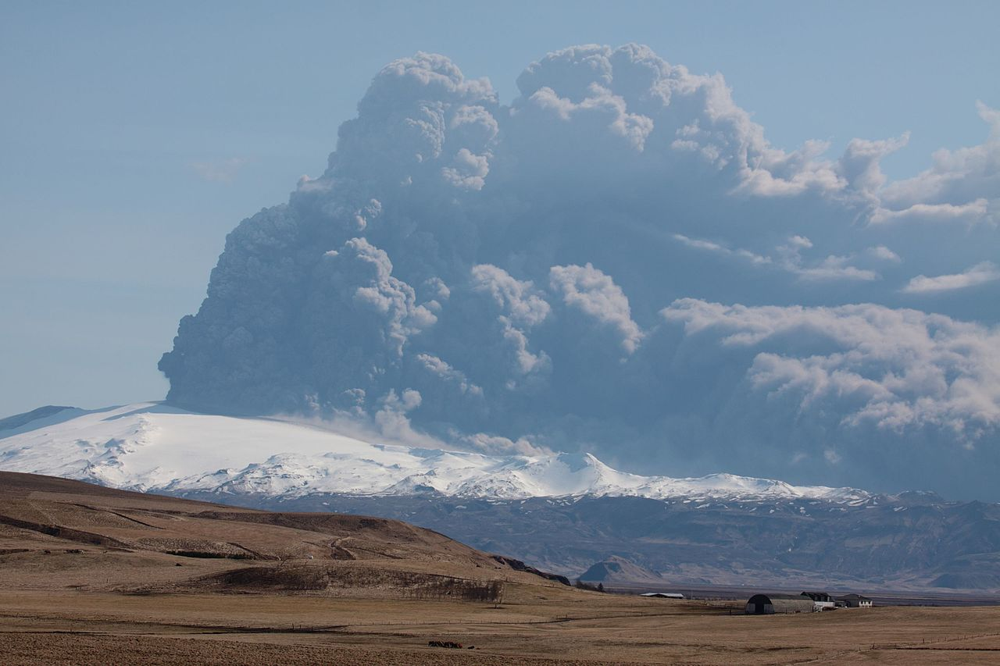
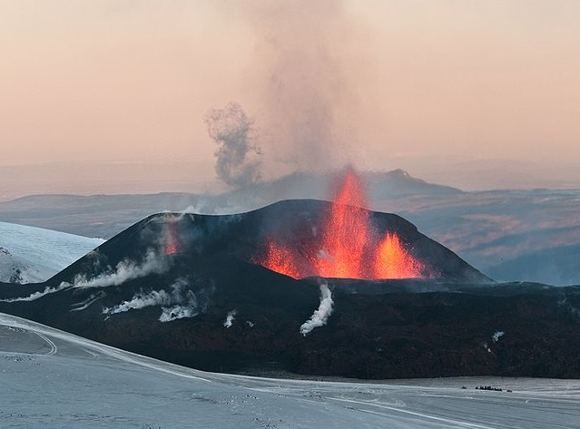
Boaworm / CC by 3.0
Ash column after explosive eruption
Fissure eruption at Fimmvörðuháls
Explosive eruption at Eyjafjallajökull
David Karnå / CC by 3.0
Notes:
Fissure eruption (effisive) at Fimmvörðuháls
Explosive eruption on Eyjafjallajokull

Slide 6

Volcanic Explosivity Index (VEI) of 4
0.27 km³ of airborne ash and rock fragments
Northwesterly winds and stable weather system → ash cloud spread over North Atlantic Ocean and Europe
Ash is made from tiny abrasive fragments → hazardous to aircraft
European airspace was closed from 15-21 April. 107,000 flights were cancelled, airline industry lost £1.1 billion (International Air Transport Association)
Many industries relying on air freighted products were badly affected → shortages of imported fruits, flowers and electronic hardware
Notes:
The eruption of Eyjafjallajökull was moderate in size (Volcanic Explosivity Index = 4) and in total, expelled 0.27 km³ of airborne tephra (ash, and rock fragments). Due to north and northwesterly winds, this ash became widely dispersed over the North Atlantic Ocean and Europe.
Volcanic ash clouds are made from tiny abrasive fragments of rock. These particles are hazardous to commercial aircraft as they erode metal, clog up fuel and cooling systems and melt to form glassy deposits inside aircraft engines leading to engine failure. Due to this danger, much of European airspace was closed from 15-21 April. 107,000 flights were cancelled and the airline industry lost £1.1 billion according to the International Air Transport Association. Many industries relying on air freighted products were badly affected by the airspace closure and shortages of imported fruits, flowers and electronic hardware were reported.

Slide 7
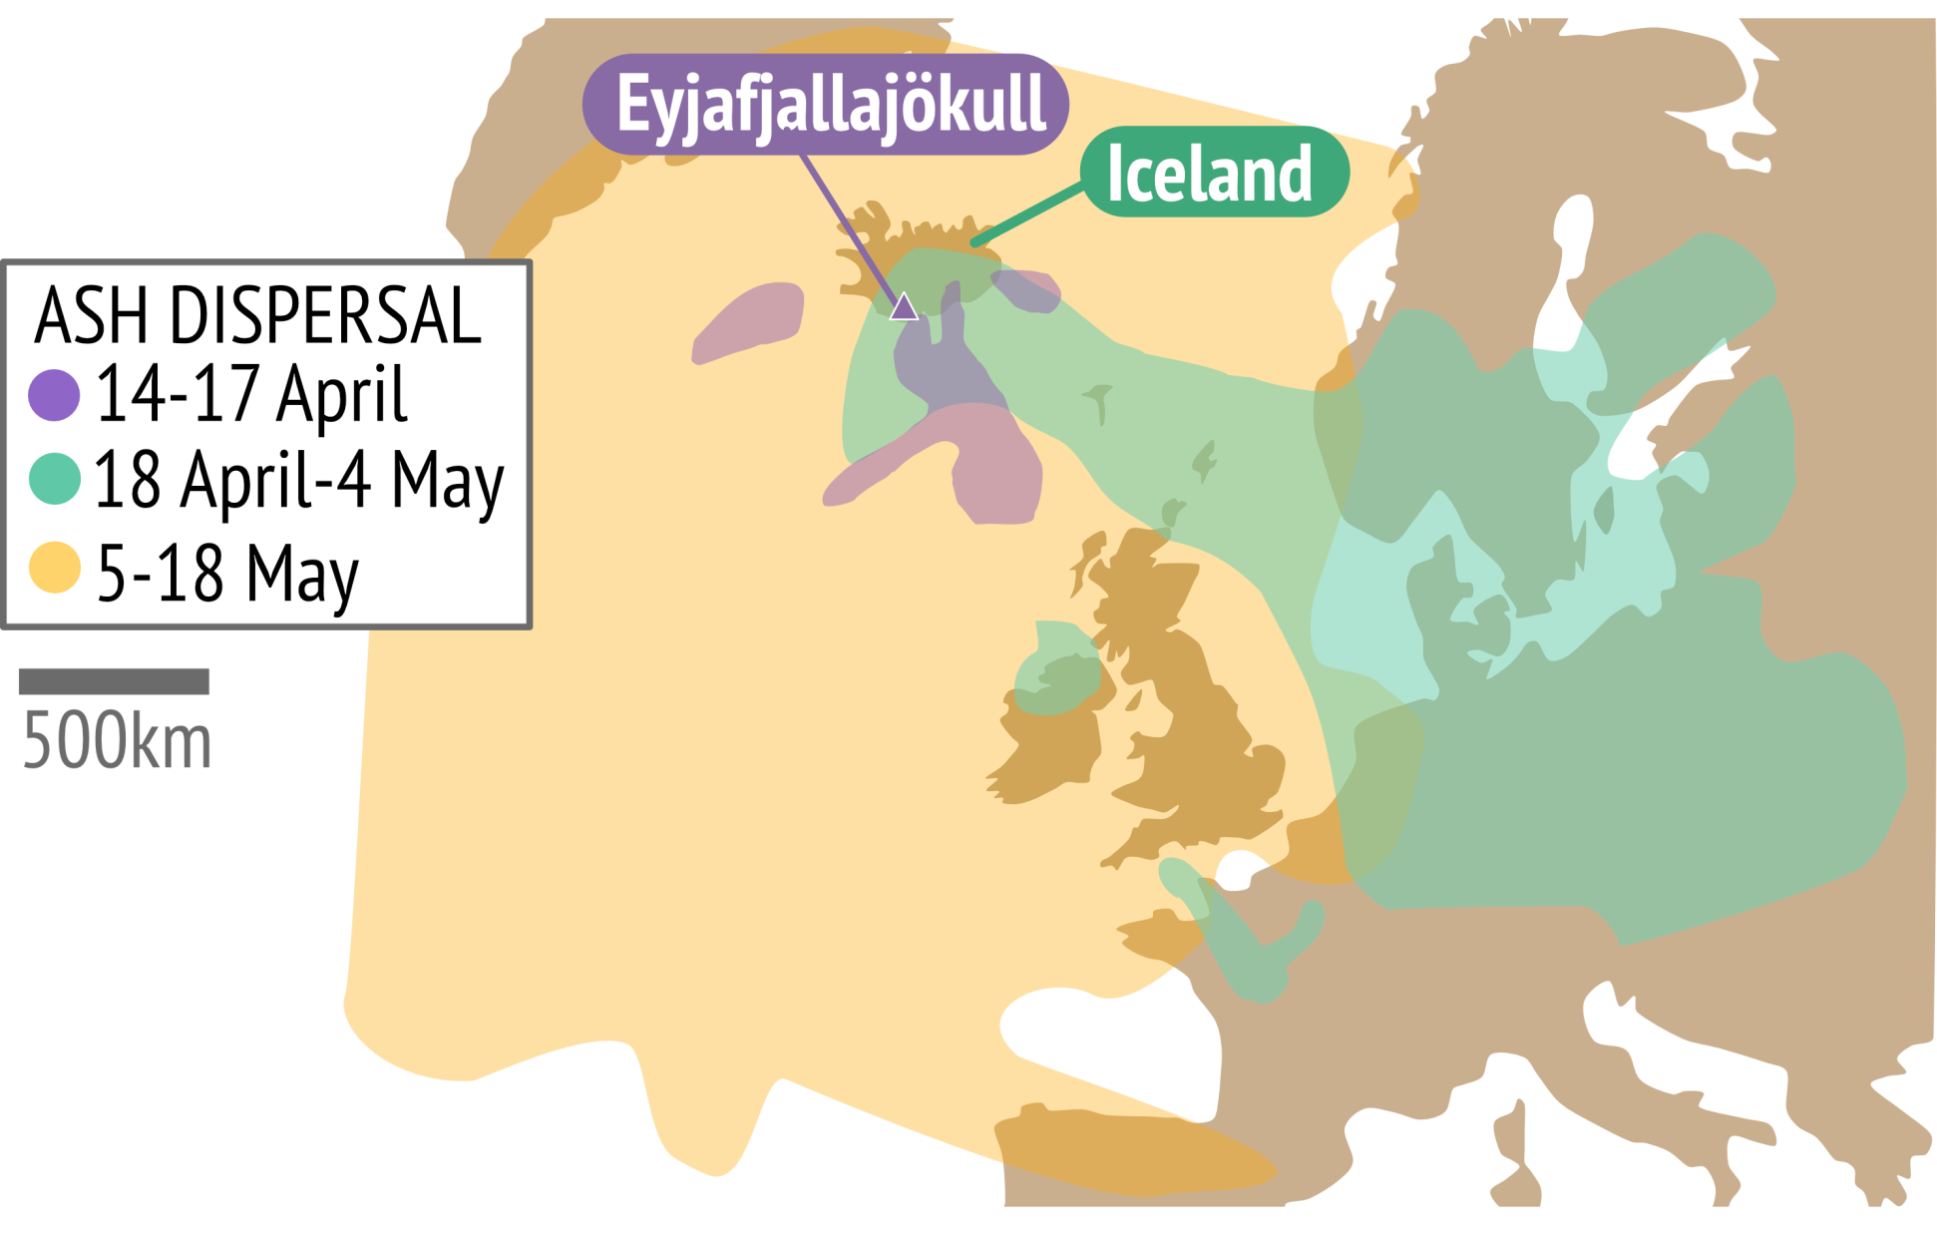
Notes:
Ash dispersal from Eyjafjallajökull

Slide 8

Eruption triggered several large glacial floods (jökulhlaups) on 14-15 April 700 evacuated
River levels raised by 3m
Agricultural land, roads, bridges and buildings damaged by flooding
800 people were evacuated via an automated telephone alert
Volcanic sediment transported by the floods completely filled the lake at the foot of Gígjökull glacier with more than 17 million m³ of sediment.
Notes:
The melting of Eyjafjallajökull ice cap triggered several large glacial floods, known as jökulhlaups on the 14-15 April. The floods raised local river levels by 3m, flooded farmland and damaged buildings, roads and bridges. 800 people were evacuated via an automated telephone alert as a precaution. The floods transported huge volumes of volcanic sediment and completely filled in the lake at the foot of Gígjökull glacier with more than 17 million m³ of sediment.

Slide 9
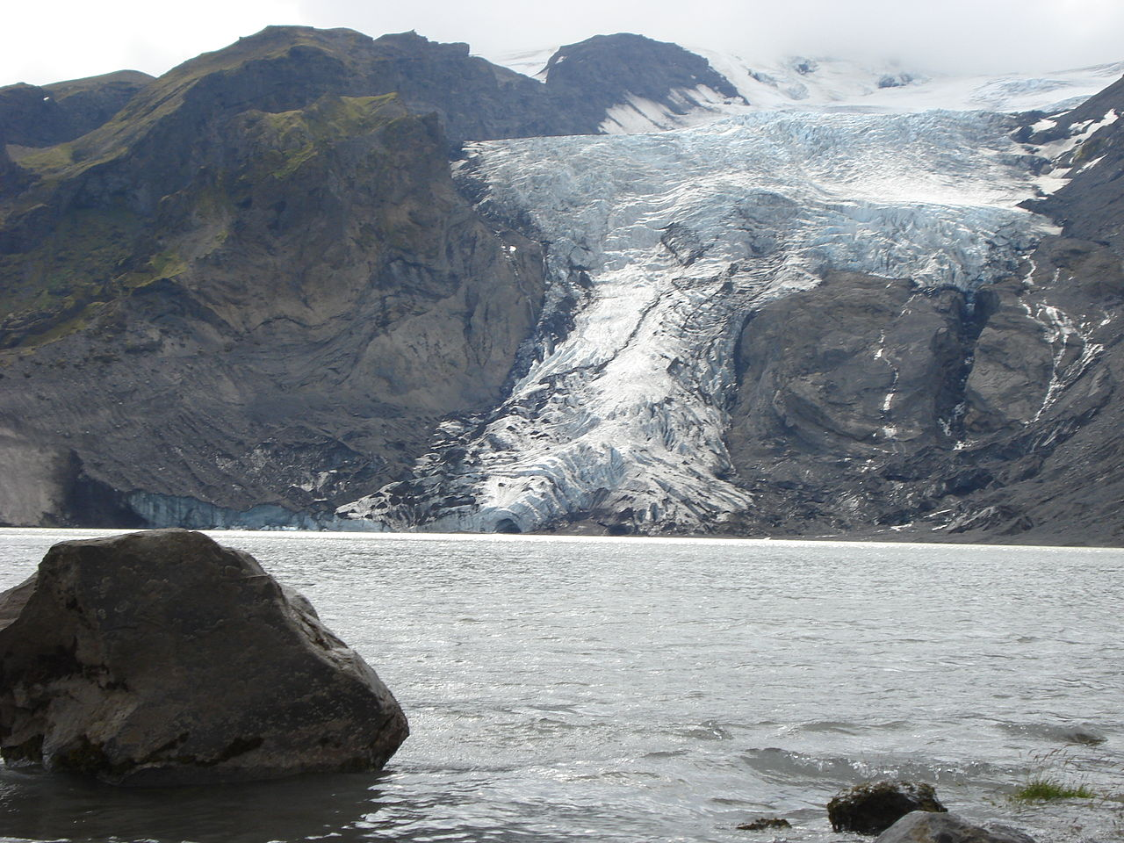
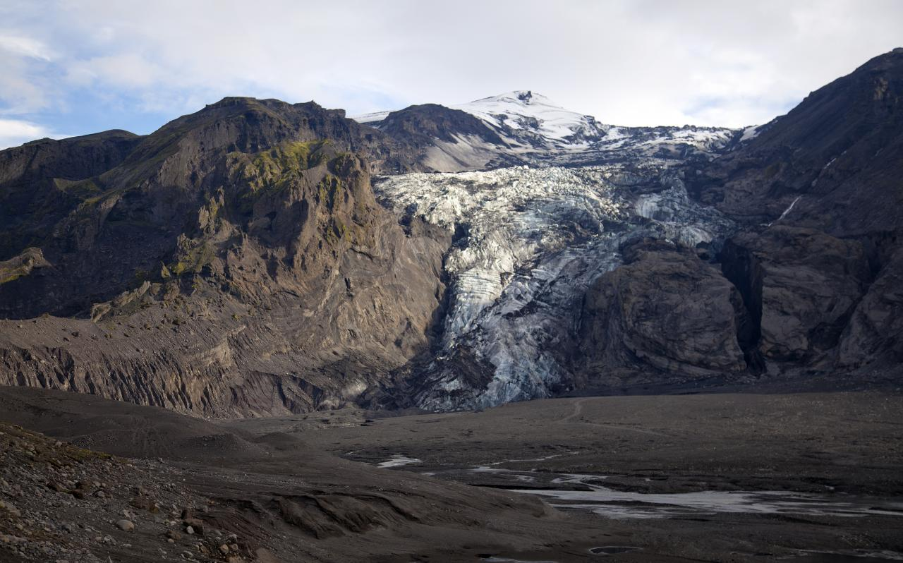
GÍGJÖKULL LAKE
Lake completely filled in with sediment after eruption in 2010
Lake at the foot of Gígjökull glacier in Summer 2008

Slide 10
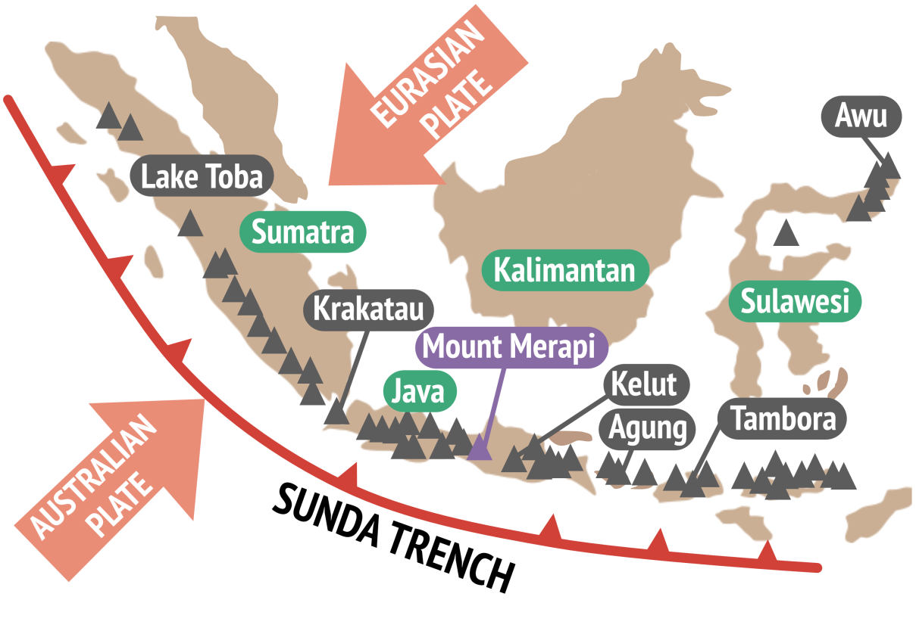
MOUNT MERAPI, INDONESIA
Sunda trench subduction zone, convergent boundary
Australian plate forced beneath the Eurasian plate at 60-70 mm yr⁻¹.
Mount Merapi is a stratovolcano on the island of Java
Eruptions of VEI 1-3 common
70,000 people live in close vicinity, 3 million in Yogyakarta 30km south
Notes:
Mount Merapi is a stratovolcano on the island of Java in Indonesia. The volcano sits on the Sunda Trench, a subduction zone in which the Australian plate is being forced beneath the Eurasian plate at a rate of 60-70 mm yr⁻¹.
Mount Merapi has erupted many times over the last 100 years, typically producing lava domes (mounds of viscous lava which pile up around the vent) and pyroclastic density currents. Prior to 2010, these eruptions had occurred approximately every 4-6 years. Eruptions were typically small with volcanic explosivity indices (VEI) of 1-3, however it was known that larger explosive eruptions were possible and had occurred in the past (e.g. in 1872, VEI=4).
Approximately 70,000 people live in the immediate vicinity of Mount Merapi and >3 million people live in the city of Yogyakarta just 30km south of the volcano, so the volcano was closely monitored by the Center for Volcanology and Geological Hazard Mitigation (CVGHM).

Slide 11

10:02 (UTC) 26 October 2010 Mount Merapi erupted, VEI = 4
6 million m³ of rock from previous lava dome were blasted out
12km ash cloud, pyroclastic flows reached 8km from summit, new lava dome started to form
4 November 17km ash column + additional pyroclastic flows
Eruption had subsided by 30 November 2010
~130 million m³ of new volcanic material (lava and ash) on Merapi’s slopes
Notes:
At 10:02 (UTC) 26 October 2010 Mount Merapi erupted explosively (VEI = 4) in the first stage of a multi-stage eruption. The eruption destroyed the previous 2006 lava dome and formed a new crater by blasting out 6 million m³ of rock. An ash cloud was projected 12km into the atmosphere and pyroclastic flows swept down the volcano’s southern slopes reaching distances of 8km.
From 1-4 November, Merapi formed a new lava dome through the eruption of 5 million m³ of lava. During the night of 4 November an unusually large explosive eruption generated a 17km ash column lava and triggered additional pyroclastic flows. Volcanic activity began to decrease from 11 November and had ended by 30 November. The eruption generated ~130 million m³ of new volcanic material (lava and ash) on Merapi’s slopes.

Slide 12
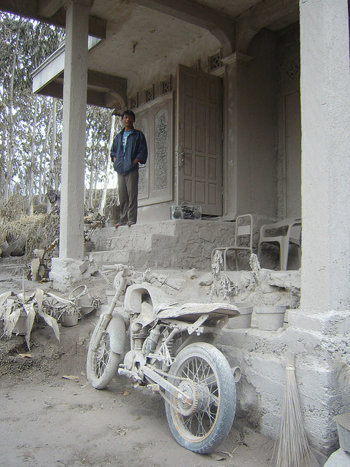
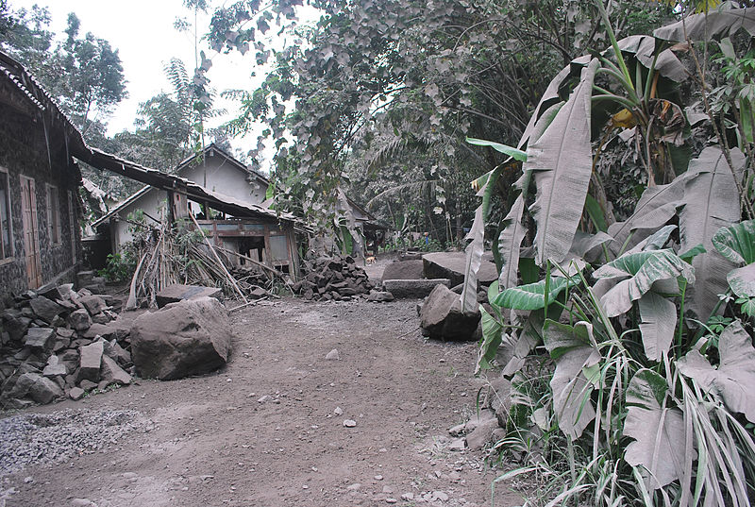
Wikimedia/AusAID/Jeong Park
Wikimedia/AusAID/Jeong Park
Notes:
Volcanic ash covers villages

Slide 13

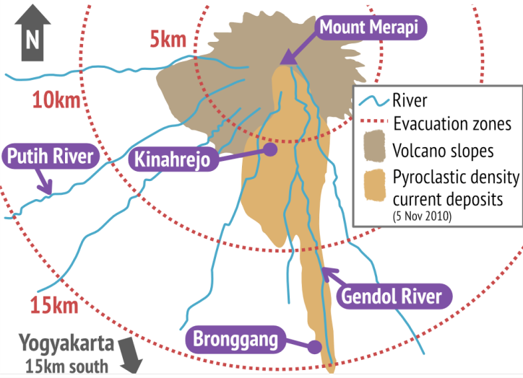
10km evacuation zone on 25 October
Increased to 20km on 5 Nov
35 people, who refused to leave the village of Kinahrejo, were killed by pyroclastic flows on 26 Oct
On 5 Nov 87 people were killed in village of Bronggang which had not yet been evacuated
In total 367 fatalities and >400,000 had to be evacuated not able to return to their homes for > 6 weeks.
Notes:
The best way of minimizing fatalities from pyroclastic flows is to evacuate people from within the risk zone.
On the 25 October the CVGHM called for the evacuation of everyone within a 10km radius of Merapi’s summit. This was increased to 15km and then 20km on the 5 November after the increase in explosive activity.
35 people, who refused to leave the village of Kinahrejo, 7km away from the summit, were killed by pyroclastic flows on 26 October. On 5 November a further 87 people were killed in village of Bronggang which had not yet been evacuated. In total the eruption and associated PDCs caused 367 fatalities and >400,000 people were evacuated, not able to return home for over 6 weeks. Even so, the close monitoring of the volcano, timely evacuations and good communication methods did save thousands of lives.

Slide 14
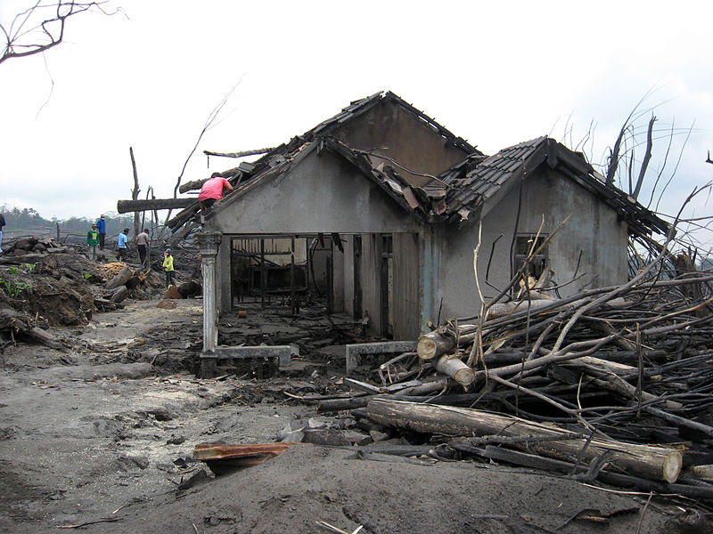
House destroyed by pyroclastic flows in 2010 eruption
Wikimedia/Crisco 1492/CC-By-3.0
Notes:
A house destroyed by the pyroclastic flows that occurred during the 2010 Eruptions of Mount Merapi

Slide 15

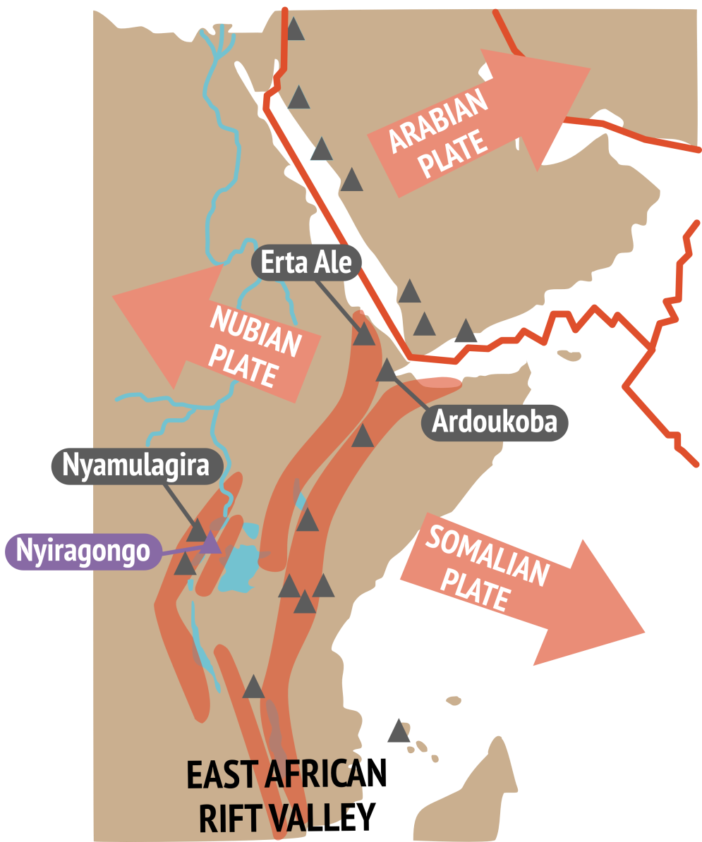
Mount Nyiragongo is in the Democratic Republic of Congo
Part of East African Rift Valley, a developing divergent plate boundary
15km north of the city of Goma ~ 500,000 people
Crater contains persistent lava lake
The lava emitted in eruptions at Nyiragongo is often unusually fluid (nephelinite - very low SiO2 content).
Notes:
Nyiragongo is a volcano in the Democratic Republic of Congo, it forms part of the Albertine rift, the western branch of the East African Rift Valley. The East African Rift Valley is a developing divergent plate boundary where the eastern portion of Africa, the Somalian plate is pulling away from the rest of the continent, that comprises the Nubian plate.
Nyiragongo lies 15km north of the city of Goma, home to 1 million people many of whom are refugees from the Rwandan genocide in 1994.
Nyiragongo crater contains a rare persistent lava lake (only 5 persistent lava lakes exist on Earth). The lava emitted in eruptions at Nyiragongo is often unusually fluid, a type of lava called melilite nephelinite, this makes it extremely dangerous as it can flow very fast down the steep sides of the volcano.

Slide 16

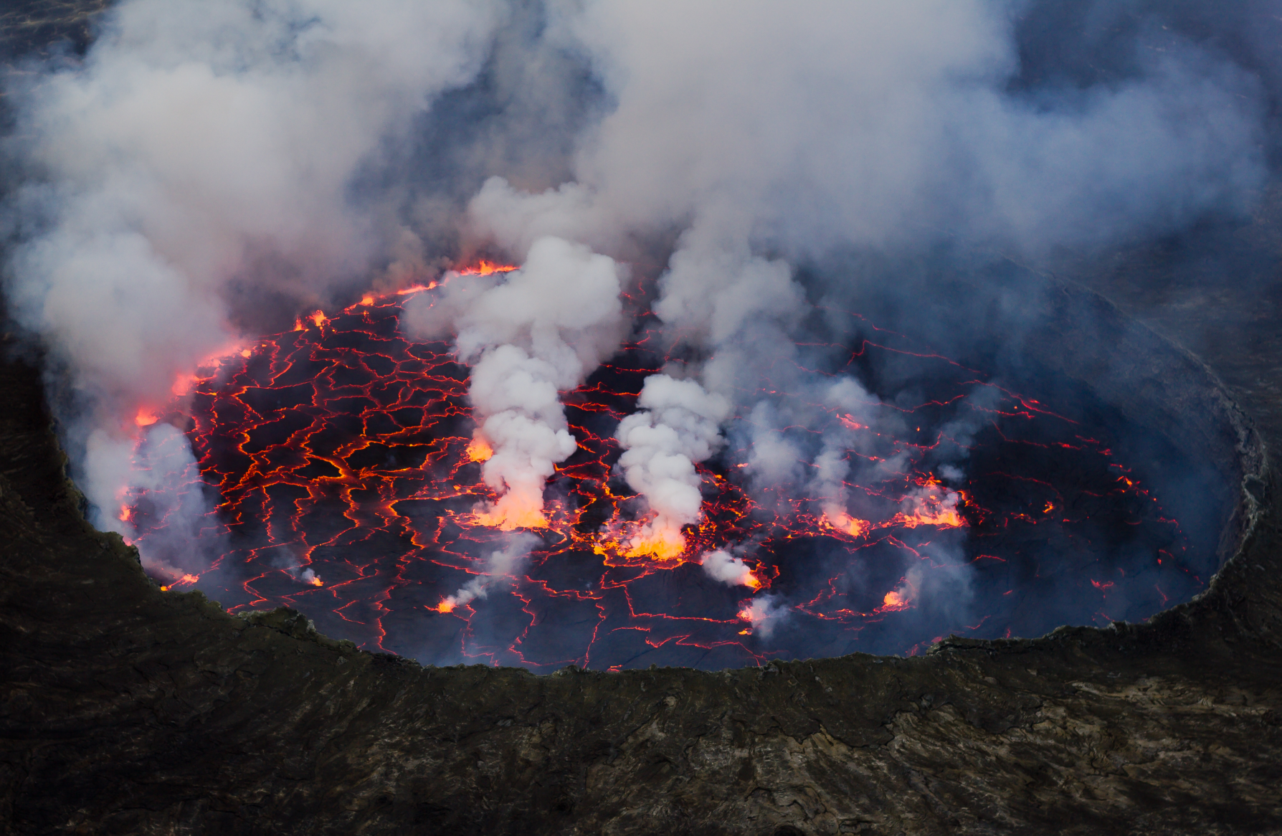
Wikimedia/Caitjeenk/CC-By-3.0
Notes:
Lava lake at Nyiragongo

Slide 17

Nyiragongo erupted on January 17, 2002
Difficult to monitor volcano due to political unrest
13km fissure opened up on the south side of the volcano
Lava flows reached speeds of 60km/hr in the direction of Goma and Lake Kivo
14-34 million m³ of lava
Eruption of lava stopped after ~12 hours but lava continued to flow towards and into Lake Kivo for a 3 days
45 fatalities in first 24 hours due to lava flows and CO2 asphyxiation
Notes:
It’s not just explosive eruptions that can be hazardous. A fissure eruption (effusive) occurred at Mount Nyiragongo on 17 January 2002. The fissures opened up to the south side of the volcano allowing lava from the lava lake to drained through. The lava reached speeds of 60 km/hr with little warning for the nearby city of Goma. The unrest in the country has made it difficult to monitor the volcano and put emergency responses in place – 3 out of 5 seismic monitoring stations had been vandalized during a civil war lasting from 1997-2003.
The volcano erupted 14-34 million m³ of lava and 45 fatalities occurred in first 24 hours due to lava flows and CO2 asphyxiation.

Slide 18
Lava flows covered 15% of Goma
2 hospitals, 14 villages, over 4,500 buildings and part of Goma’s international airport runway were destroyed by lava flows
120,000 people left homeless
350,000 people fled eastwards to Rwanda to escape the lava flows
Cholera break out in camps from lack of clean drinking water and sanitation
Lava flows set alight a petrol station on 21 January. 50 people were in the petrol station trying to siphon off fuel and died in the explosion.
Total fatalities = 147
Notes:
As a result of the eruption lava flows covered 15% of the city of Goma. 2 hospitals, 14 villages over 4,500 buildings and part of the international Goma airport runway were destroyed by the lava flows. 120,000 people left homeless and over 350,000 people fled eastwards to Rwanda to escape the lava flows.
There were cholera break outs in refugee camps from lack of clean drinking water and sanitation
Lava flows set alight a petrol station on 21 January. 50 people were in the petrol station trying to siphon off fuel and died in the explosion.
In total 147 people dies due to lava flows, CO2 asphyxiation and building collapse.

Slide 19
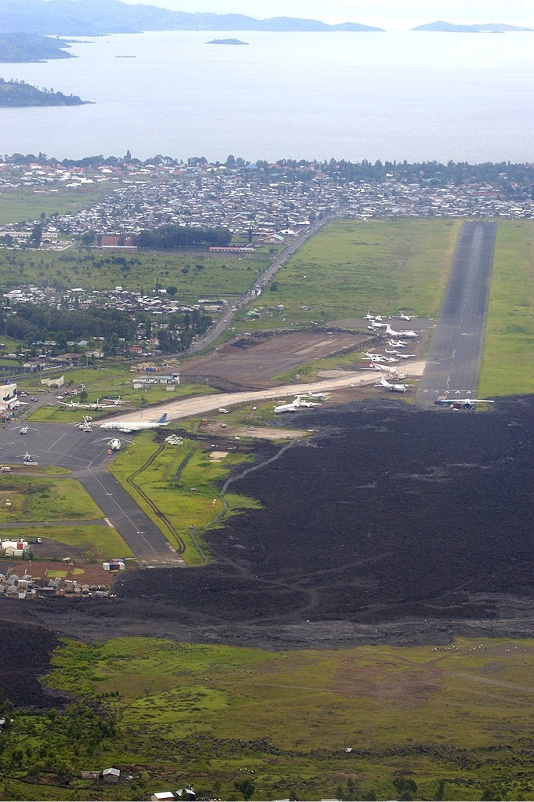
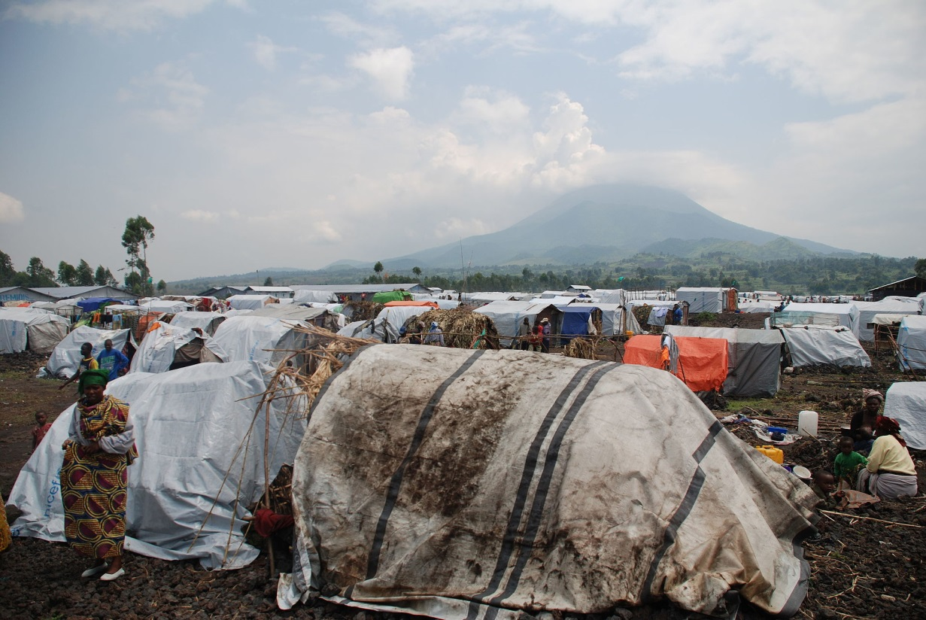
Lava covering airport runway
Shelters in Kanyaruchinya camp
Steven van Damme/Oxfam/CC BY 2.0

Slide 20
KILAUEA HAWAII, USA

