Slide 1
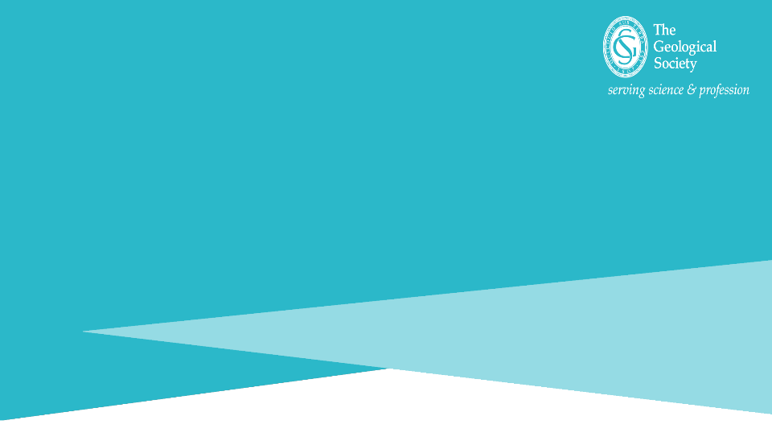

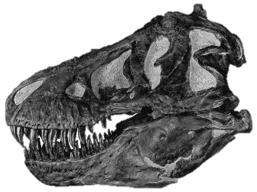
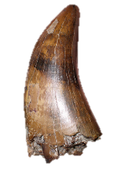
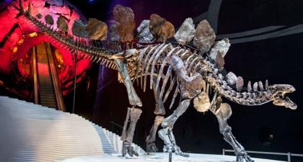
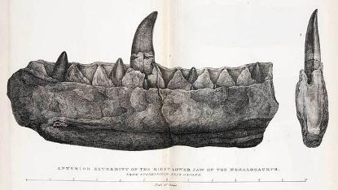
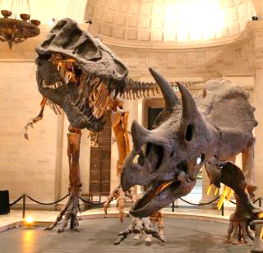
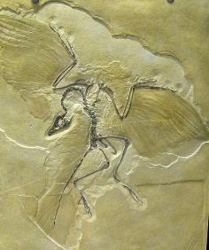
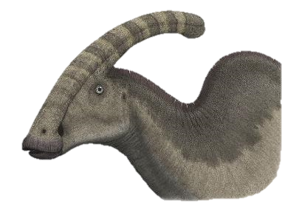
© Trustees of the Natural History Museum
Wikimedia/Steveoc86
Notes:
Teacher and presenter guidance
This presentation is broken down into 5 main sections. With a short quiz activity at the end. Each slide has some suggested guidance in the notes section on how to explain the slide. The Geological Society gives permission for individuals to adapt the presentation however they see fit.
Factsheet and activity sheet on dinosaurs suitable for KS2 pupils available at www.geolsoc.org.uk/factsheets
Geological time and history of naming the dinosaurs
- How old is the Earth?
When did the dinosaurs live?
Naming the dinosaurs
What is a dinosaur?
Vertebrates, tetrapods and reptiles
Dinosaur characteristics
Sauropods
-Sauropods
-Sauropod teeth
Ornithischians
Ornithischians
Stegosaurs
Hadrosaurs
Anklysosaurs
Ceratopsians
Theropods
Theropods and carnivores
Different diets
Dinosaur colours
Evolution of birds
Quiz

Slide 2

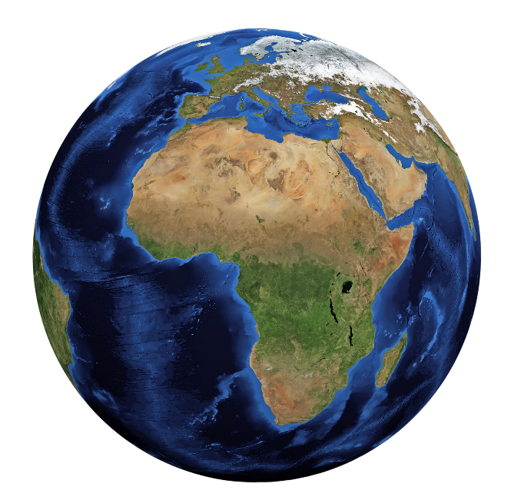
4,600,000,000 years old!
Notes:
Who can guess at how old the Earth is? Allow guessing - guide with higher or lower than. Click for 4.6 billion years
The Earth is 4.6 billion years old. This is a huge amount of time, so geologists and palaeontologists, scientists who study rocks and fossils, have split the 4.6 billion years up into different sections which they call geological time periods.
Does anyone know the names of any geological time periods? (might know Jurassic, Cretaceous etc. )
(next slide for geological time periods)

Slide 3


Present day
Quaternary
0.5Ma First humans
Present day
Crows
Flamingoes
2.5
Neogene
Song birds
Chickens
23
Paleogene
Cenozoic
Owls
Hawks
Kiwis
66
Penguins
Kingfishers
Woodpeckers
Parrots
Cretaceous
55 Ma
First modern birds
145
66 Ma
Extinction of dinosaurs
Jurassic
Triceratops
201
Ankylosaurus
Triassic
Tyrannosaurus
Velociraptor
252
Cretaceous
Spinosaurus
Parasaurolophus
Permian
Baryonyx
Iguanodon
Millions of years ago
298
Carboniferous
Microraptor
358
145 Ma
Archaeopteryx
Devonian
150 Ma First bird-like dinosaurs
419
Brachiosaurus
Stegosaurus
Silurian
Jurassic
Allosaurus
443
Ordovician
Heterodontosaurus
485
Megalosaurus
Lesothosaurus
541
Cambrian
201 Ma
Eoraptor
Coelophysis
Thecodontosaurus
Triassic
Herrerasaurus
Precambrian
245 Ma
First dinosaurs
4600
Notes:
Here are all of the time periods in a chart called the geological timescale. The oldest time period is at the bottom of the chart, called the Precambrian, and the most recent time period, the one we are currently living in, is the small orange slither at the top and is called the Quaternary period.
When did the Quaternary period begin? 2.5 million years ago
The different geological periods relate to events which have happened in the Earth's history. For example, during the Carboniferous period (dark blue) there were tropical weather conditions in the UK and lots of coal and limestone were formed.
Lots of different ancient animals have lived on Earth throughout its 4.6 billion years, the earliest plants and animals evolved were extremely simple and made from only one cell where as humans and other animals today are made up of trillions of cells. Over millions of years these simple organisms have evolved into a huge range of different plants and animals, and some of these were the dinosaurs.
What geological time periods did the dinosaurs live in? (might already know Jurassic, Cretaceous, if not they can make guesses using names on the geological timescale)
Click for more detailed Triassic- Cenozoic timescale
Here is a blown up version of the past 250 million years showing the Triassic, Jurassic, Cretaceous periods and the Cenozoic era with silhouettes of dinosaurs that were around during these times.
The first dinosaurs evolved around 245 million years ago in the Triassic period. Some of these first dinosaurs are called Eoraptor, Herrerasaurus and Coelophysis (point on diagram).
The dinosaurs lived throughout the Triassic, Jurassic and Cretaceous periods however different species of dinosaur evolved and died out during the these time periods. For example T. rex lived right at the end of the Cretaceous period 68 – 66 million years ago, where as Stegosaurus lived in the middle of the Jurassic period from 155–150 million years ago. These dinosaurs would have never met because Stegosaurus went extinct more than 80 million years before T. rex evolved - in fact T. rex lived closer in time to humans than it did to Stegosaurus!
Almost all of the dinosaurs went extinct end of the Cretaceous period 66 million years ago. What does it mean when we use the word ‘extinct’? Becoming extinct means that all individuals in a species have died out.
A few dinosaurs did manage to survive this extinction event 66 million years ago and they went on to evolve into many different forms which are still around today.
Does anyone know which dinosaurs are still around today?
Birds
Almost all of the dinosaurs went extinct at the end of the Cretaceous period however some ancient birds, which evolved form a group of dinosaurs called the theropods, managed to survive.
These ancient birds went on to evolve into over 10,000 species which live in different environments and habitats across the Earth. So when we say that the dinosaurs went extinct 66 million years ago, we really mean that all of the dinosaurs that were not birds went extinct 66 million years ago.

Slide 4

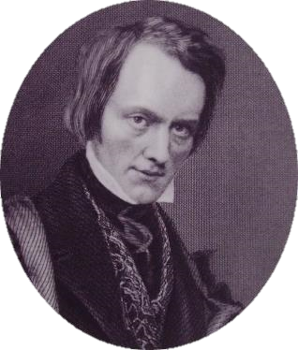
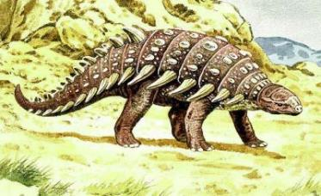
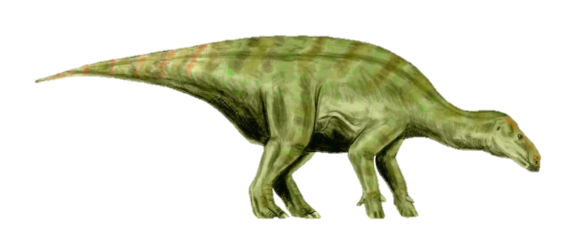
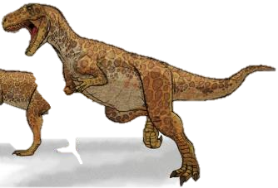
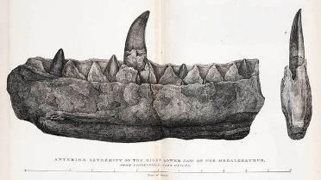
Sir Richard Owen
©Trustees of the Natural History Museum
Hylaeosaurus
Iguanodon
Megalosaurus
Notes:
This is Sir Richard Owen a Victorian palaeontologist and anatomist. He is most famous for inventing the name Dinosaur in 1842.
Richard Owen had been studying fossils from animals called Megalosaurus, Hyleaosaurus and Iguanodon. He realised that these fossils were from reptiles, but they shared unique characteristics that no other living reptiles had. He worked out that they must have all belonged to an ancient group of reptiles that no longer lived on Earth. He named this group the ‘Dinosauria’ or the dinosaurs, which means ‘terrible lizard’ in Greek.
The picture in the bottom right hand corner shows a drawing of fossil jaw from a scientific paper published in 1824 by a man called William Buckland. This fossil was found in a quarry in Oxfordshire and belongs to a dinosaur called Megalosaurus, the first ever dinosaur to be named.
Do you think Megalosaurus was a meat eater or a plant eater? The blade like teeth mean that Megalosaurus was a meat eater
Since the first three dinosaurs were named in 1842, over 700 species of extinct dinosaurs have been found as fossils.

Slide 5



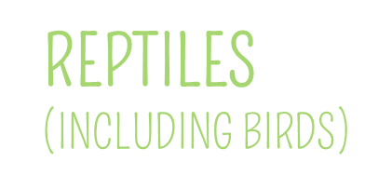
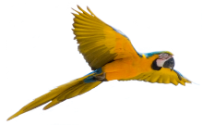
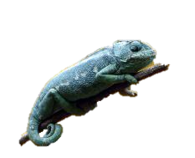
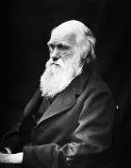

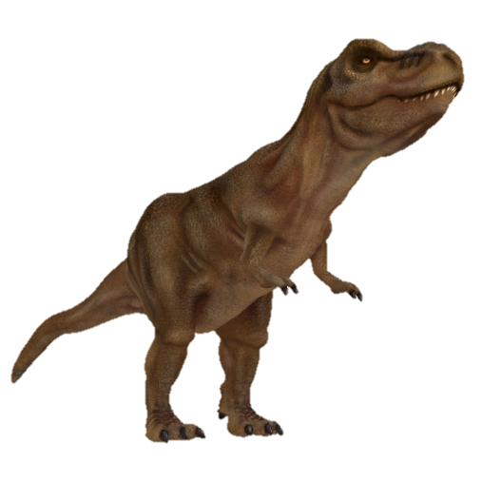
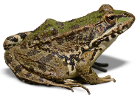
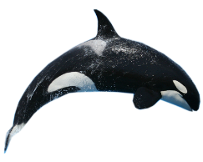
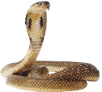
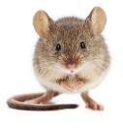
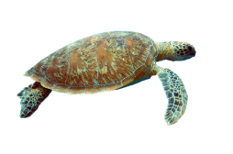
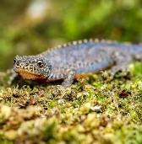
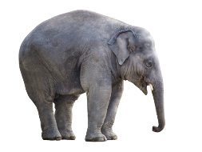
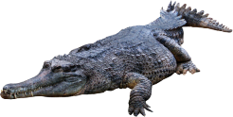
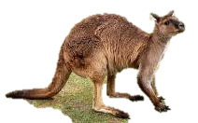
Notes:
So what is a dinosaur?
A vertebrate is an animal with a backbone, an invertebrate is an animal without a backbone (e.g. insects, jellyfish, snails etc.)
Are dinosaurs vertebrates or invertebrates? Dinosaurs have a backbone which means they are vertebrates.
They also have arms, legs, fingers and toes. Animals with these characteristics are called tetrapods, a word which means ‘four legs’ in Greek.
All mammals, amphibians, reptiles and birds are tetrapods. Some tetrapods, like snakes, have lost their arms and legs, and others, such as bats and birds, have evolved to use their arms as wings. Even so, these animals are still classified as tetrapods because they evolved from animals that had arms, legs, fingers and toes.
Out of the mammals, reptiles and amphibians which group do you think the dinosaurs belonged to?
Click for dinosaur to appear in reptile box
As well as being vertebrates and tetrapods, dinosaurs belong to the reptile group alongside the turtles, snakes, lizards and crocodiles.

Slide 6
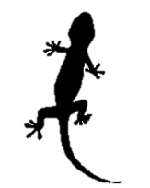
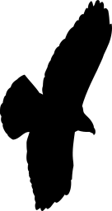
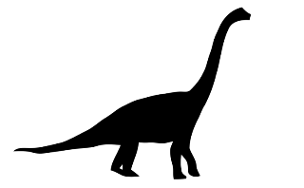
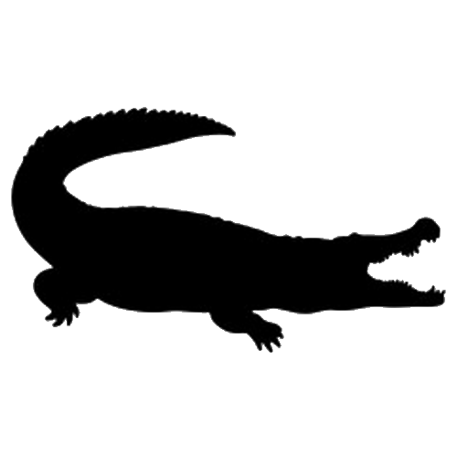
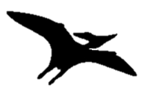

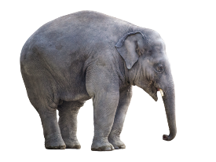

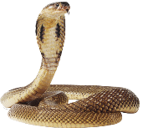
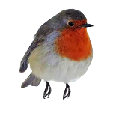

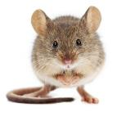

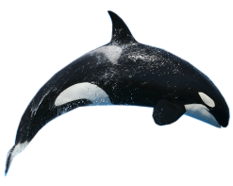

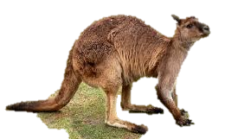
SO WHAT IS A DINOSAUR?
TETRAPODS
Lizards & Snakes
Pterosaurs (EXTINCT)
Birds & Dinosaurs
Crocodiles
Notes:
When the dinosaurs were first named palaeontologists though they were closely related to lizards and ‘sauros’ in Greek means lizard. However out of the living reptiles, dinosaurs and birds are actually most closely related to crocodiles.

Slide 7

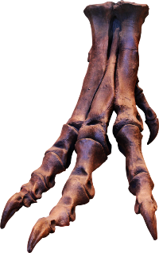
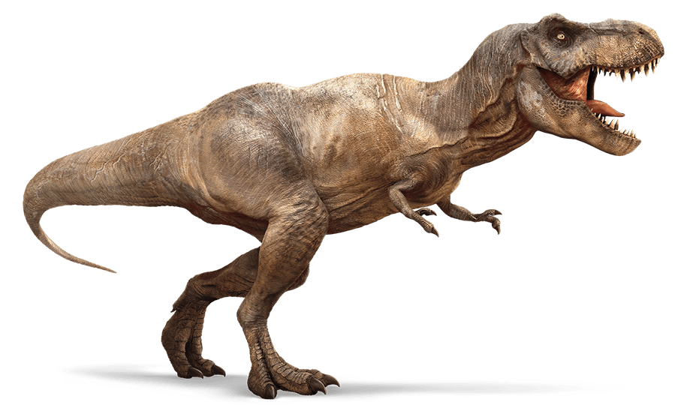
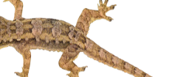
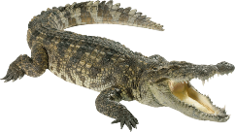
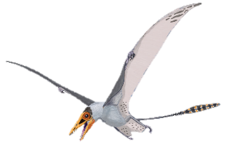
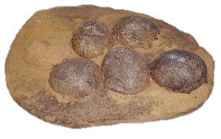
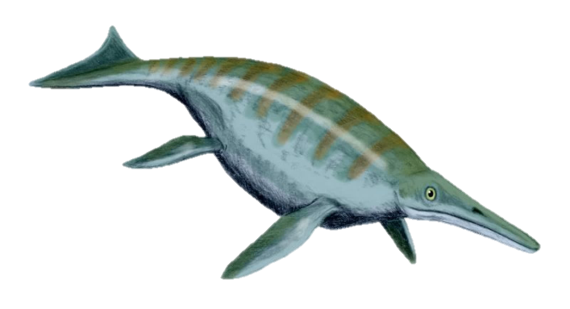
Ankle
Foot bones
(off the ground)
Dinosaur
Legs under body
Toe bones
Crocodile
Lizard
Legs sprawled
Hard shelled eggs in nest
Wikimedia/ Nobu Tamura
Wikimedia/ Dmitry Bogdanov
Notes:
Even though different dinosaurs may look and act very differently from one another, there are certain characteristics that all dinosaurs share.
Dinosaurs walk with their legs directly under their bodies similar to most modern mammals, other reptiles such as crocodiles and lizards don’t walk like this and instead walk with their legs sprawled to the sides. Having upright bodies means that dinosaurs could run and breathe at the same time – lizards for example cannot do this –they must take breaks to breathe when running.
Dinosaurs stand on their toes rather than on their whole foot.
Dinosaurs built nests and laid hard shelled eggs. Other reptiles like turtles and lizards lay soft shelled eggs.
All of the dinosaurs lived on land so flying pterosaurs and swimming ichthyosaurs were not dinosaurs.
Dinosaurs also have lots of distinctive features in their skeletons, particularly in their skulls, ankles and hip bones – these features help palaeontologists to decide whether a fossil they’ve found could be a dinosaur.

Slide 8



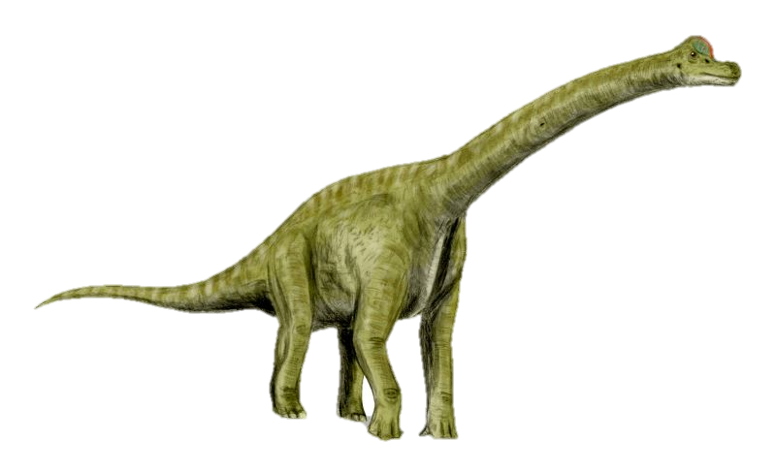
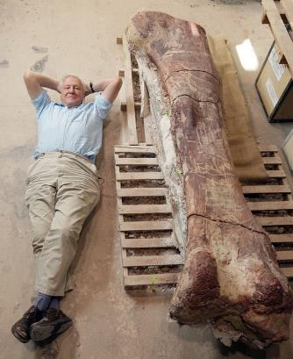
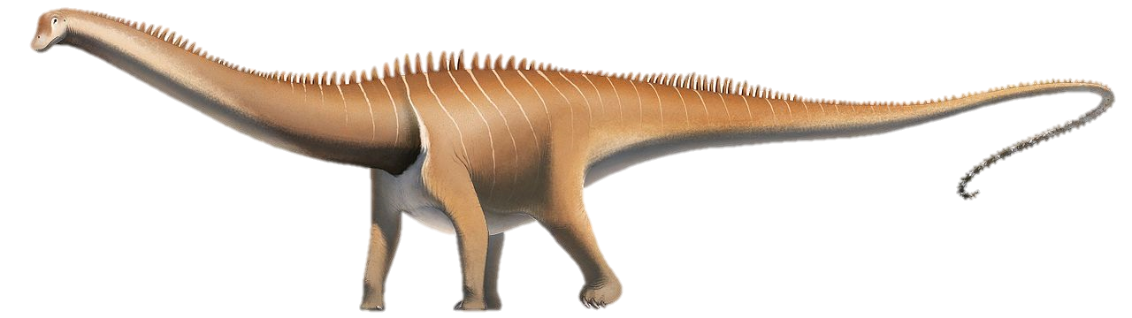
Brachiosaurus
Wikimedia/Nobu Tamura
Diplodocus
Photograph: Robin Cox/BBC
Wikimedia/Fred Wierum
Notes:
So we know that dinosaurs are reptiles but we also know that not all dinosaurs are the same. There are in fact three main different types of dinosaur – the sauropods, ornithischians and the theropods.
Let’s start with the sauropods.
Sauropods were plant eating dinosaurs so they were herbivores. They walked on four legs, had extremely long necks and tails, tiny skulls and huge stomachs.
The smallest sauropods were probably about 5-6m long, but giants like the titanosaurs grew to be over 30m from head to tail, these would’ve been the largest animals to ever live on land!
The picture on the left shows Sir David Attenborough lying next to a thigh bone of a titanosaur. This sauropod dinosaur was about 37m long and weighed 70 tonnes, that’s about the same weight as 12 adult elephants!
Initially palaeontologists from the Victorian era thought that sauropods would have lived in water because of their long necks and nostrils at the top of their heads. However palaeontologists know that these long necks actually just made it easier for them to search for food without having to move their bodies.
Fossilized footprint tracks suggest that sauropods travelled in groups or herds like elephants.
Some sauropods, like Brachiosaurus, held their necks high like giraffes whereas others, like Diplodocus, held their necks horizontally.
These dinosaurs sometimes lived alongside each other so why do you think having different neck heights could have been useful?
Different neck heights would’ve allowed the dinosaurs to reach different types of plants so they were not competing for the same type of food.

Slide 9

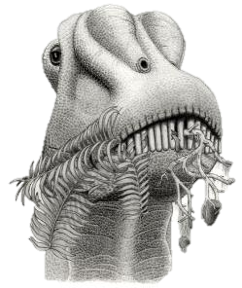





© The Trustees of The Natural History Museum
Diplodocus
Camarasaurus
Wikimedia/PaleoPortfolio
400kg per day!
© 2012 PaleoGallery
Notes:
Sauropods also had differently shaped teeth which allowed them to eat different types of plants.
Diplodocus for example had long, thin, peg-shaped teeth so it could eat ferns and strip soft leaves from trees. A different sauropod called Camarasaurus had leaf or spoon-shaped teeth and these were better at grinding down on tougher vegetation.
Why do you think sauropods had to have such large stomachs?
Eating plants doesn’t give you as much energy as eating meat, so sauropods had to eat a colossal 400kg of greenery every day to survive. To take in all of this food sauropod stomachs had to be enormous.
To help with digestion, some sauropods swallowed stones, called gastroliths, to help them grind up plants and twigs in their stomachs.

Slide 10










Iguanodon
Stegosaur
Wikimedia/ Steveoc86
Wikimedia/Nobu Tamura
Triceratops
Hadrosaur
© Nobu Tamura
Wikimedia/ Steveoc86
Ankylosaur
Pachycephalosaur
Wikimedia/Nobu Tamura
Wikimedia/ PaleoPortfolio
Notes:
The ornithischians were another group of plant eating dinosaurs, however unlike the sauropods who were all quite similar in shape (long neck, small head, large stomach), there were lots of different types of ornithischian dinosaurs with very different shapes and behaviours.
Does anyone know the names of any of these dinosaurs? Click for names
What different features can you see on these dinosaurs?
Armoured plates, spikes, horns, crests, frills, clubbed tails etc.
More information in next slides.

Slide 11



Wikimedia/Nobu Tamura
Sophie the Stegosaurus
Maidment et al. 2015 PLoS ONE
Wikimedia/Tim Evanson
Notes:
Stegosaurs were dinosaurs with large bony plates along their backs and spikes along their tails.
The spikes would’ve been used to defend themselves against predators, but the plates are thought to have been to make the stegosaurs to appear more impressive and perhaps to attract mates. Because the plates were so big they might have also been used to radiate heat away from the body to cool the dinosaur down when it was too warm.
If you’ve been to the Natural History Museum you might have seen Sophie the Stegosaurus, she is one of the most complete Stegosaur fossils ever found.

Slide 12





Parasaurolophus
Edmontonosaurus
Wikimedia/ Steveoc86
Wikimedia/ Nobu Tamura
Oxford University Museum of Natural History
Notes:
The hadrosaurs are often called the duck-billed dinosaurs because they have a sharp edged beak at the front of their jaws used for gathering plant food.
Some of the hadrosaurs like Parasaurolophus had large bony crests on their heads that contained a network of tubes whereas other hadrosaurs such as Edmontonosaurus did not have these.
Originally palaeontologists thought that these bony crests might have been used as snorkels enabling the dinosaurs to breathe underwater whilst they searched for food, however now palaeontologists think they probably used these crests like trumpets to make loud booming to communicate with others in their herd.

Slide 13


Armoured plates
Horns
Flickr/Tim Evanson
Clubbed tail
Wikimedia/Nobu Tamura
Notes:
The ankylosaurs are most well known for being covered in armoured plates and having heavy clubbed tails made bone. They also had wide skulls and two horns that pointed backwards. Ankylosaurs were so heavily armoured that even their eyelids were covered in small bony plates!
What do you think the ankylosaurs armoured plates and clubbed tail were for?
These adaptations would have protected the ankylosaurs against predators like T. rex that may have tried to eat them, they would have used their tails like weapons, swinging them at attackers to try and ward them off.
Ankylosaurs probably couldn’t run due to their bulky stature, and their short legs meant that they would’ve foraged for plants to eat close to the ground.

Slide 14



Horns
Neck frill
Styracosaurus
Wikimedia/ Nobu Tamura
Triceratops
Notes:
You’ve probably heard of the dinosaur Triceratops. Triceratops was a type of ornithischian dinosaur called a ceratopsian. The ceratopsians lived in the late Cretaceous period mainly in western North America. They walked on four legs and had large neck frills and horns, compared to modern animals they are probably most like rhinos.
Different species of ceratopsians had different numbers of horns. Triceratops is famous for having three horns on its face but some ceratopsians only had one horn, and others, such as Styracosaurus, had lots of horns sticking out from its neck frill as well has having three on its face.
The ceratopsian neck frills may have been used to protect the neck area against predators, or they may have been used to impress mates or for fighting – a bit like how stags fight each other with their antlers.

Slide 15


Good eye sight
Tyrannosaurus rex
Sharp teeth
Strong jaw
Claws
Strong legs
Notes:
We’ve looked at the sauropods and the ornithischians, the third and final group of dinosaurs are called the theropods. These dinosaurs walked on two legs rather than four and were mostly meat-eating carnivores who either hunted down their prey, fed on dead animals that they had not killed themselves, or did a bit of both.
Does anyone know what type of theropod dinosaur this is? Click for Tyrannosaurus rex
This is Tyrannosaurus rex or T. rex, one of the most famous theropod dinosaurs. T. rex lived at the end of the Cretaceous period about 68 million years ago in western north America and it was one of the largest land carnivores of all time. It is thought T. rex would have eaten other dinosaurs such as hadrosaurs, ceratopsians, ankylosaurs and even large sauropods.
Palaeontologists know that theropods were mostly meat eaters this because most theropods share these carnivorous adaptations:
- Good eyesight and large nostrils to see and smell out prey
- Sharp teeth for slicing through flesh
- Strong jaws for crushing bone
- Sharp claws for ripping apart prey
- Strong muscular legs for chasing down prey

Slide 16






Spinosaurus
Therizinosaurus
Small head
Wikimedia/Steveoc 86
Long neck
Weak jaw
Large stomach
Large claws
Wikimedia/Durbed
Notes:
Although most of the theropods were meat eaters, some theropods did evolve different diets.
Spinosaurus is a huge theropod dinosaur, even bigger than Tyrannosaurus rex, from North Africa. It has long thin jaws and sharp slanted teeth which make it look like a crocodile. Instead of hunting down prey on land it is thought to have hunted in the water for fish to eat.
The therizinosaurs are a group of theropods whose fossils were first found in Mongolia. They have large rake like claws, huge stomachs, long necks and small skulls. These characteristics are quite similar to the sauropods and show that the therozinosaurs were probably herbivores, using their large claws like rakes to gather plants.

Slide 17





Microraptor
Hone DWE, Tischlinger H, Xu X, Zhang F (2010) PloS One
Sinosauropteryx
Wikimedia/Sam/Olai Ose /Skjaervoy
©Jim Robins/ University of Bristol
Notes:
Quite a lot of the theropod dinosaurs are known to have been covered in feathers rather than being scaly.
If fossil feathers are extremely well preserved palaeontologists can use powerful microscopes to work out which colour they may have been in life. They do this by studying tiny structures in the feathers called melanosomes which have different shapes depending on their colours. Melanosomes can be sausage shaped or round. Sausage shaped melanosomes give black, brown and yellowy colours whereas round melanosomes are a reddish orange colour. Humans have melanosomes too and they give us our different skin and hair colours.
Palaeontologists have recently been studying the melanosomes in the feathers of theropod dinosaur Sinosauropteryx (bottom image). They think that it would have been covered in orange feathers with a white and orange striped tail! If you look closely at the fossil you can see feathers running all the way down its back and you can even see where the stripes would’ve been on its tail.
Another theropod dinosaur called Microraptor (top image) has also been found as a fossil with extremely well preserved feathers on all four of its limbs. From studying the melanosomes in the Microraptor feathers, palaeontologists think that this dinosaur it would’ve been covered in glossy black iridescent feathers like a starling.

Slide 18










Archaeopteryx
Notes:
Birds are actually living dinosaurs!
Modern birds evolved from a group of theropods that included T. rex and Velociraptor. Over millions of years some of the dinosaurs in this group of theropods gradually started to evolve bird-like characteristics – first they evolved simple feathers, then wishbones and eventually wings and beaks!
Archaeopteryx , a theropod dinosaur that evolved in the Jurassic period, is one of the first dinosaurs to really look like a bird. It has teeth, claws and a bony tail like a theropod dinosaur, but it has feathers, wings and a wishbone like a modern bird. Palaeontologists think that Archaeopteryx could either fly or glide between trees.
By the end of the Cretaceous period many different types of bird had evolved, they were the only dinosaurs to survive the mass extinction that occurred 66 million years ago, when a huge asteroid struck the Earth. After the extinction event the birds then exploded across the Earth and there are over 10,000 species of bird today

Slide 19


Notes:
Additional activity – 10 questions long
Get children into mixed ability teams –each team will need a pencil and paper – answers will be either A, B, C or D
Winning team could be given a small prize (badge, pen etc.)

Slide 20





Who came up with the name Dinosaur?
A: Mary Anning
C: Richard Owen
B: William Buckland
D: Charles Darwin
Notes:
Answer: C – Richard Owen

Slide 21





When did the first dinosaurs evolve?
Notes:
Answer: A - Triassic

Slide 22







Which of these dinosaurs was not an ornithischian dinosaur?
Wikimedia/ Nobu Tamura
Wikimedia/ Nobu Tamura
Wikimedia/Fred Wierum
Wikimedia/ Nobu Tamura
Notes:
Answer: C - Diplodocus

Slide 23






What type of dinosaur is this?
Notes:
Answer: B - Theropod

Slide 24









How many years ago was the Jurassic period?
Notes:
Answer: A – 200 million years ago

Slide 25








Which of these dinosaurs had a duck like beak?
Wikimedia/ Steveoc86
Wikimedia/ Nobu Tamura
Wikimedia/ Steveoc86
Notes:
Answer: A - Parasaurolophus

Slide 26









Which of these dinosaurs had feathers?

Slide 27







Which group of dinosaurs evolved into birds?
Wikimedia/ Nobu Tamura
Wikimedia/ Dmitry Bogdanov
Wikimedia/ Nobu Tamura
Notes:
Answer: B - Theropods

Slide 28





Which one of these is not a characteristic of dinosaurs?
Notes:
Answer: D – stood with their legs sprawled to the sides

Slide 29








Which animal group did the dinosaurs belong to?
Notes:
Answer: C - Reptiles

Slide 30

© Trustees of the Natural History Museum
Wikimedia/Steveoc86
Notes:
Teacher and presenter guidance
This presentation is broken down into 5 main sections. With a short quiz activity at the end. Each slide has some suggested guidance in the notes section on how to explain the slide. The Geological Society gives permission for individuals to adapt the presentation however they see fit.
Factsheet and activity sheet on dinosaurs suitable for KS2 pupils available at www.geolsoc.org.uk/factsheets
Geological time and history of naming the dinosaurs
- How old is the Earth?
When did the dinosaurs live?
Naming the dinosaurs
What is a dinosaur?
Vertebrates, tetrapods and reptiles
Dinosaur characteristics
Sauropods
-Sauropods
-Sauropod teeth
Ornithischians
Ornithischians
Stegosaurs
Hadrosaurs
Anklysosaurs
Ceratopsians
Theropods
Theropods and carnivores
Different diets
Dinosaur colours
Evolution of birds
Quiz

