Slide 1
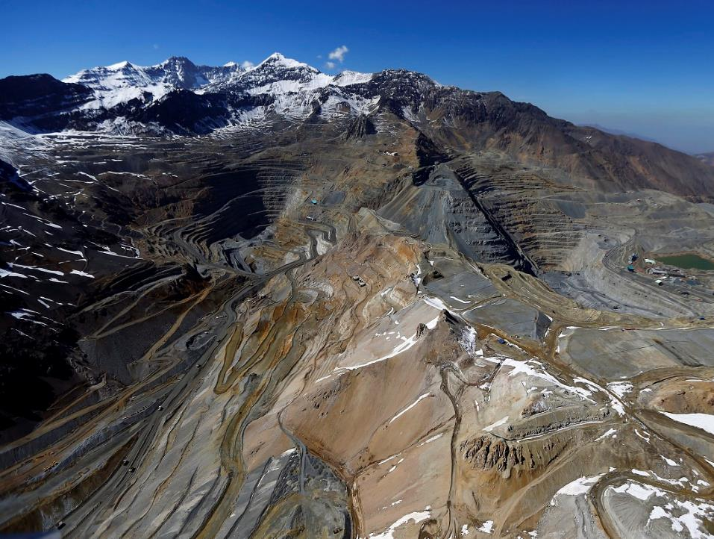



Mineral Deposits and Exploration
Dr Matt Loader

Slide 2
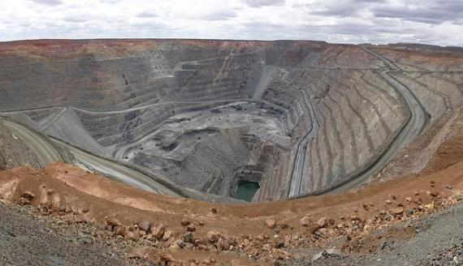

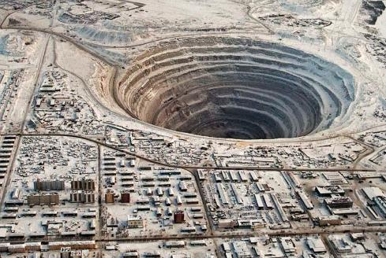
Natural Resources – where do they come from?
Dig them out of the ground….
or grow them
Gold mine – Western Australia

Slide 3
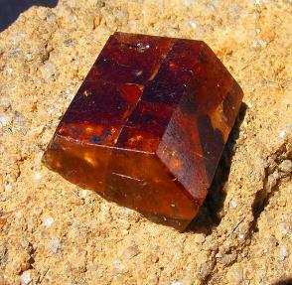
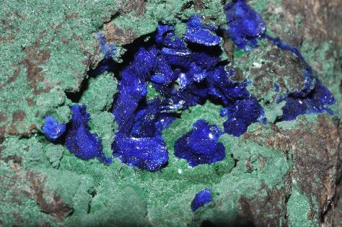
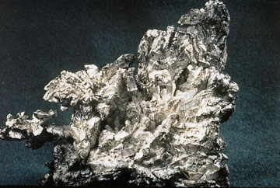
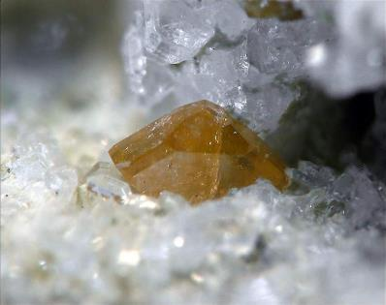
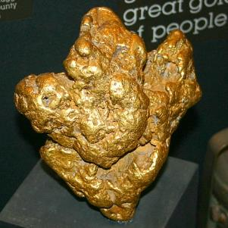
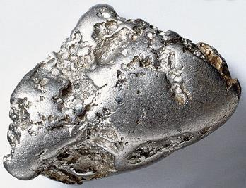
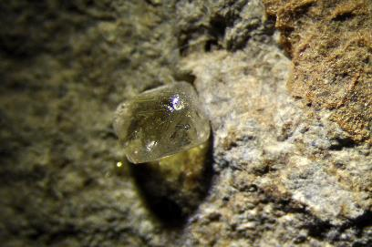
There are lots of types of mineral deposit
Copper
Silver
Rare Earth Elements
Gold
Diamonds
Platinum

Slide 4
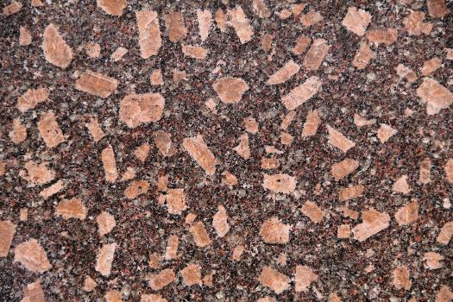
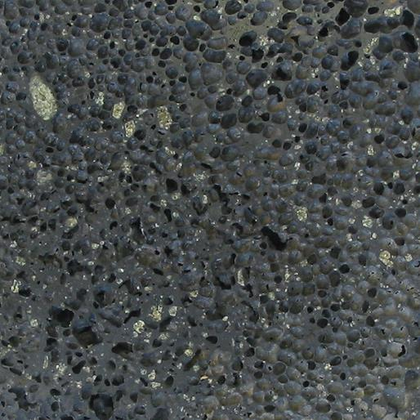
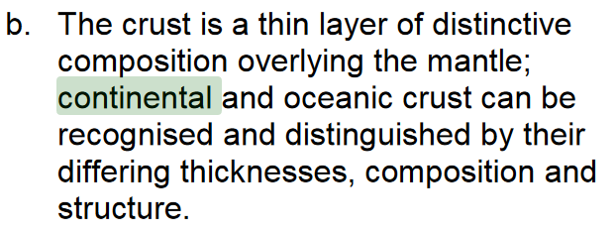
The basic problem
Shap granite (UK)
Basalt (Canary Islands)
The continental crust is felsic (or ‘granitic’)
The oceanic crust is mafic (or basaltic)
^From the A-Level specification

Slide 5


The basic problem
Shap granite (UK)
Basalt (Canary Islands)
Shap granite (UK)
Etna basalt (Italy)
Cu (copper – 19 ppm)
Au (gold – 0.002 ppm)
Ag (silver – 2.1 ppm)
Cu (copper – 74 ppm)
Au (gold – 0.002 ppm)
Ag (silver – trace)
^From the A-Level specification

Slide 6
The basic problem
Shap granite (UK)
Basalt (Canary Islands)
We need some natural process which concentrates valuable elements to levels which are high enough to be economically viable

Slide 7
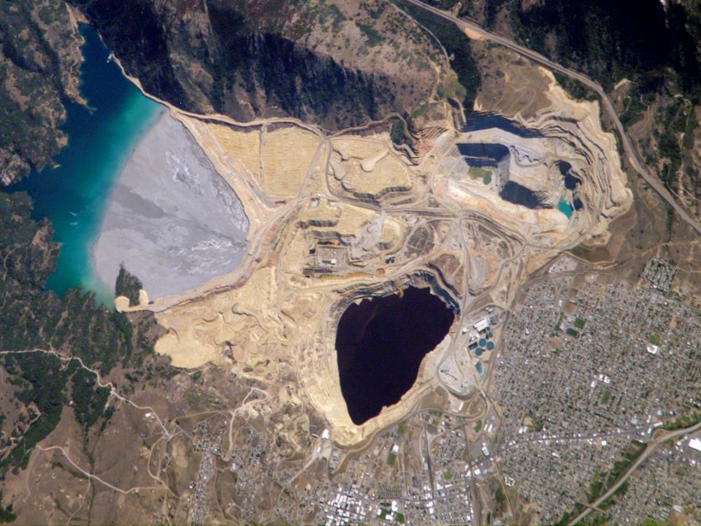
Today, we will focus on a type of copper deposit called a ‘porphyry Cu deposit’
Berkley Pit, Butte, Montana

Slide 8
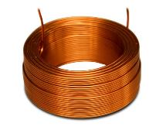

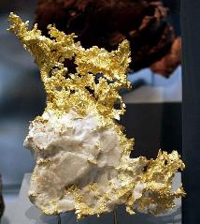
Porphyry Copper Deposits – production statistics
>75% of the world’s copper
50% of the world’s molybdenum
20% of the world’s gold

Slide 9
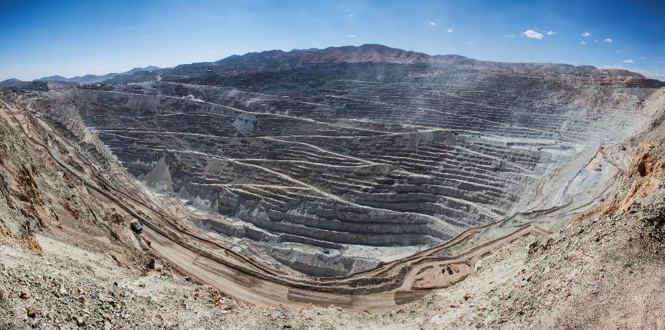
World’s biggest holes in the ground…
Flickr/Codelco/CC BY-NC-ND 2.0
3.5 km
3.5 km
3.5 km
4.5 km
4.5 km
4.5 km
850 m
850 m
850 m
Chuquicamata porphyry mine, Chile

Slide 10

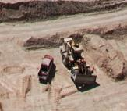
World’s biggest holes in the ground…
Flickr/Codelco/CC BY-NC-ND 2.0
3.5 km
3.5 km
3.5 km
Burj Khalifa 828m
4.5 km
4.5 km
4.5 km
850 m
850 m
850 m
Chuquicamata porphyry mine, Chile
Notes:
Burj Khalifa (828m) for scale.

Slide 11
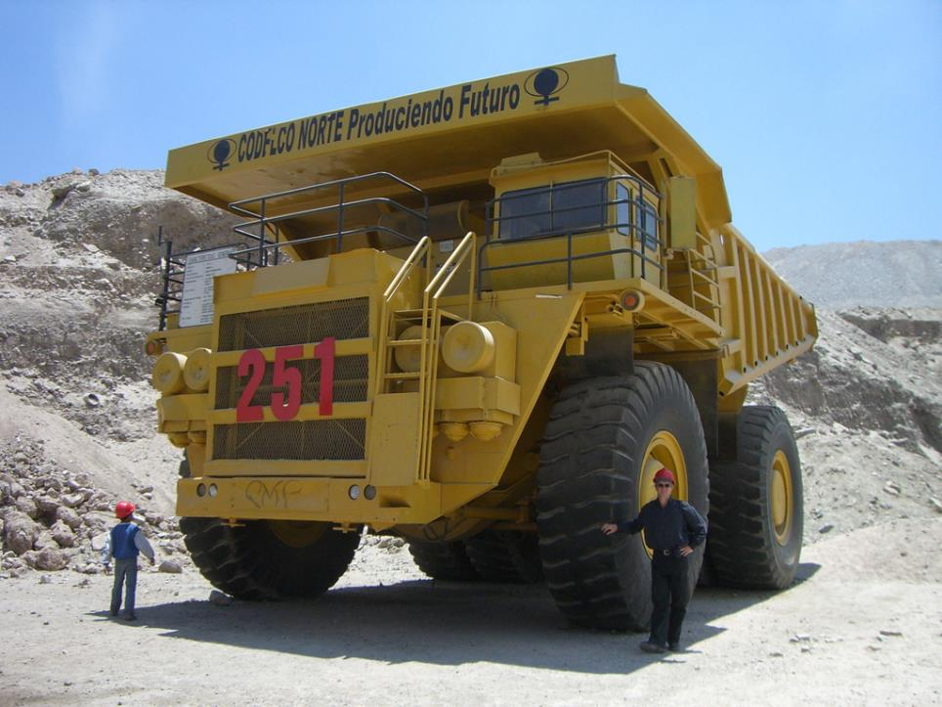
Flickr/CC BY-SA 2.0/Peter Collins
Notes:
Trucks in previous image

Slide 12
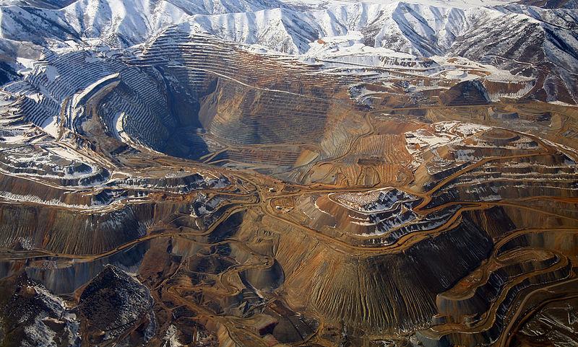
World’s biggest holes in the ground…
Bingham Canyon, Utah, USA
Wikimedia/CC BY 2.0

Slide 13
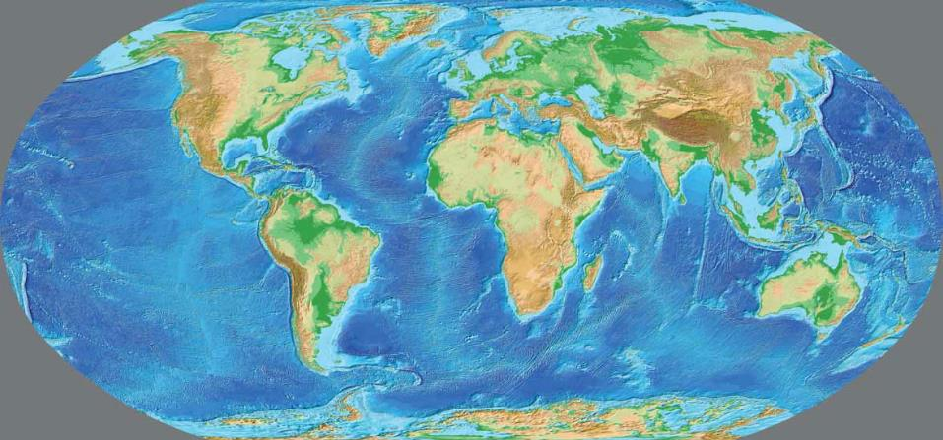
What tectonic environments do porphyry deposits form in?
Subduction (convergent)
Mid Ocean Ridge (divergent)
Porphyry Copper Deposit

Slide 14
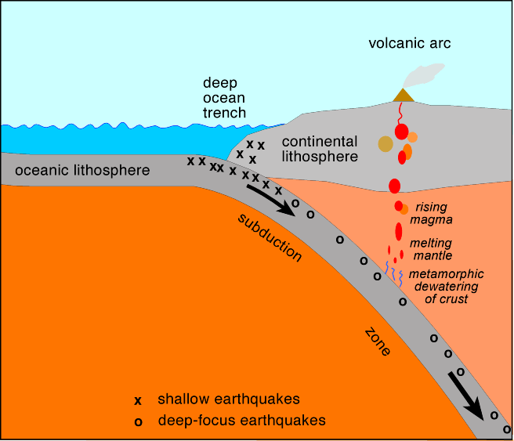
Subduction in more detail…
www.coumbia.edu

Slide 15
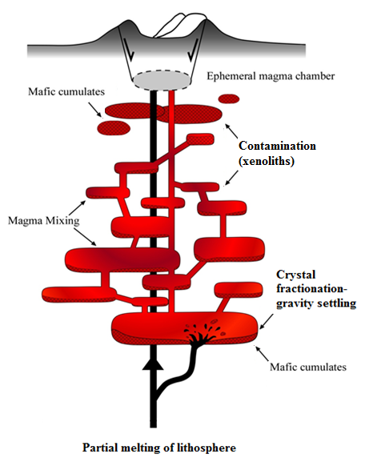
Magma ‘plumbing’ systems are complex, and span the length of the crust
Sometimes, we get magma chambers near the top…
Image: Matt Loader

Slide 16
Subduction zone
volcano
Volcanoes are supplied by large magma chambers
Magma chamber
(5 -15km depth)

Slide 17
Volcanoes are supplied by large magma chambers
If changes in the motion of the subducting plate happen, volcanism can be cut off.
Gas bubbles start to form in trapped magmas

Slide 18
Volcanoes are supplied by large magma chambers
If changes in the motion of the subducting plate happen, volcanism can be cut off.
Gas bubbles start to form in trapped magmas
Copper wants to be in the bubbles over the magma
Cu
Cu
Cu
Cu
Cu
Cu

Slide 19
Volcanoes are supplied by large magma chambers
If changes in the motion of the subducting plate happen, volcanism can be cut off.
Gas bubbles start to form in trapped magmas
Copper wants to be in the bubbles over the magma
Copper-rich fluids rise to the tops of magma chambers, pressure increases
Trapped Cu rich hydrothermal fluid

Slide 20
Volcanoes are supplied by large magma chambers
If changes in the motion of the subducting plate happen, volcanism can be cut off.
Gas bubbles start to form in trapped magmas
Copper wants to be in the bubbles over the magma
Copper-rich fluids rise to the tops of magma chambers, pressure increases
Fluids burst out from the magma into the surrounding rock

Slide 21
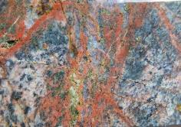
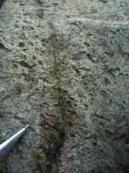
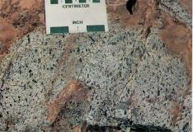
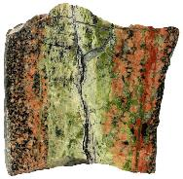
The hot acidic hydrothermal fluid chemically alters the surrounding rock, forming an alteration ‘halo’
copperking.blogspot.com
Mitchell G. Mihalynuk
Hydrothermal alteration
Atlas of Alteration: Thompson & Thompson
Sandatlas.org

Slide 22
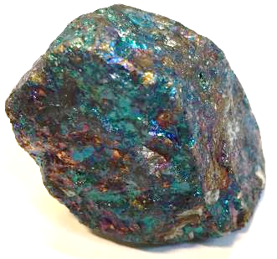
The hot acidic hydrothermal fluid chemically alters the surrounding rock, forming an alteration ‘halo’
Copper minerals also form, usually making an ‘orebody’ with in an upside-down cup shape

Slide 23
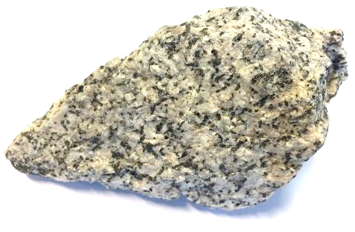
Over millions of years, the magma chamber cools to form a granite ‘pluton’
Hydrothermally
altered rock
Copper minerals

Slide 24
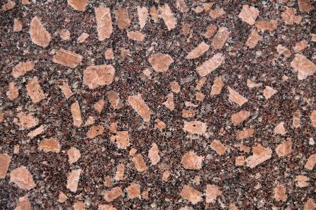
Over millions of years, the magma chamber cools to form a granite ‘pluton’
The feeder intrusion cools to form a porphyritic texture –larger crystals (phenocrysts) are embedded in a fine-grained groundmass (that’s why we call these porphyry deposits)
Hydrothermally
altered rock
Copper minerals

Slide 25
Over millions of years, the magma chamber cools to form a granite ‘pluton’
The feeder intrusion cools to form a porphyritic texture –larger crystals (phenocrysts) are embedded in a fine-grained groundmass (that’s why we call these porphyry deposits)
Over time, erosion will expose the deposit…
Hydrothermally
altered rock
Copper minerals

Slide 26
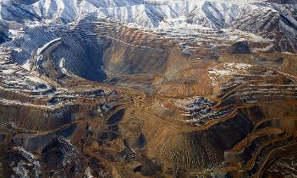
Over millions of years, the magma chamber cools to form a granite ‘pluton’
The feeder intrusion cools to form a porphyritic texture –larger crystals (phenocrysts) are embedded in a fine-grained groundmass (that’s why we call these porphyry deposits)
Over time, erosion will expose the deposit… ready for someone to dig out of the ground!
Hydrothermally
altered rock

Slide 27
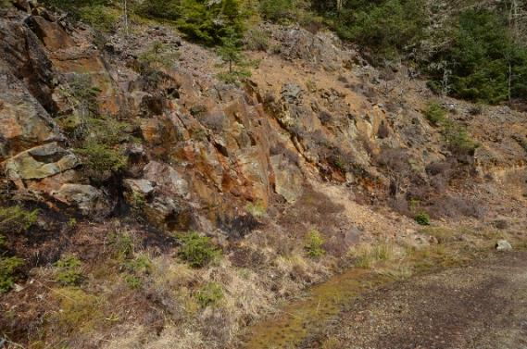
How do we find porphyry deposits?
Lots of fieldwork
Mapping
Sampling
Geochemistry
Geophysics
Coed-y-Brenin Porphyry Cu-Mo Deposit
© Copyright Ashley Dace/Geograph

Slide 28
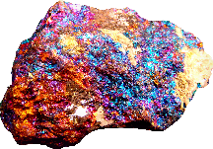
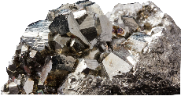

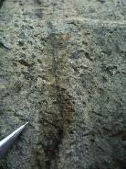
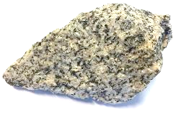
Porphyry alteration zoning
Copper ore zone
Pyrite zone
Atlas of Alteration: Thompson & Thompson
Clay alteration
Actinolite alteration
Sandatlas.org
copperking.blogspot.com
Potassic alteration
Intrusion
Epidote alteration
Fresh granite
Mitchell G. Mihalynuk
Fresh granite
Chlorite alteration
Notes:
copperking.blogspot.com

Slide 29
Porphyry alteration zoning
Pyrite zone
Copper ore zone
Clay alteration
Erosion level
Potassic alteration
Actinolite alteration
Epidote alteration
Intrusion
Chlorite alteration
Fresh granite
Bullseye!
Geological cross section
Geological map

Slide 30
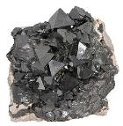

Magnetic survey
Magnetite
Strong magnetic response
+
-
Weak magnetic response
Igneous magnetite in a granite
(no ore deposit)
Hydrothermal magnetite
in potassic altered zone of an ore deposit

Slide 31
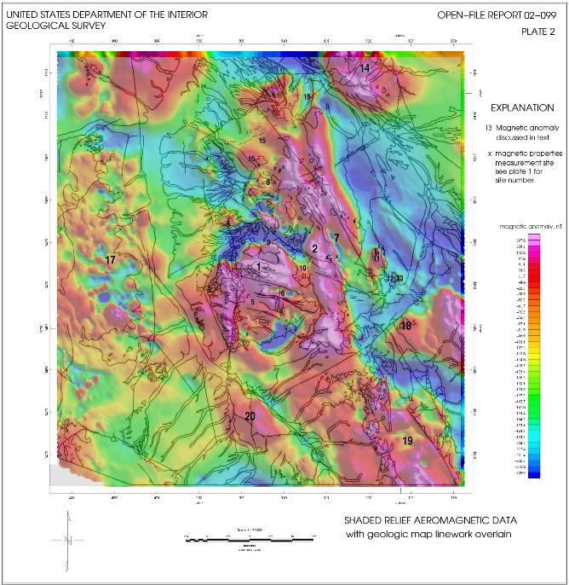
USGS

Slide 32
Stream sediment minerals
Pyrite zone
in ore body
surface
Pyrite in sediments
River sediments

Slide 33
Stream sediment minerals
No ore body – no pyrite in higher ground
surface
NO Pyrite in sediments

Slide 34
Erosion level
TOO SHALLOW
Erosion level
Intrusion
Fresh granite

Slide 35
Erosion level
PERFECT!
Clay alteration
Erosion level
Intrusion
Fresh granite

Slide 36
Erosion level
TOO DEEP
Erosion level
Clay alteration
Intrusion
Fresh granite

Slide 37
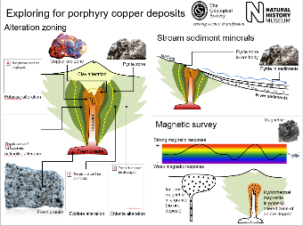
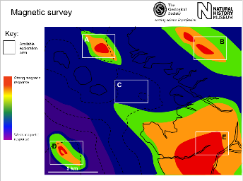
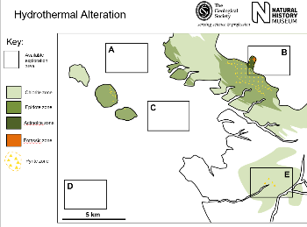
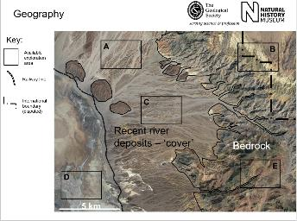
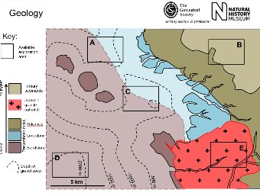
Now it’s your turn!

