Slide 1
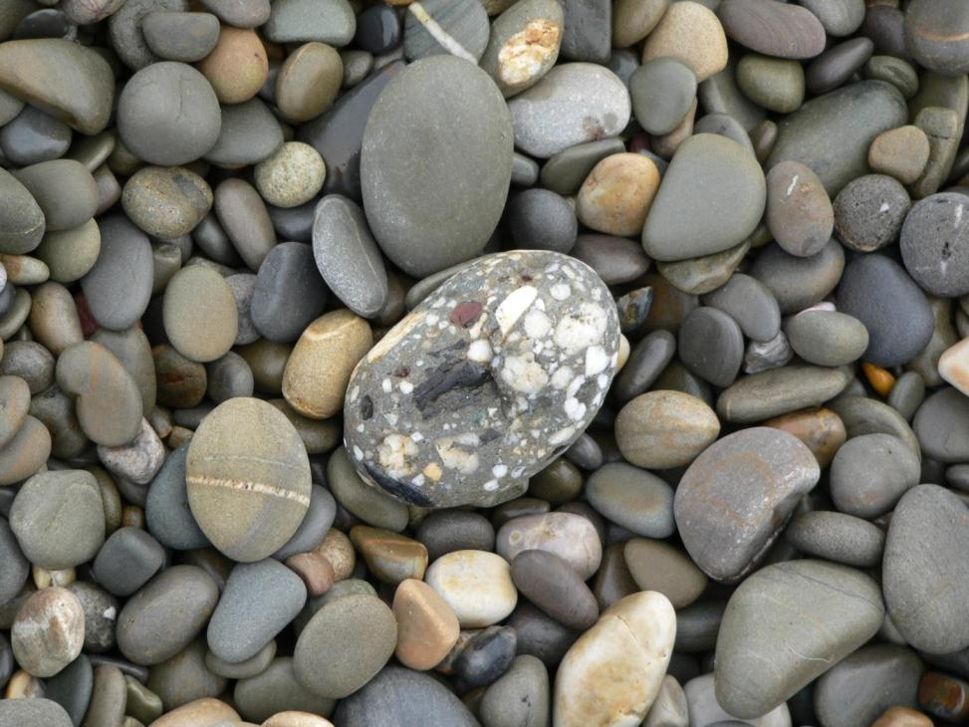
Particle size, shape and sorting:
what grains can tell us
Maggie Williams

Slide 2
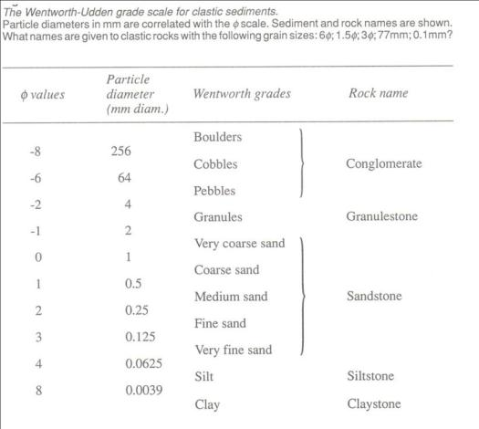
Most sediments contain particles that have a range of sizes,
so the mean or average grain size is used in description.
Mean grain size of loose sediments is measured by size analysis using sieves

Slide 3
Grain size
>2mm Coarse grain size (Granules<pebble<cobbles<boulders)
0.06 to 2mm Medium grain size Sand: very coarse-coarse-medium-fine-very fine)
<0.06mm Fine grain size (Clay<silt) Difficult to see
Remember that for sediment sizes > fine sand, the coarser the material
the greater the flow velocity needed to erode, transport & deposit the grains

Slide 4
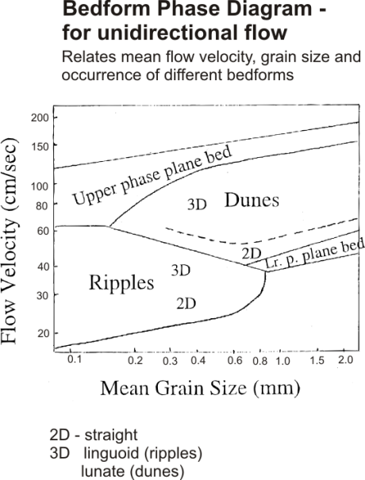

Slide 5
Are the grains the same size of different?
What does this tell you?
If grains are the same size this tells you that the sediment was sorted out
during longer transportation (perhaps moved a long distance by a river or for a
long time by the sea.
If grains are of different sizes the sediment was probably deposited close to its
source or deposited quickly (e.g. by a flood or from meltwater).

Slide 6

Depositional environments

Slide 7
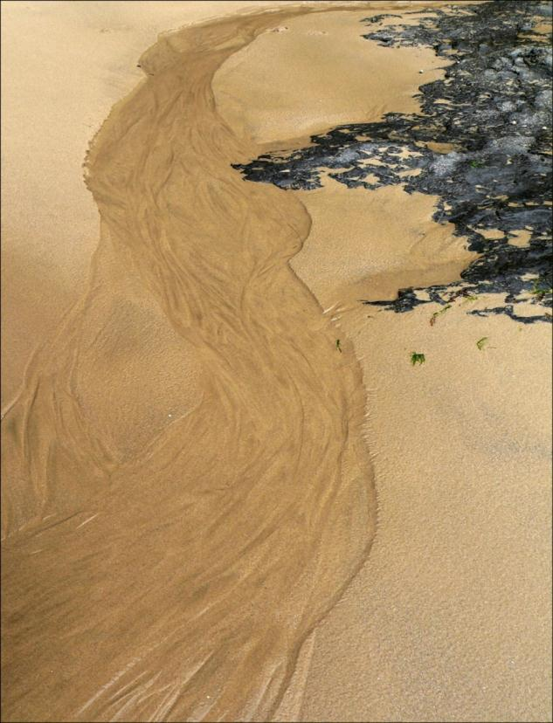
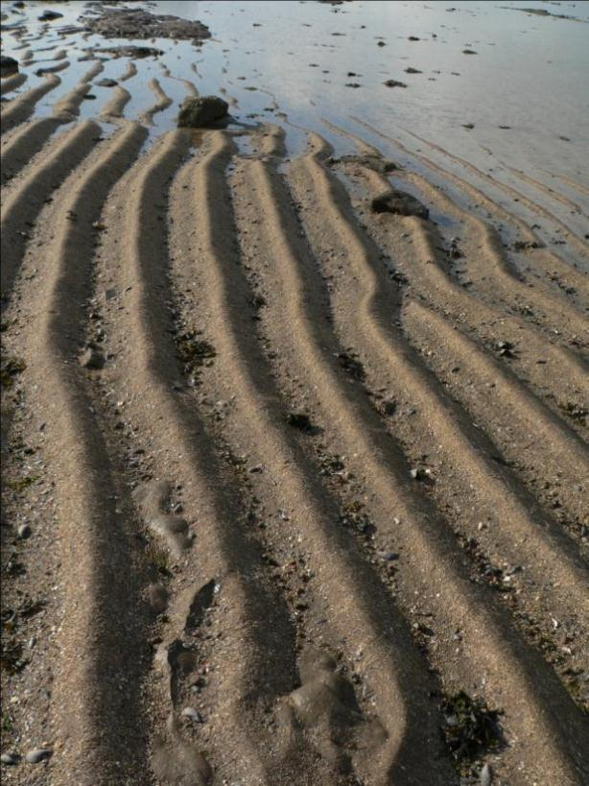
Environment 1

Slide 8
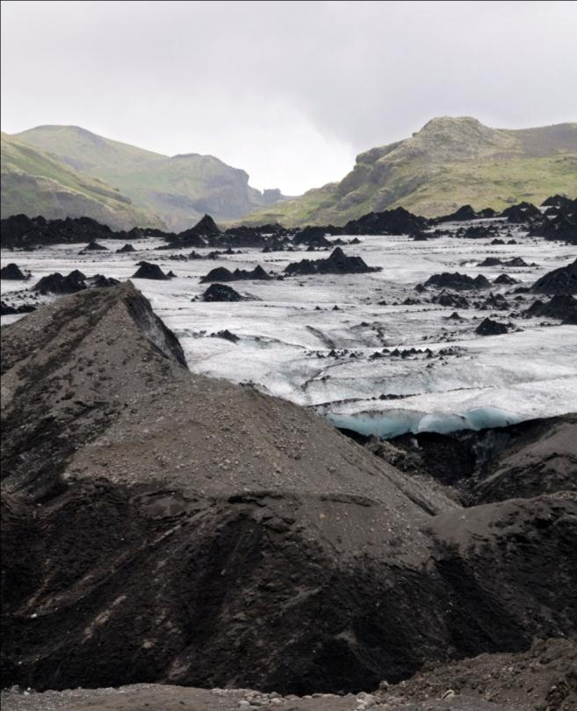
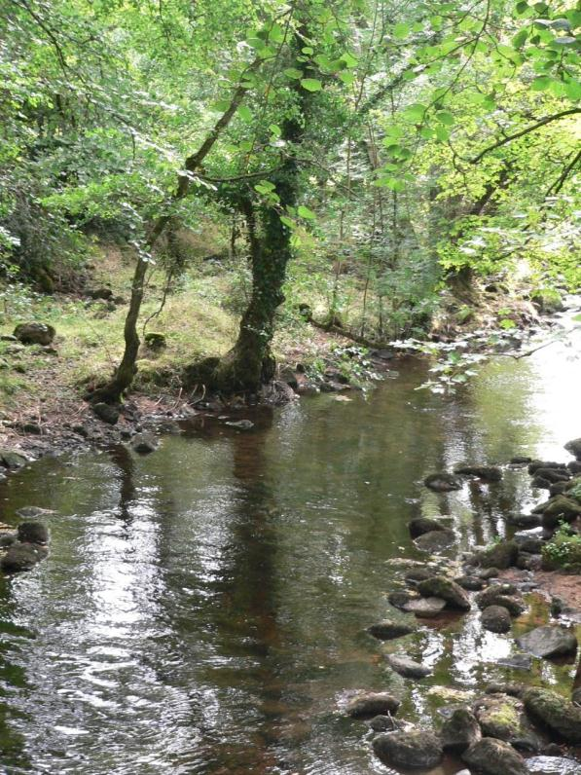
Environment 2
Environment 3

Slide 9
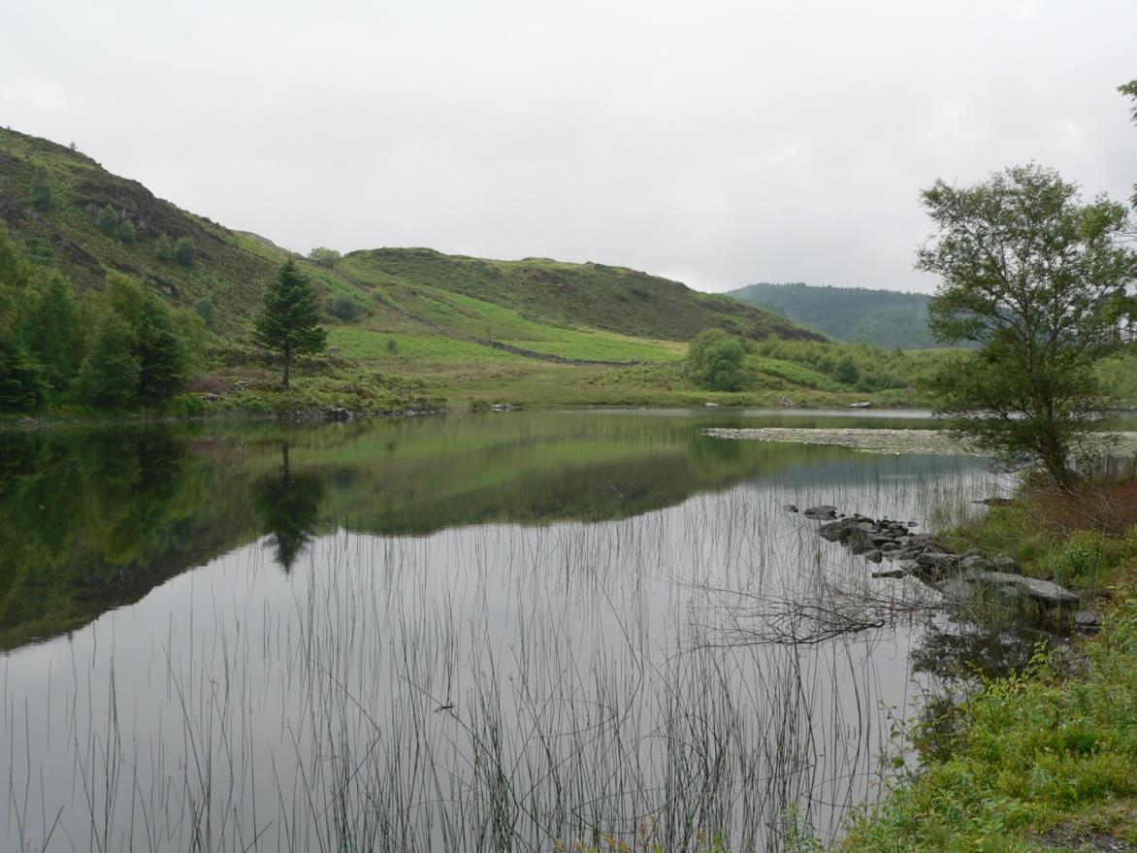
Environment 4

Slide 10
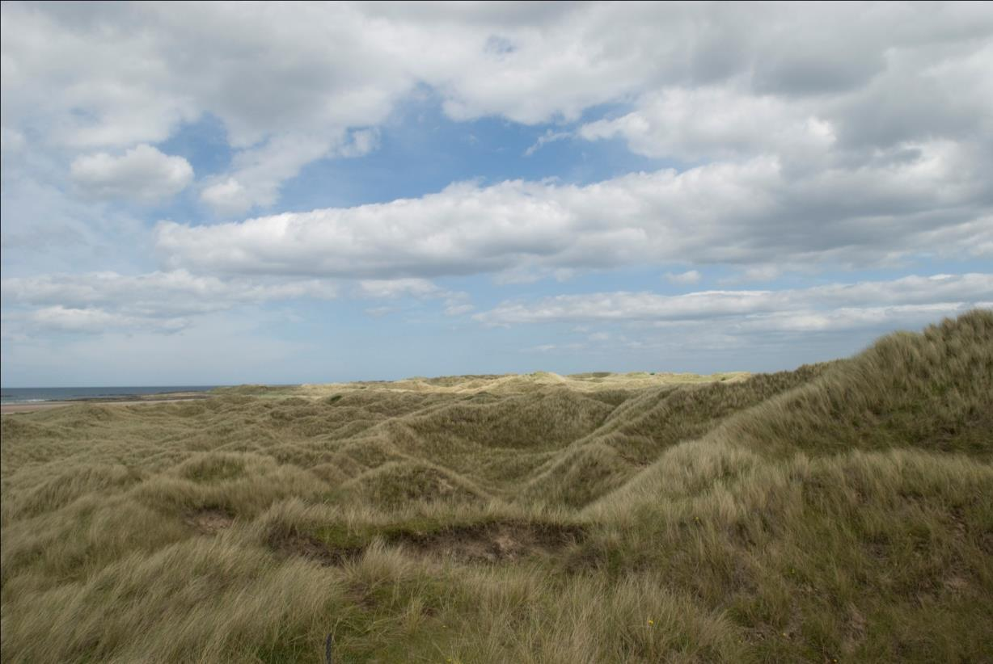
Environment 5

Slide 11
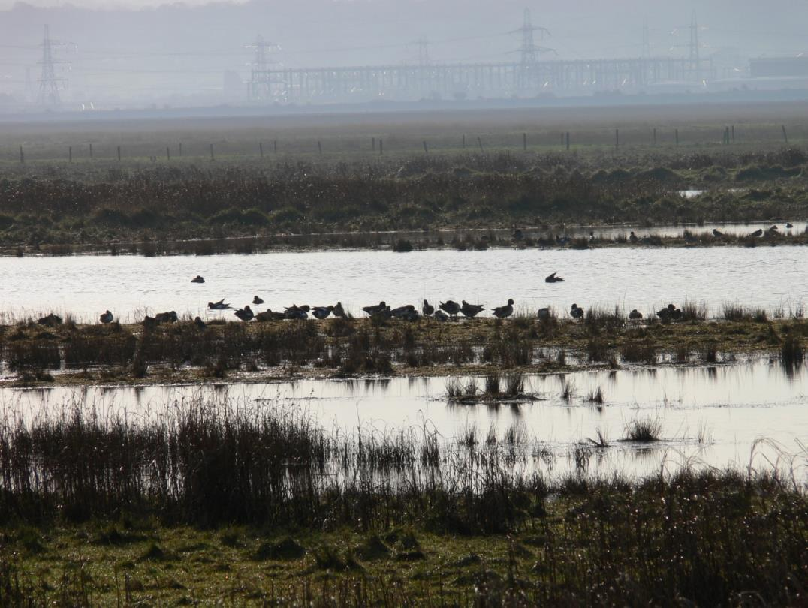
Environment 6

Slide 12
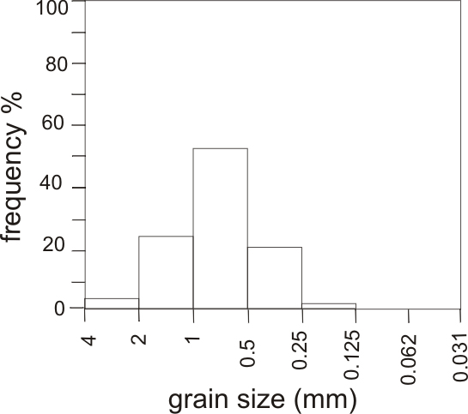
Sediment size frequency plots from different depositional environments
When loose sediment collected from a sedimentary environment is washed and then sieved it is possible to measure the grain sizes in the sediment accurately.
The grain size distribution may then be plotted as a histogram or as a cumulative frequency curve.
Sediments from different depositional environments give different sediment size frequency plots.
This shows the grain size distribution for a river sand.
This sand is described as fairly well sorted.

Slide 13
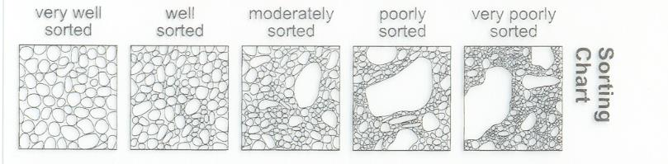
Grain sorting
What is sorting?
Very well-sorted sediments - grains all the same size
Very poorly-sorted sediments - grains with a wide range of sizes
What does sorting tell you?
Generally, sediment sorting improves along the sediment transport path.
Poorly sorted sediments were usually deposited quickly (e.g. in storm beds
or from flows/mudflows. Better sorted sediments may have been reworked by
wind or water. (e.g. Sand deposits on beaches, in shallow seas or in deserts)

Slide 14
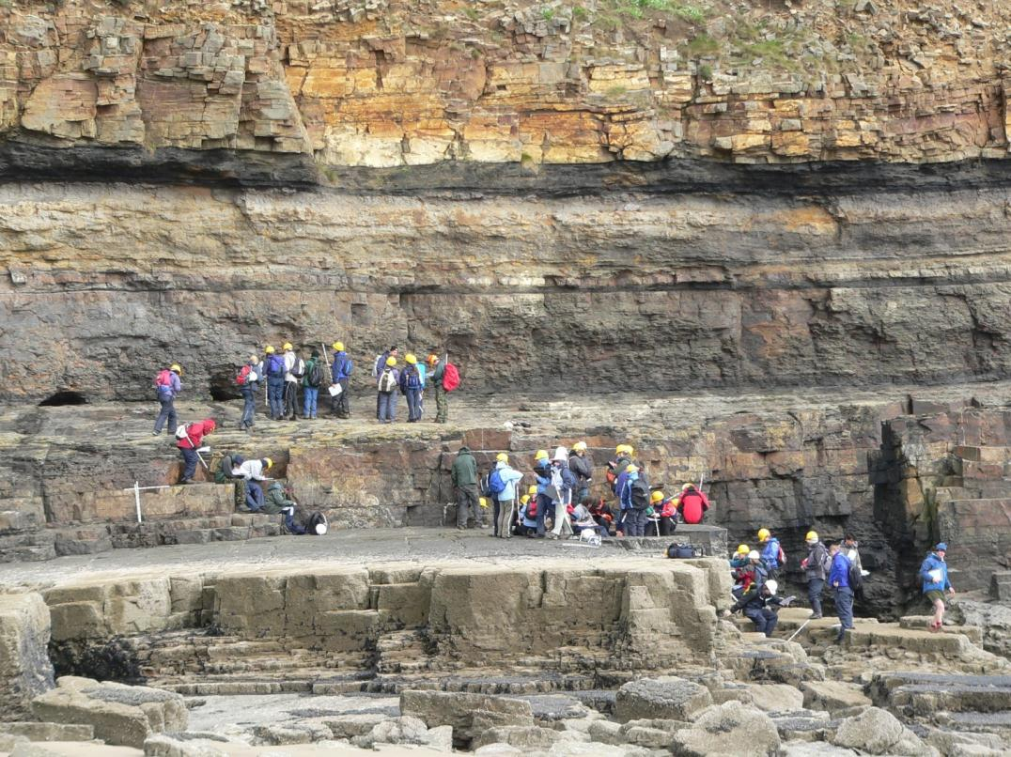
Studying sedimentary rocks

Slide 15
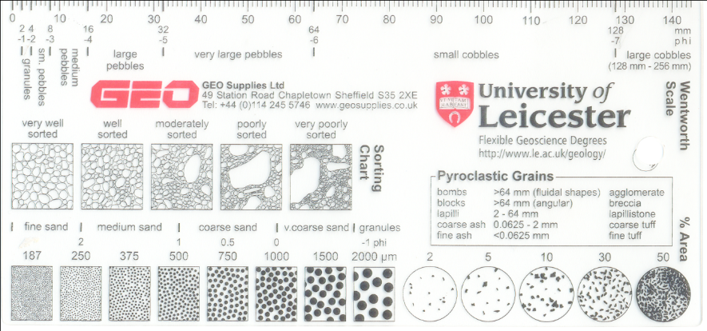
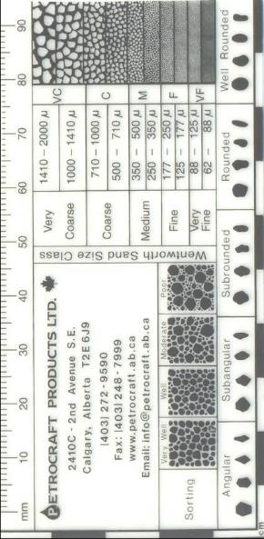
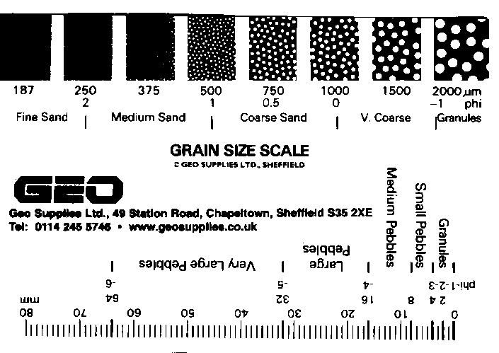
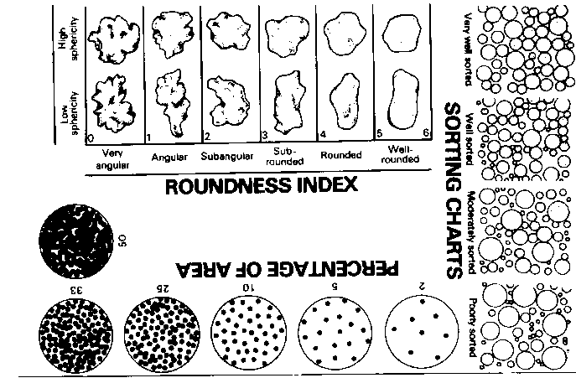
Mean grain size and sorting - more difficult to analyse in consolidated sedimentary rocks

Slide 16
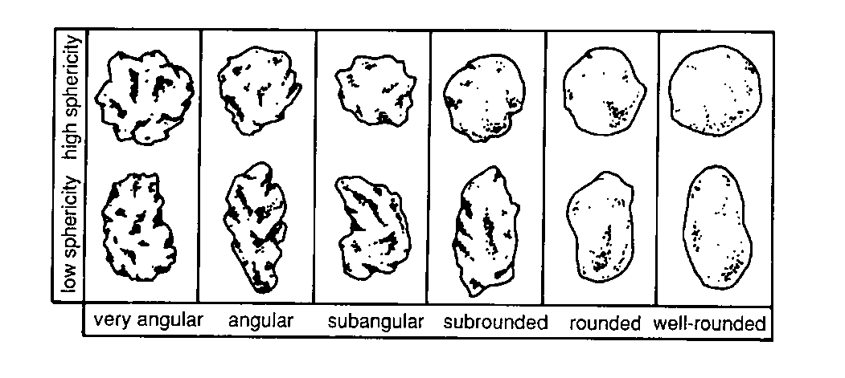
Grain shape
What does high or low sphericity tell you?
Not much! Sphericity of grains mainly depends on the physical properties of
the source material. (Sphericity is little changed by transport)
What does the degree of rounding tell you?
Generally – the more rounded the grains are the more they have been moved
around (i.e. the longer the length of time or distance they have moved).
Angular grains cannot have travelled far.

Slide 17
1. For each of the following four rocks:
describe the grain size and sorting of the grains,
name the rock.

Slide 18
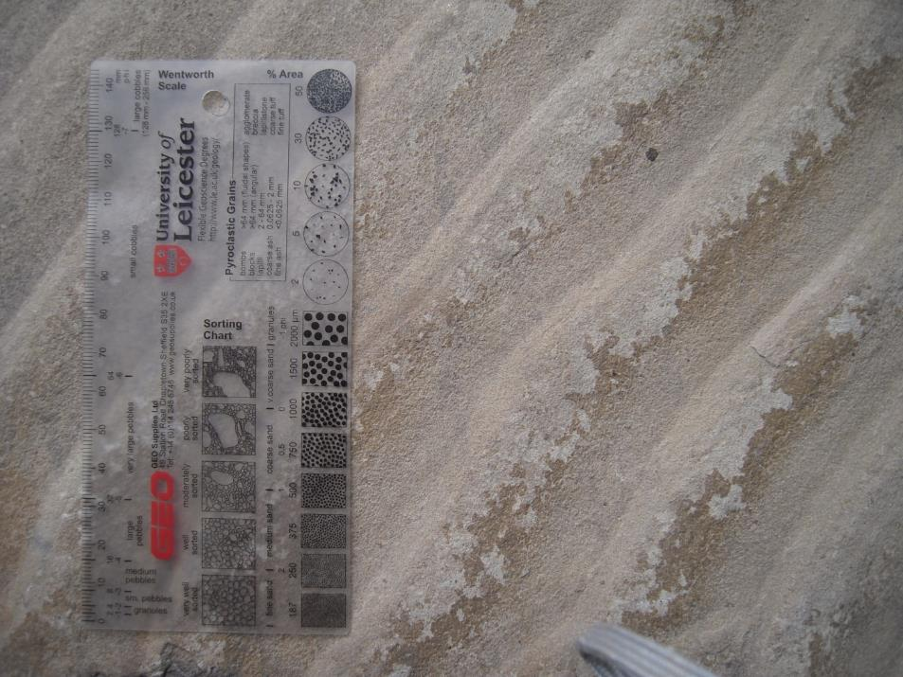
Rock A

Slide 19
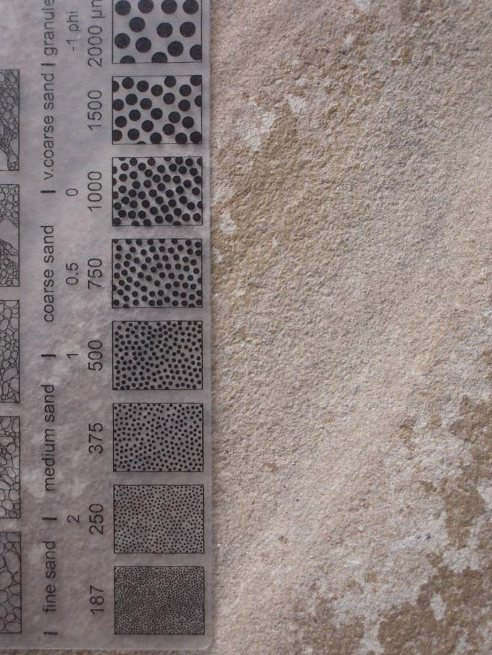
Detail of rock A

Slide 20
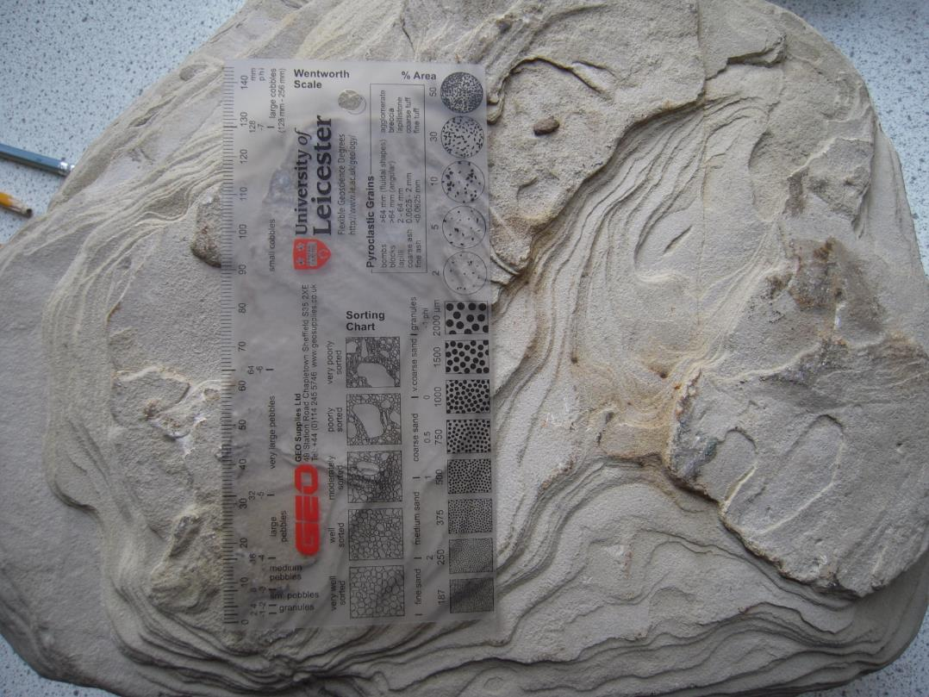
Rock B

Slide 21
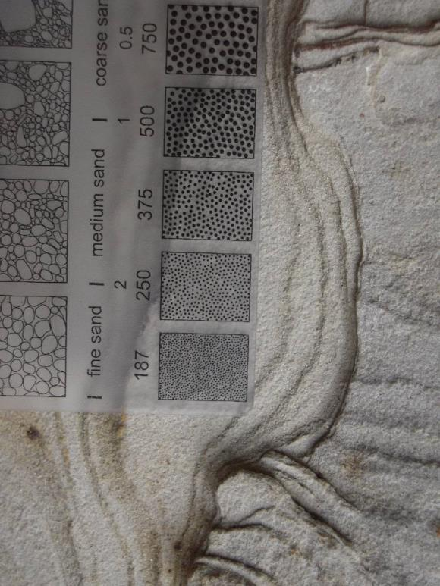
Detail of rock B

Slide 22
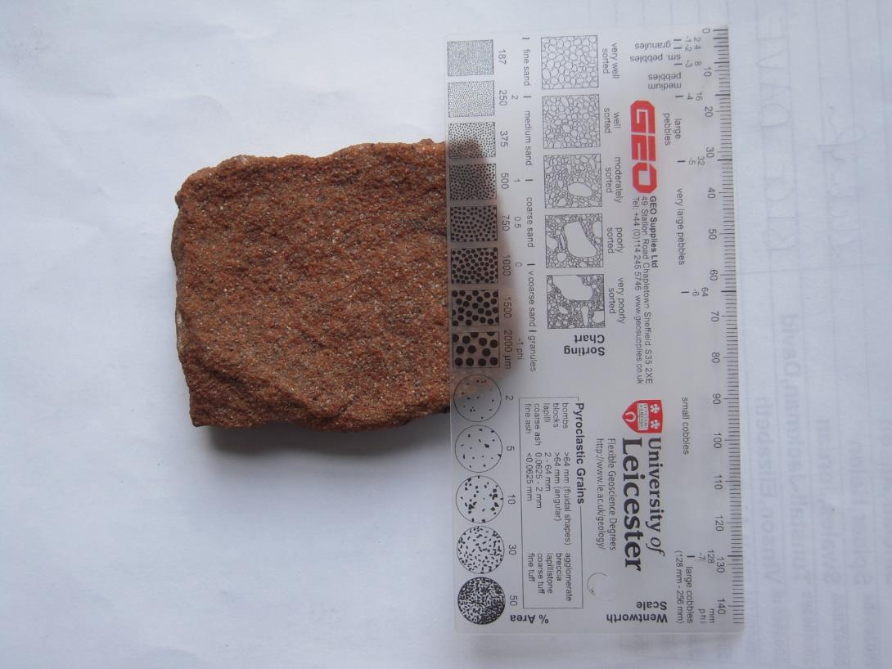
Rock C

Slide 23
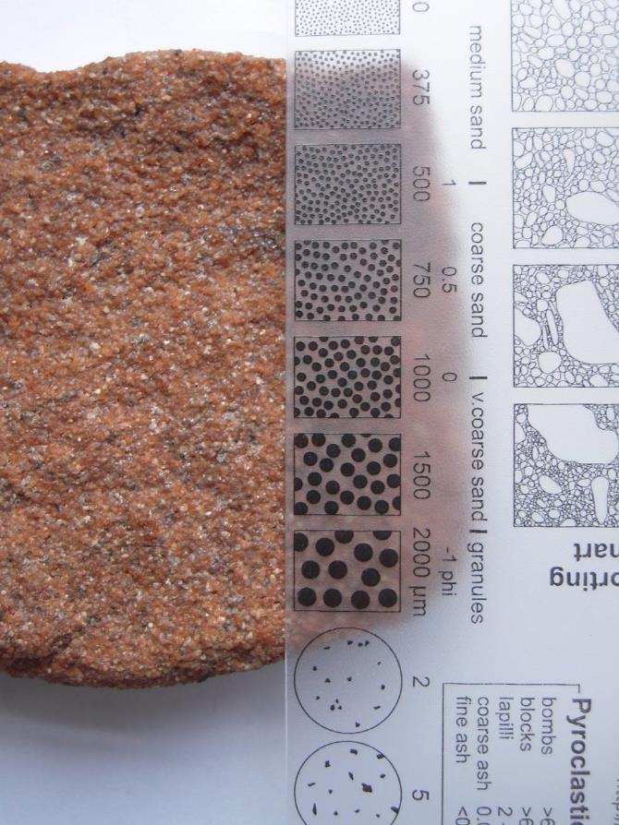
Detail of rock C

Slide 24
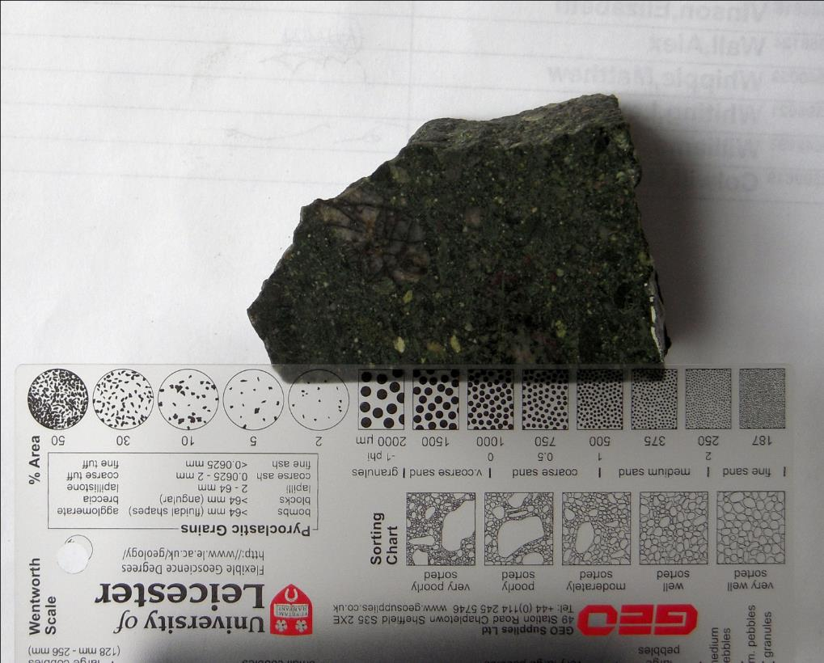
Rock D

Slide 25
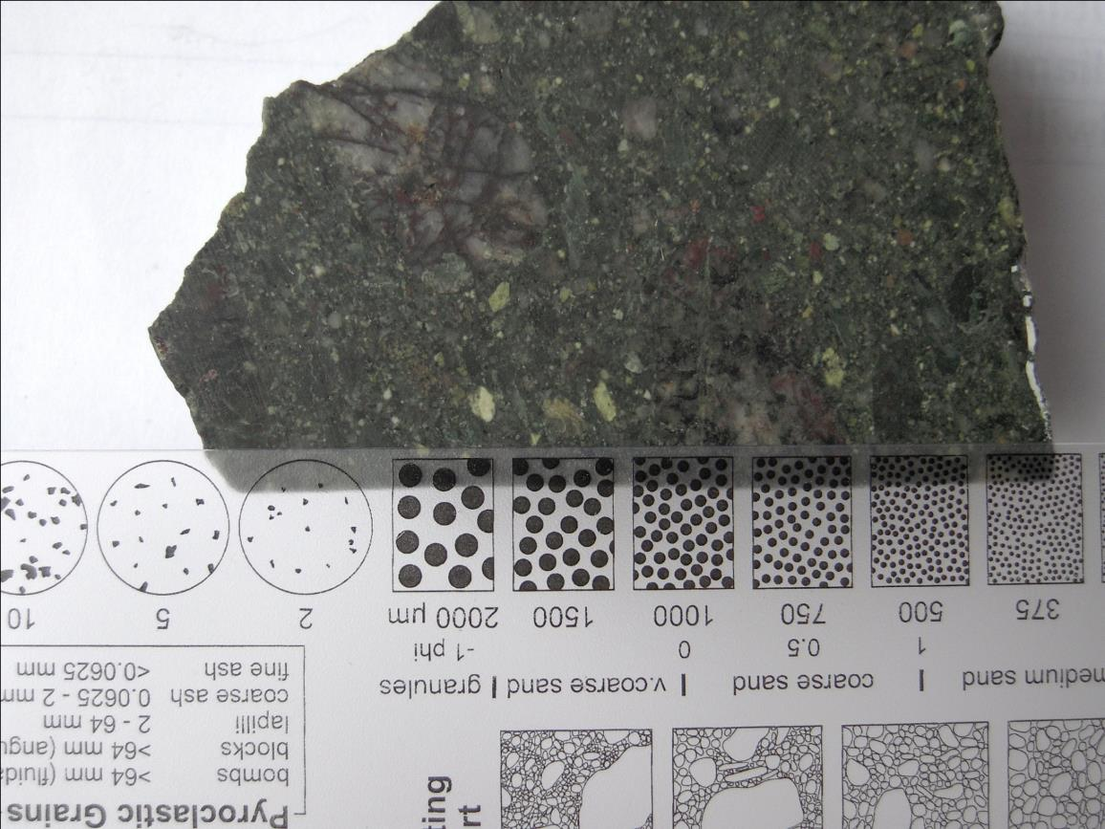
Detail of rock D

Slide 26
2. For each of the following sediments describe the :
grain size,
grain sorting,
rounding of the grains.

Slide 27
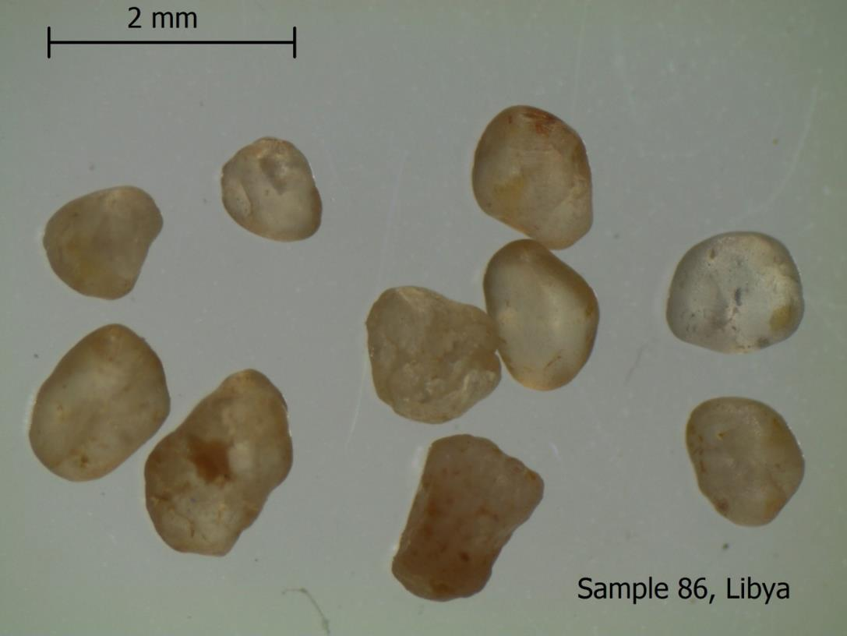

Slide 28
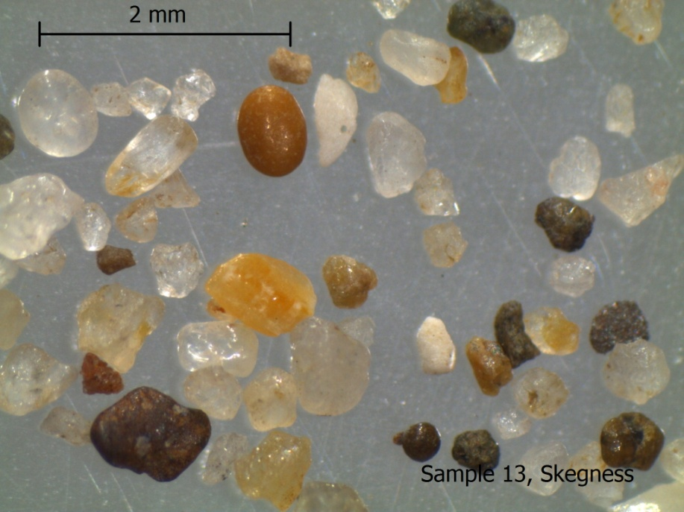

Slide 29
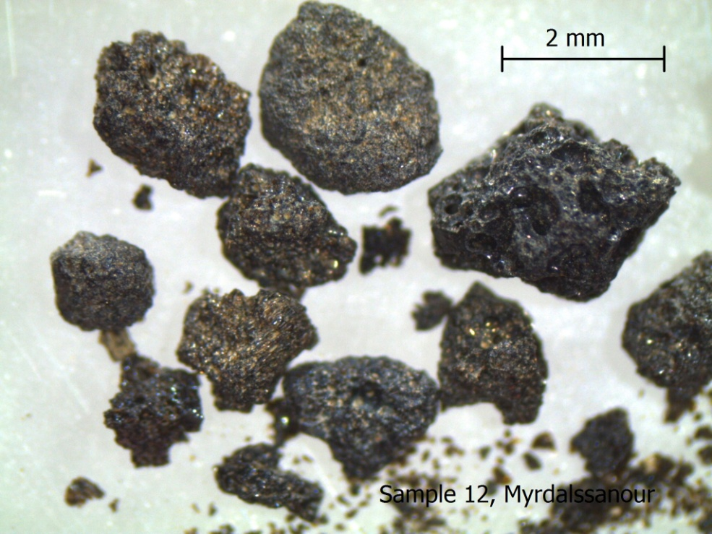

Slide 30
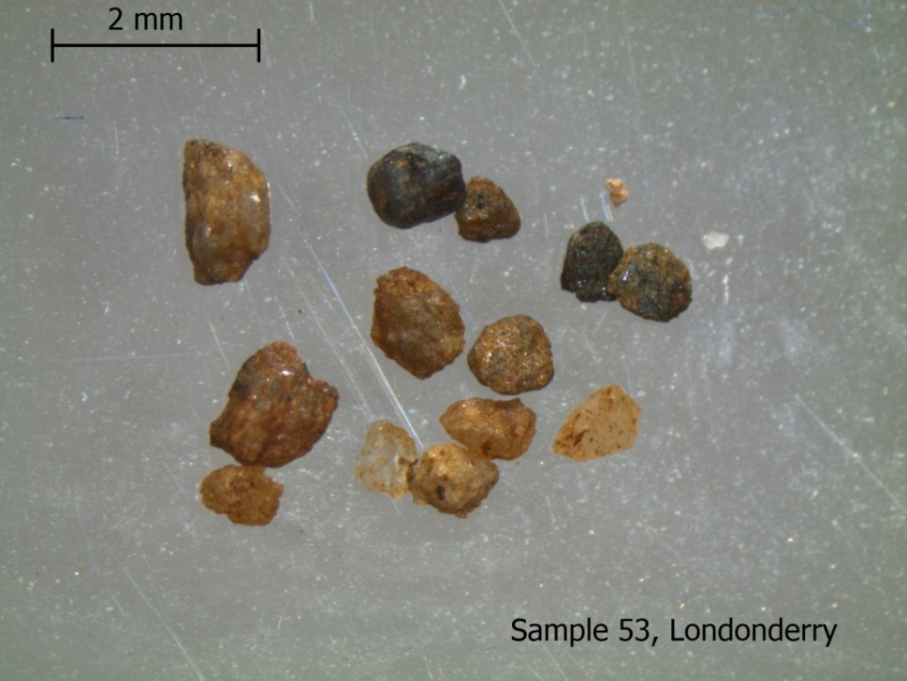

Slide 31
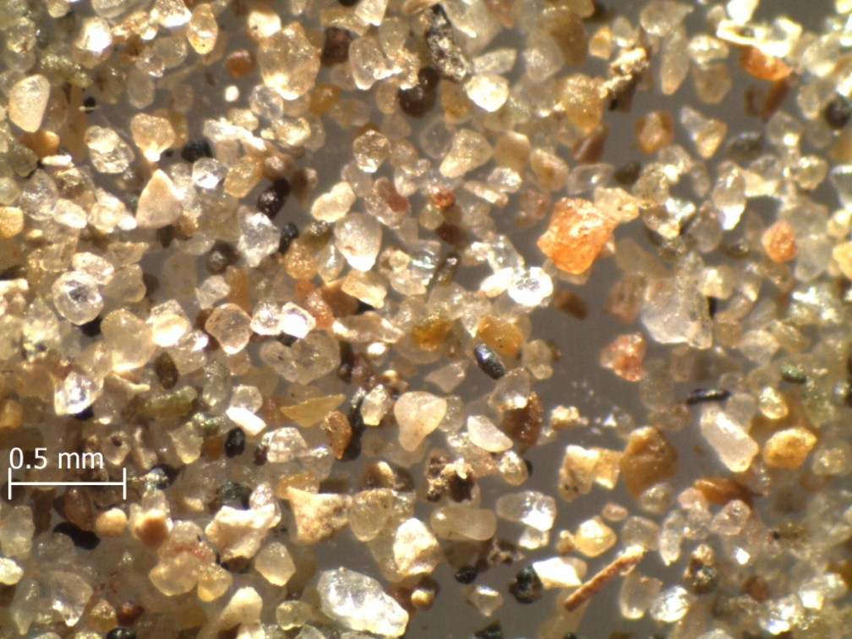
Sample 2, Towy

Slide 32
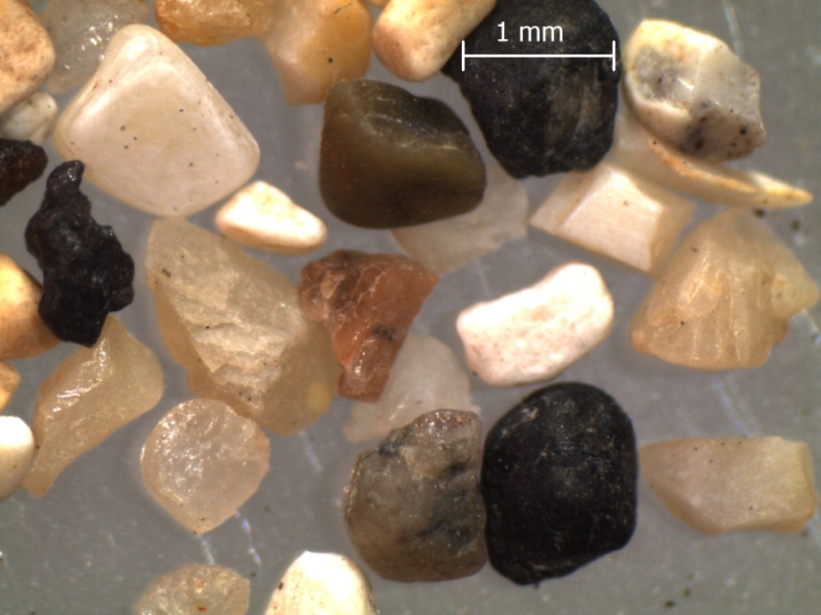
Sample 10, Flamborough Head

Slide 33
3. Which of the following sediment samples contains:
only quartz grains,
mostly rock fragments (lithic grains)
mostly skeletal remains?

Slide 34
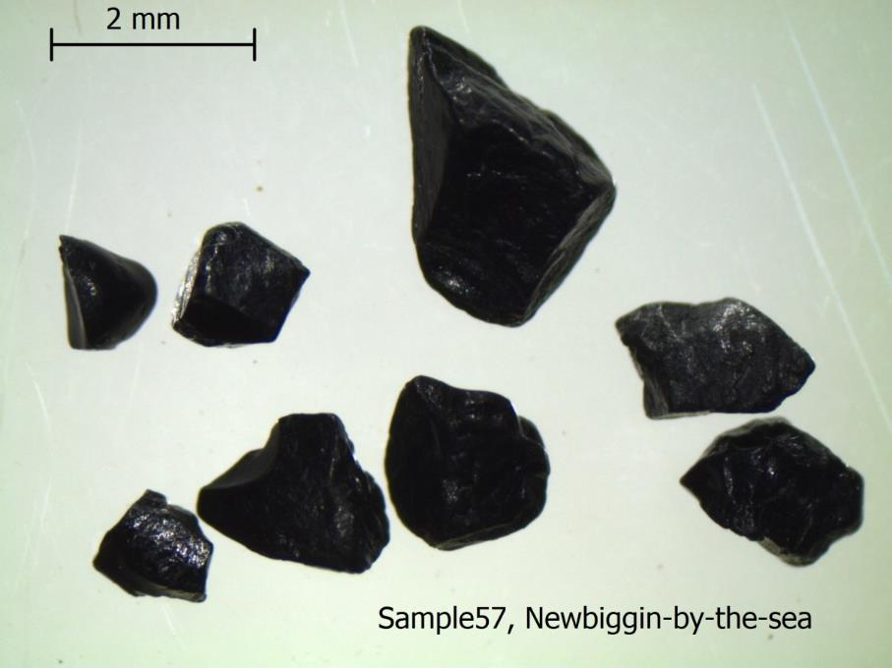

Slide 35
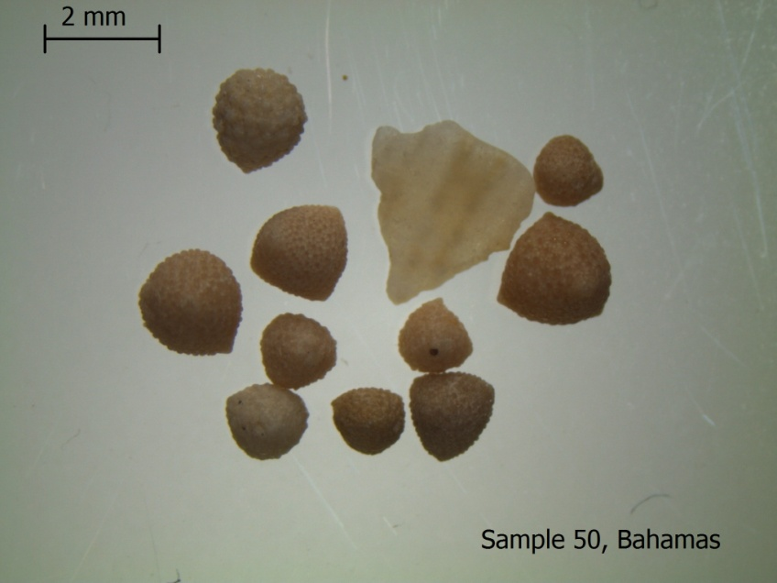

Slide 37
4. For the following four slides answer the question given on each slide.

Slide 38
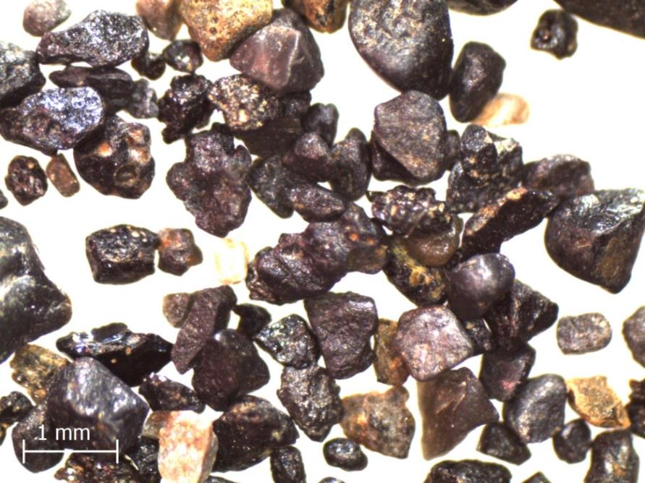
Sample 1
This sediment was collected from the beach at Vik, Island.
What evidence does it show that has been reworked by water?

Slide 39
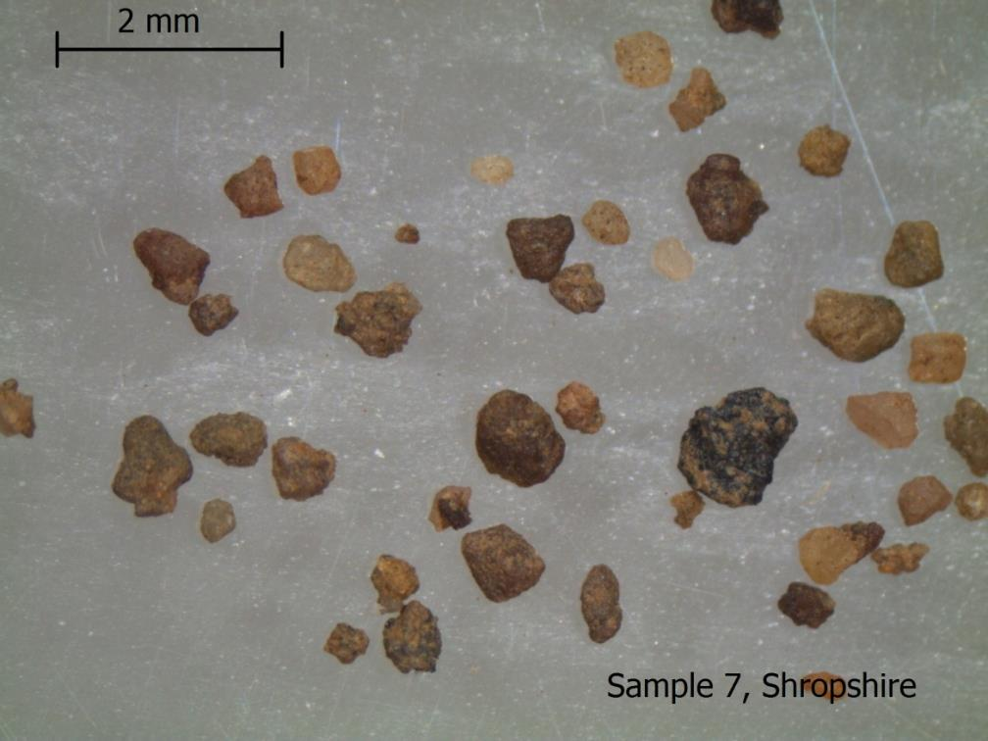
This sediment was collected on the banks of the River Severn in Shropshire.
What evidence does it show that it was not transported a long distance?

Slide 40
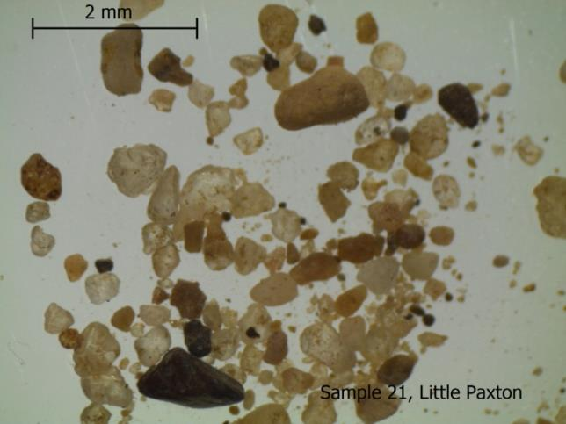
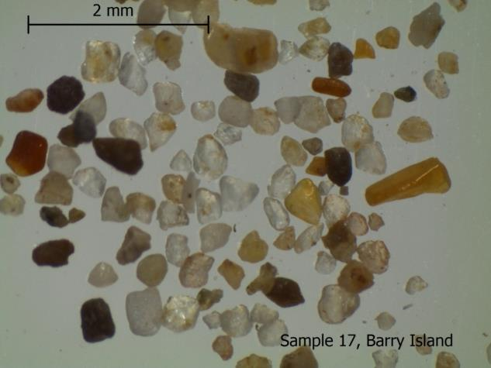
Which of these two sediment samples
shows evidence that it was probably
deposited as a glacial outwash deposit?
Give reasons for your answer.

Slide 41
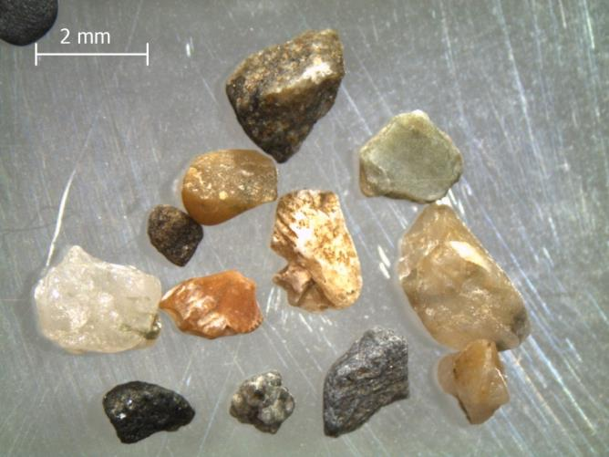
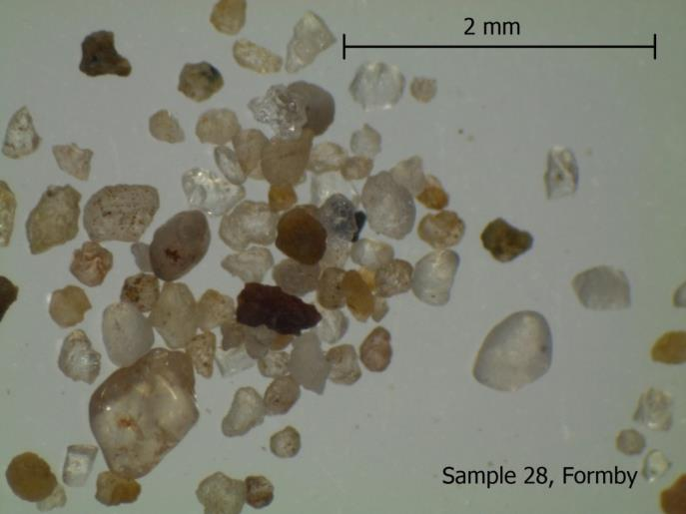
Which of these two sediment
samples was most likely to have been
deposited as a wind-blown beach sand?
Give a reason for your answer.
Sample 7, Broadhaven

